Slide 1
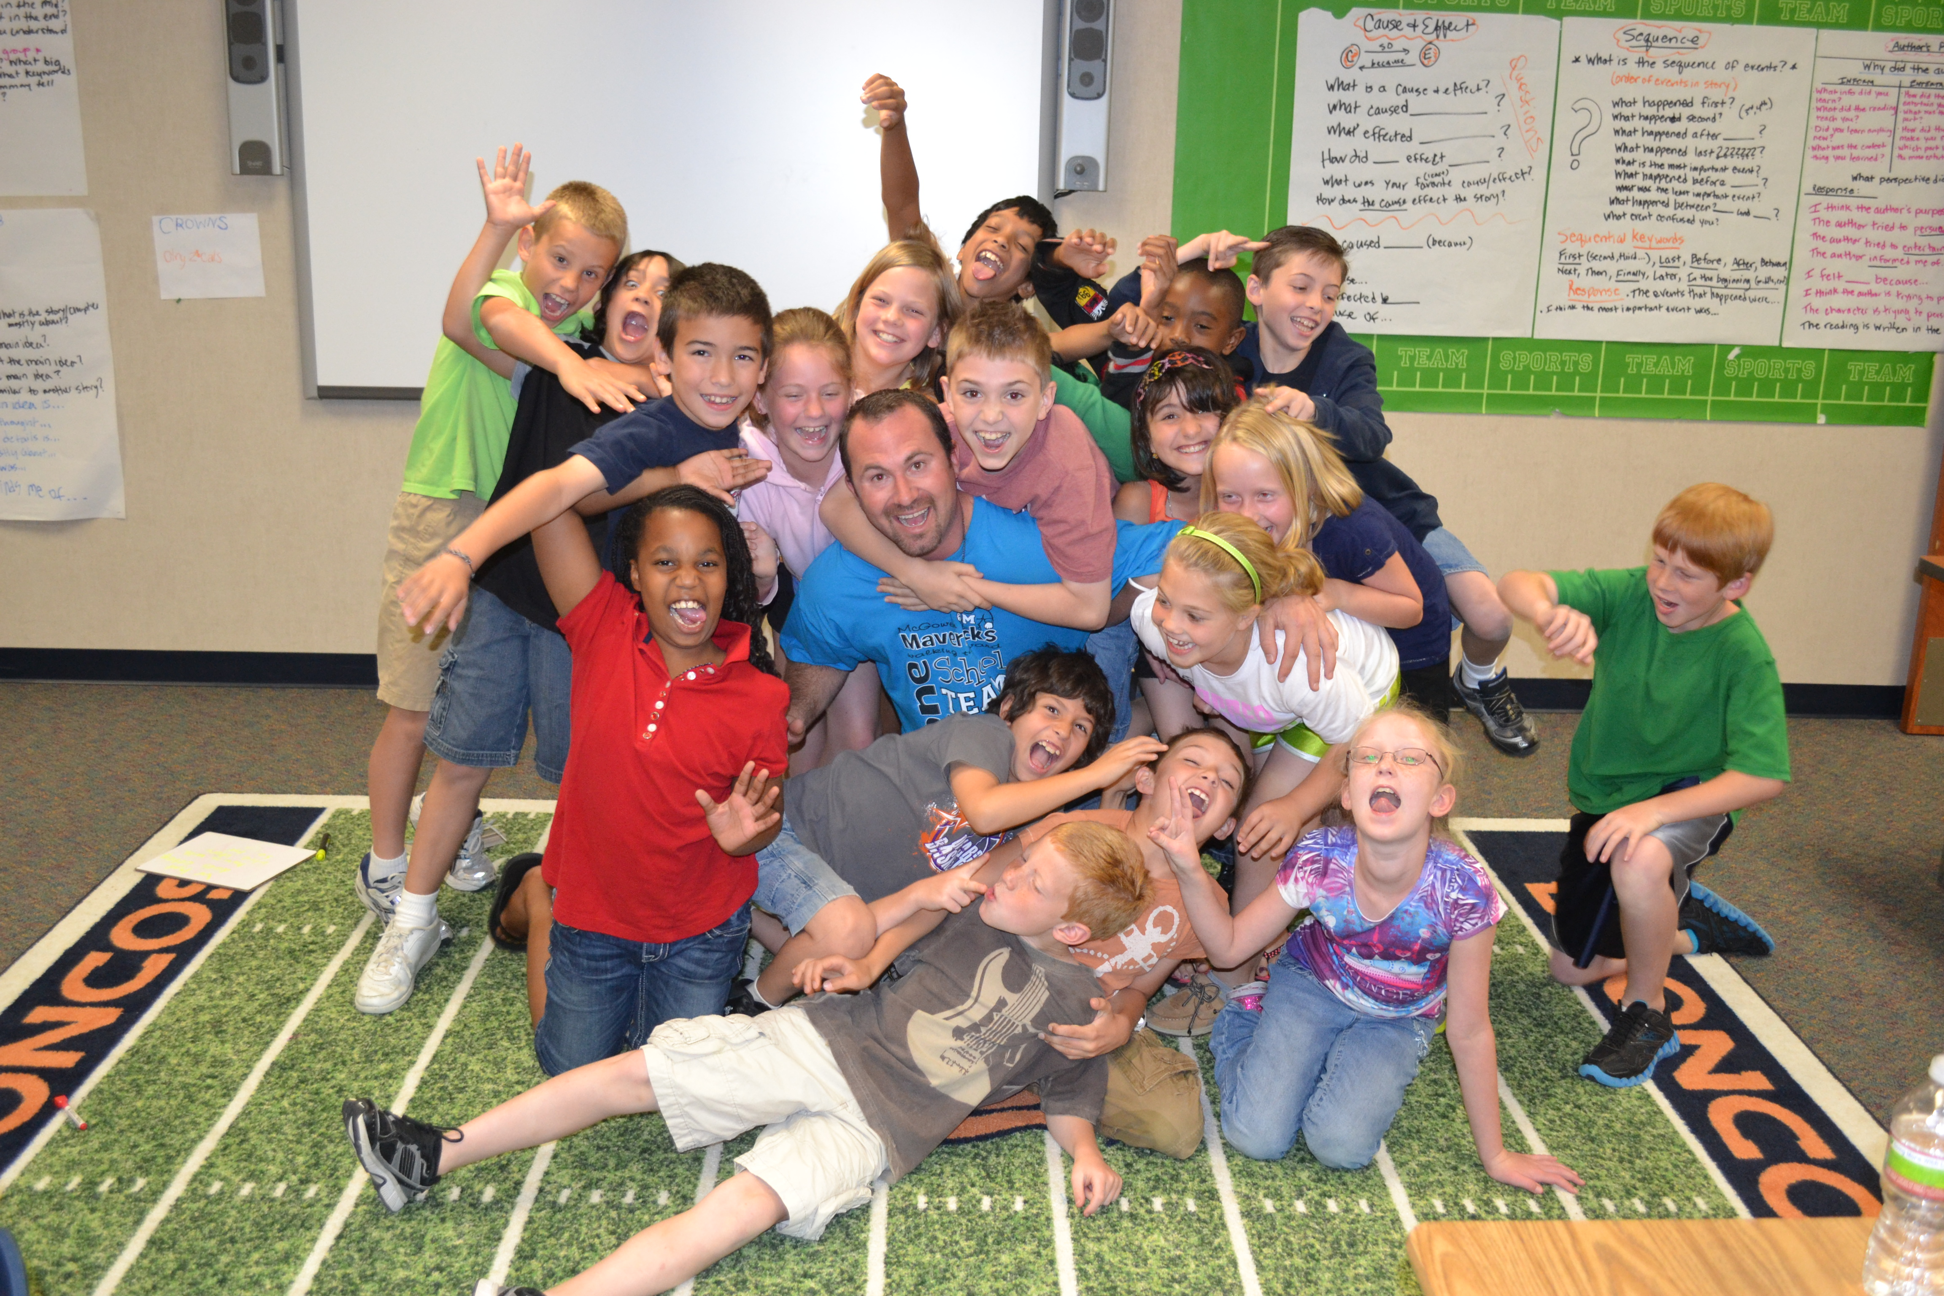

TIERED FLUENCY INSTRUCTION
drchaseyoung.com chase@thebestclass.org

Slide 2
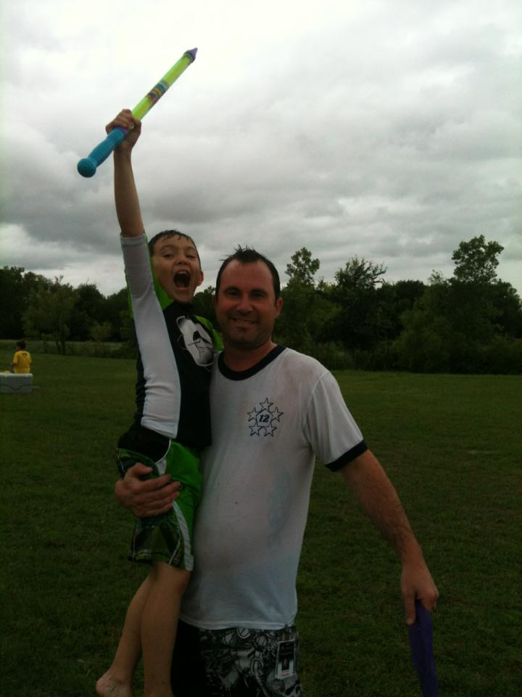
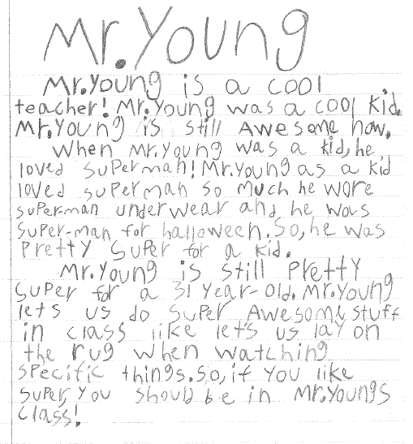
Introduction by Riley
Video

Slide 3
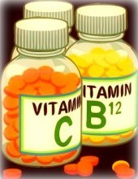
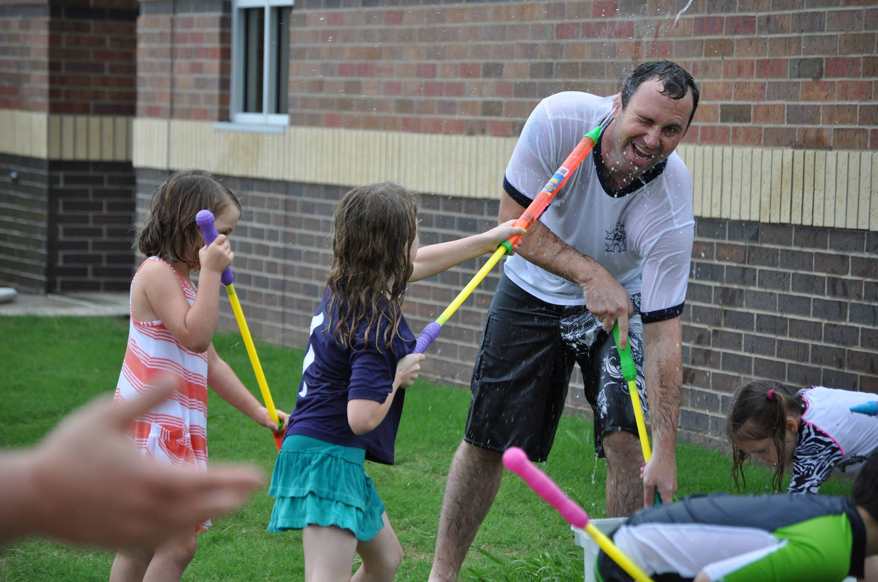
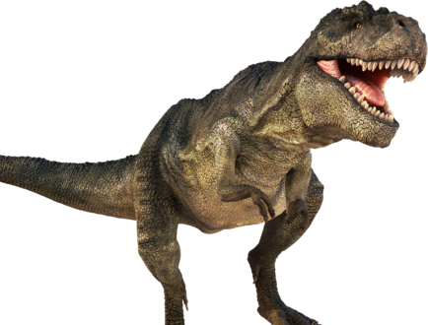
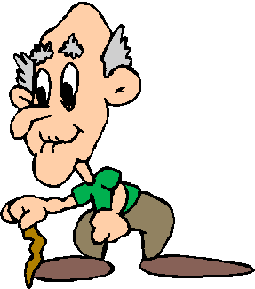
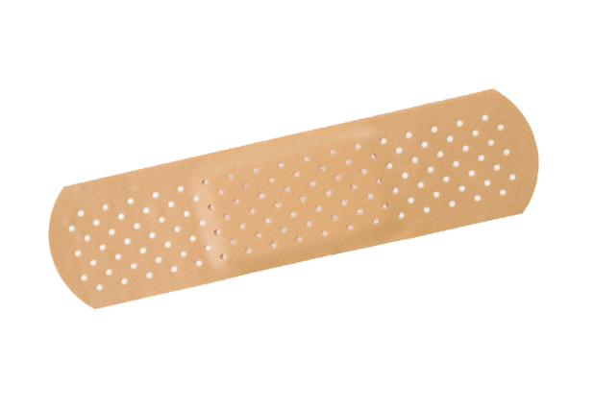
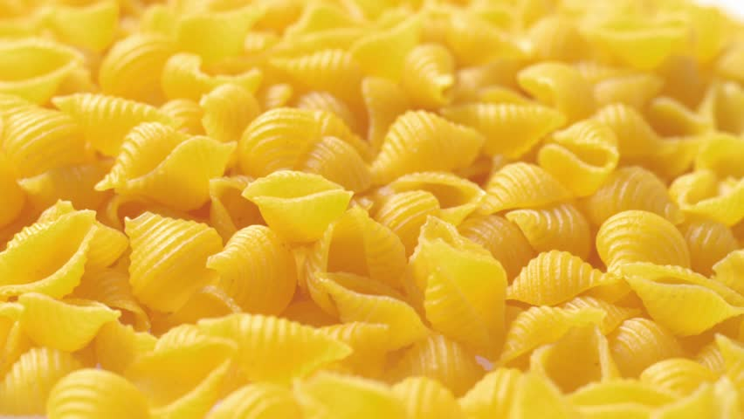
Congratulations

Slide 4
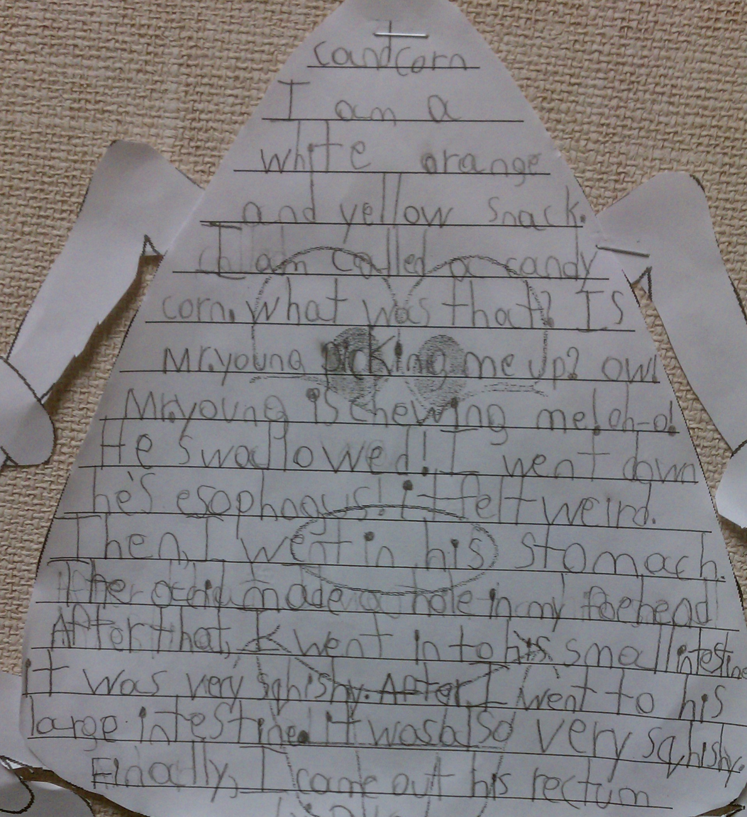
NOT TO MENTION THE “KEEP-SAKES”

Slide 5
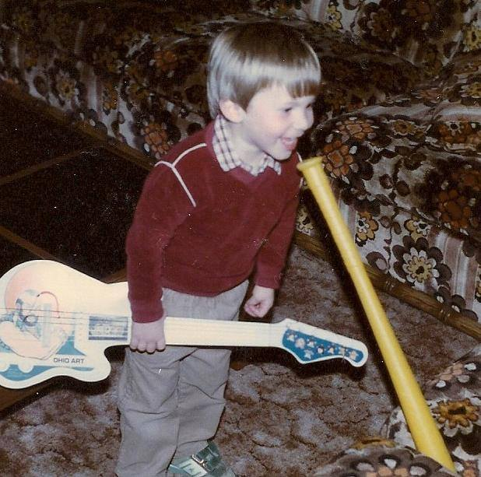
TIER I

Slide 6
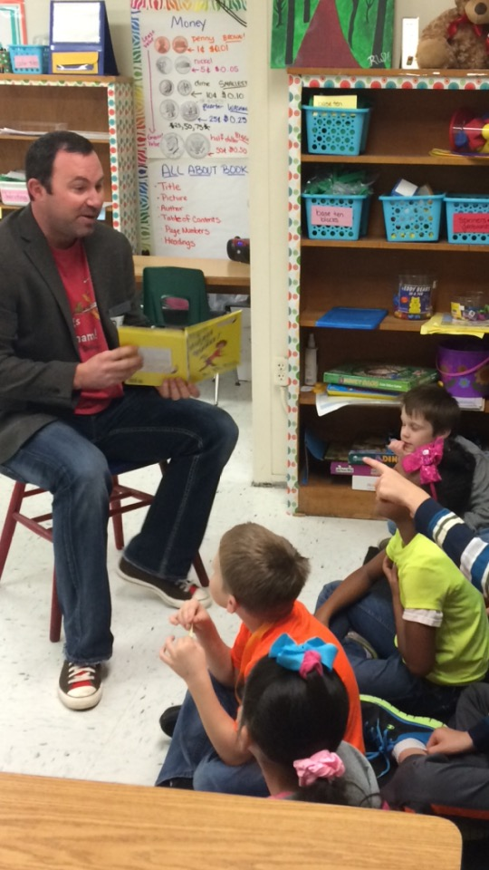

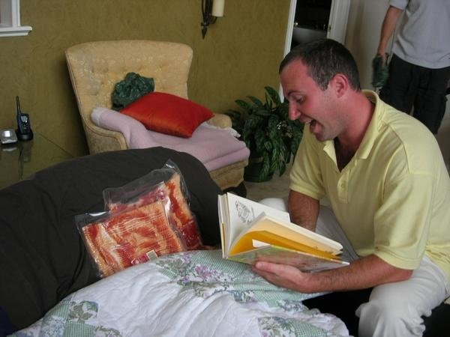
Listen child…
…and you shall read.

Slide 7

Channel your inner Oprah

Slide 8

Monday: Select scripts and read for meaning
Tuesday: Choose parts and focus on automaticity
Wednesday: Focus on Prosody
Thursday: Practice Performance
Friday: Performance

Slide 9

The Performance
Video (Example)

Slide 10
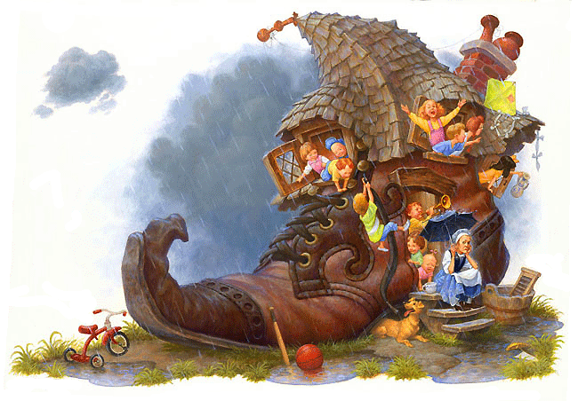
There Was An Old Woman – 4 Parts
Narrator 1: There was an old woman
Who lived in a shoe;
Narrator 2: With so many children,
What else could she do?
Narrator 3: Their home had no windows,
No doors, and no locks—
Narrator 4: The kids were all happy
But smelled like old socks.

Slide 11
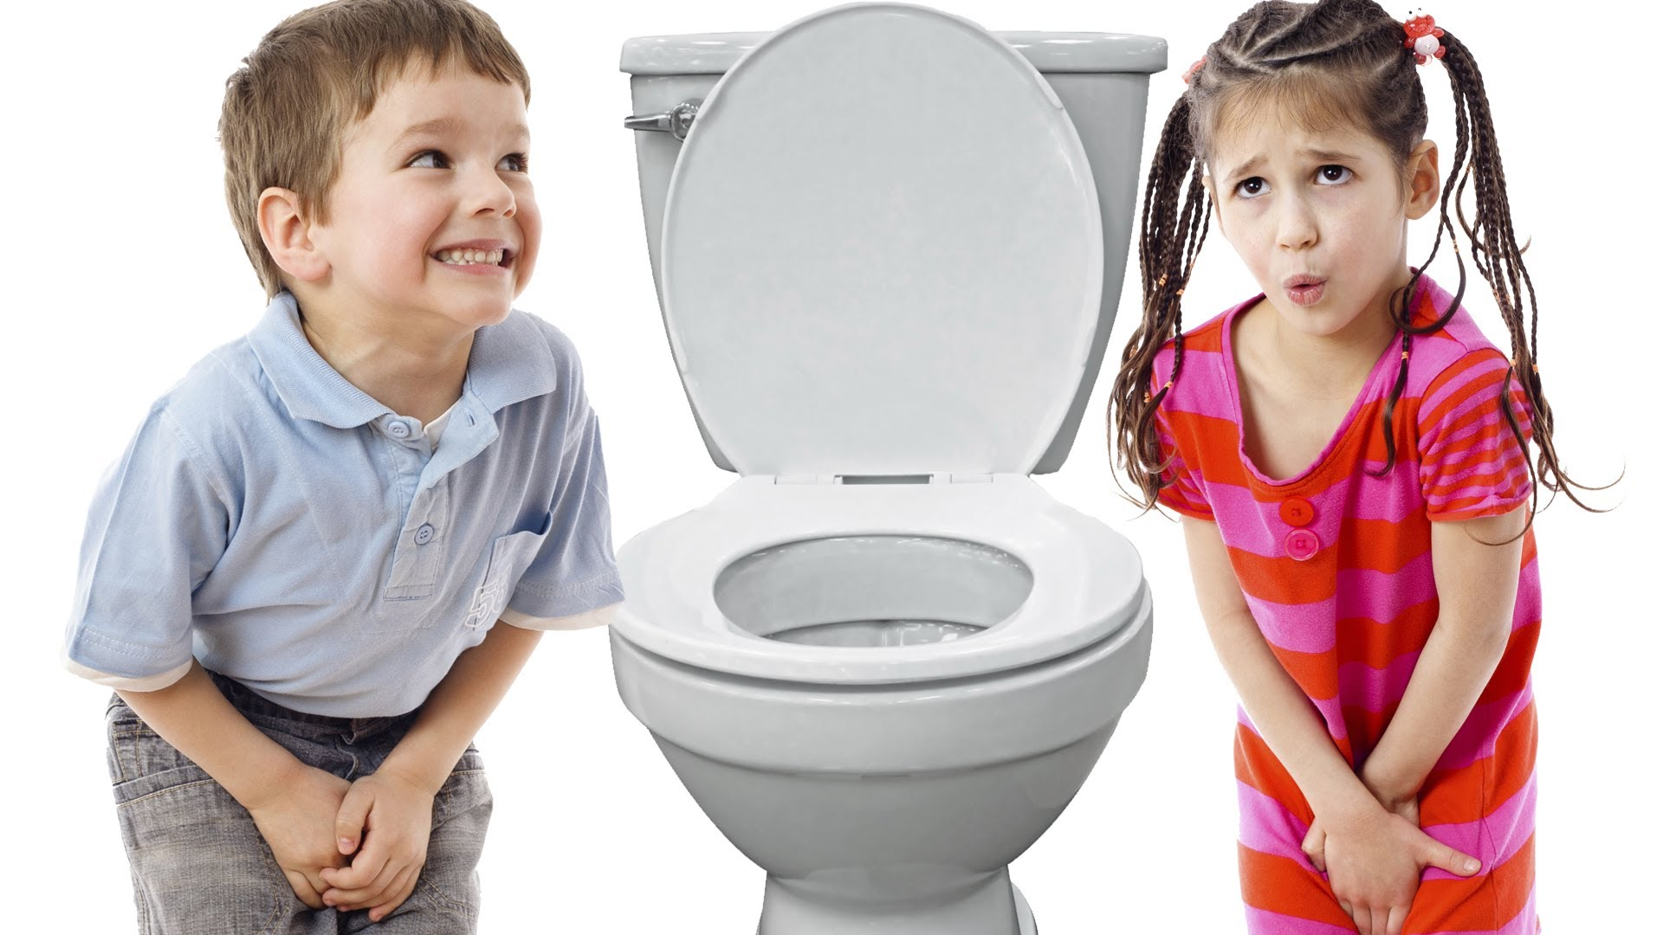
I Gotta Go!
Readers Theater Performance

Slide 12
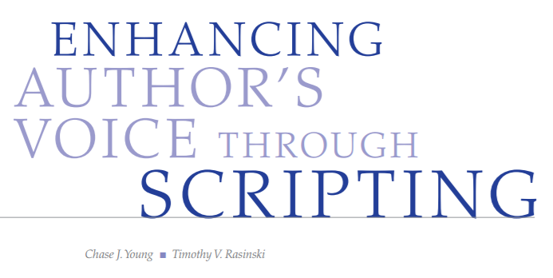
www.thebestclass.org (rtscripts)
www.timrasinski.com (resources)
Google “Readers Theater Scripts”
Teacher Created
Student Created
  Mentor
  Parody
  Scratch

Slide 13
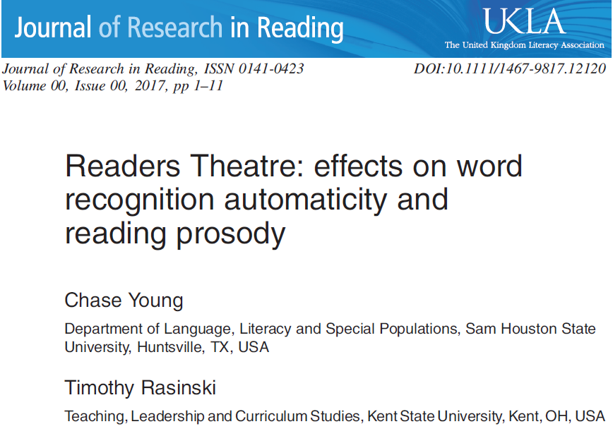
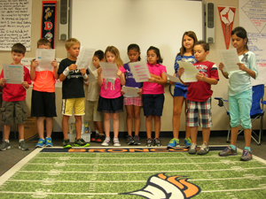
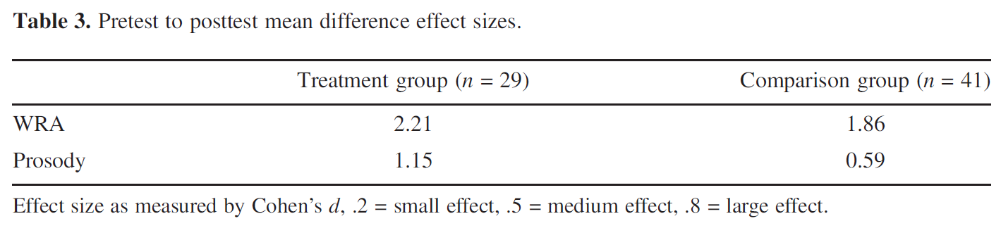

Slide 14
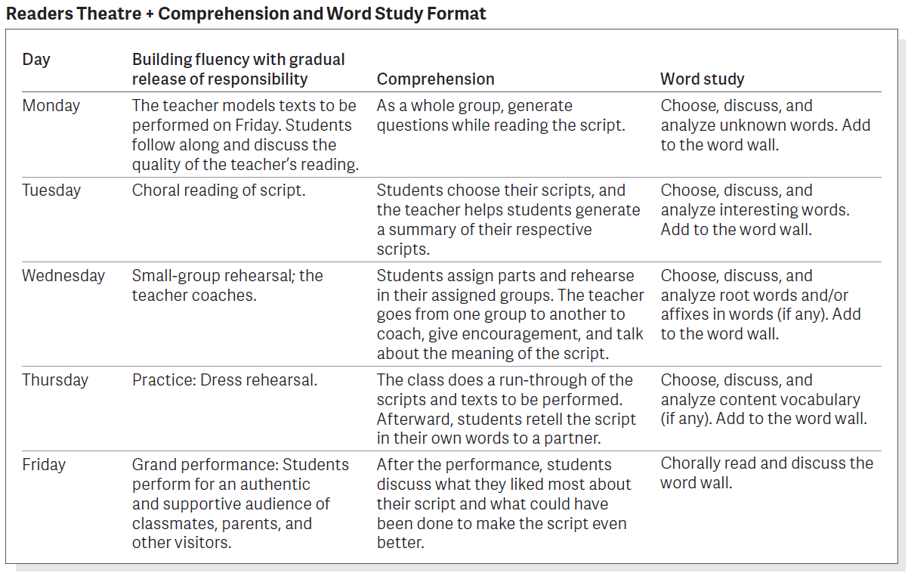
Young, C., Stokes, F, & Rasinski, T. (In press). Readers Theater plus comprehension and word study. To appear in the Reading Teacher

Slide 15
Predictive Power Of Early Vocabulary
Best kindergarten predictors of 1st and 2nd Grades reading achievement:
  Phonemic Awareness
  Alphabet Knowledge
Best kindergarten predictor of Grades 3 & up reading achievement:
  Oral Vocabulary
Notes:
This slide shows the importance of vocabulary even in elementary school. Phonemic awareness and alphabet knowledge are the best predictors of success in beginning reading (the task is to learn to decode and to develop a good “sight” vocabulary). By third grade, decoding has caught up with oral language for most students, and they beginning reading text with more challenging vocabulary. Thus, we have to pay attention to students understanding of word meanings from an early age.
You may want to ask the group to read the slide and discuss in pairs or groups why kindergarten PA and Alphabet Knowledge predict 1st and 2nd reading, but kindergarten vocabulary is a better predictor in 3rd and up.

Slide 16
Oral Vocabulary Differences For Disadvantaged Children
Total Oral Vocabulary
  2700 words middle SES 1st graders
  1800 words low SES 1st graders
New Words Per Year Primary Grades
  3000 words/year middle SES
  1000 words/year low SES
Top high school seniors know 4 times as many words as lower-performing classmates.
Notes:
The major headings come in one at a time, in order for the presenter to be able to show, one step at a time, how the gap grows over the course of schooling.
Notes: SES stands for Socio-Economic Status
This slide shows that students who begin school low in oral vocabulary usually drop farther behind as students who start out with higher oral vocabulary gain new vocabulary at a much faster rate. This makes the gap grow larger and larger (another example of “rich get richer”). In general, children from families living in poverty come to school with much lower levels of vocabulary for many of the same reasons for the gaps discussed in Unit 2.

Slide 17
How Many Words????
18 month needs to learn avg. of ___ new words a day to have avg. vocab. of approx. ______ words by the time he or she is 6 years old (Senechal & Cornell, 1993)
Avg. high school graduate knows approx. ______ words (Nagy & Herman, 1985)
To go from 8,000 to 40,000 in 12 years, a child needs to learn 32,000 words or ____ words a day.
Children typically learn _________ words a year (over 8 words a day) between 3rd and 12th grades (Nagy & Anderson, 1984)
₅
_{8,000}
_{40,000}
₇₋₈
_{3,000}
Notes:
Handout: PPt slides for Vocab. and Comprehension
Have participants fill in the blanks on their handout or ppt. whichever is easier for them to use.
1. 18 month needs to learn avg. of 5 new words a day to have avg. vocab. of approx. 8,000 words by the time he or she is 6 years old (Senechal & Cornell, 1993)
2. Avg. high school graduate knows approx. 40,000 words (Nagy & Herman, 1985)
3. To go from 8,000 to 40,000 in 12 years, a child needs to learn 32,000 words or 7 words a day.
4. Children typically learn 3,000 words a year (over 8 words a day) between 3rd and 12th grades (Nagy & Anderson, 1984)

Slide 18
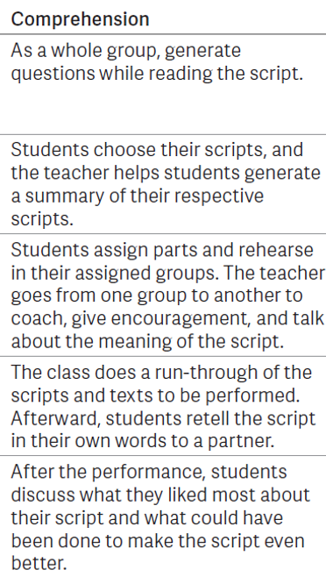
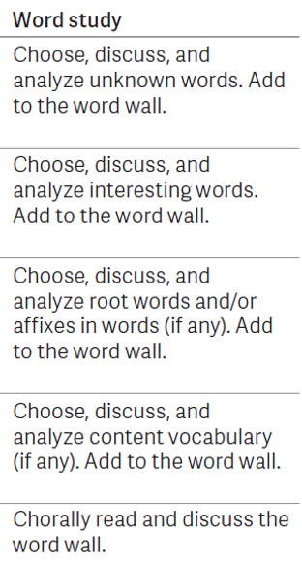
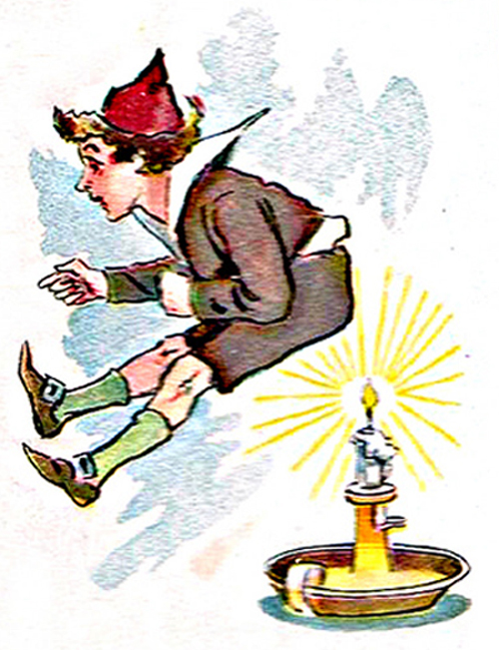
Jack was Nimble – 3 Parts
Narrator 1: Jack was nimble,
Narrator 2: Jack was quick.
Narrator 3: Jack jumped over the candlestick.
Narrator 1: Jack kept jumping much too close.
Narrator 2: Now his pants
Narrator 3: smell like burnt toast.

Slide 19
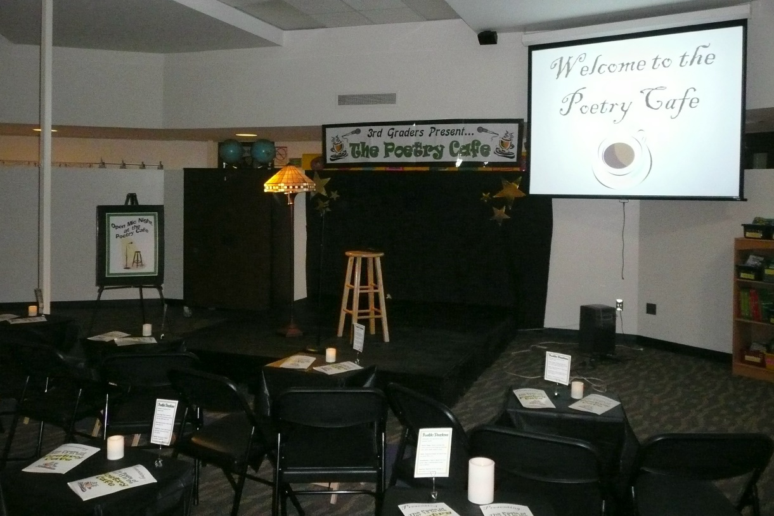
POETRY ACADEMY Wilfong (2008)
Students choose a poem
Rehearse the poem daily
Recite to a volunteer
POETRY SLAMS
(Young & Rasinski, 2017)
Day 1: Choose a poem and read for overall meaning
Day 2: Word Identification
Day 3: Prosody
Day 4: Practice for a Partner
Day 5: Dim the lights, dress in black, and enjoy the poetry slam – don’t forget to “snap clap”

Slide 20
I NEED A VOLUNTEER!
With an evil eye that stares you down
and a bulbous warty nose,
a furrowed brow, a nasty scowl,
and old outdated clothes,
my costume is the scariest
the world has ever seen.
I’m not an ogre, ghost, or ghoul:
I’m a teacher for Halloween.

Slide 21
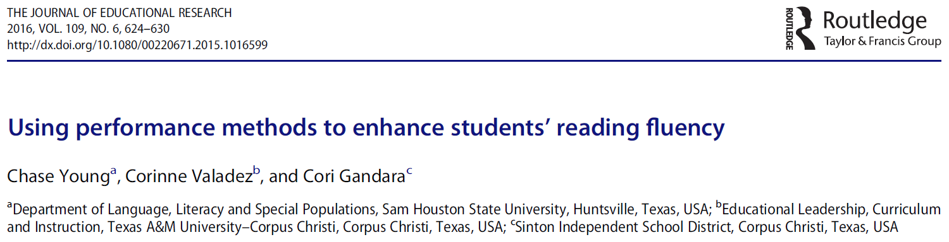
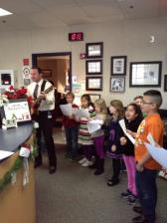

Primary Advanced
You can sing about anything!
Take our Test
Snowball Fight

Slide 22

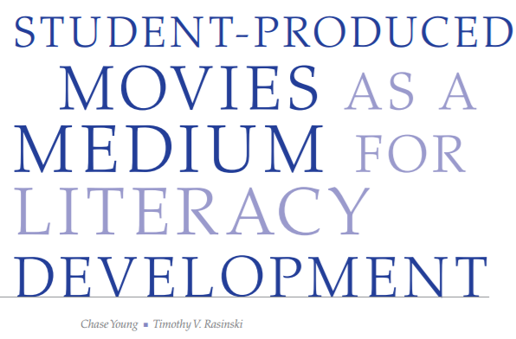
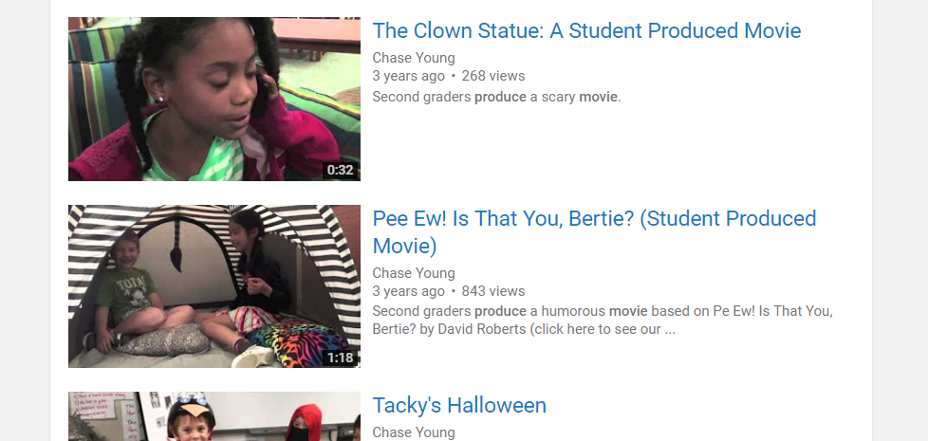

Slide 23
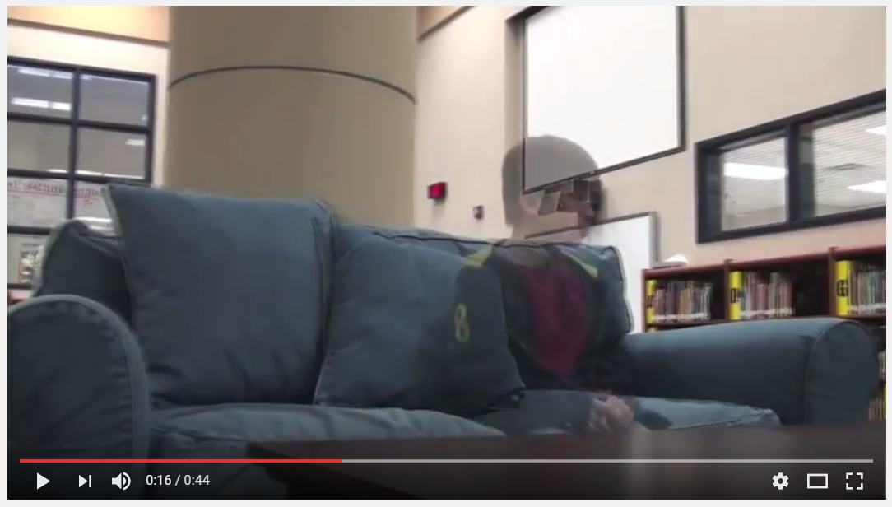
The Bad News by Alvin Schwartz

Slide 24
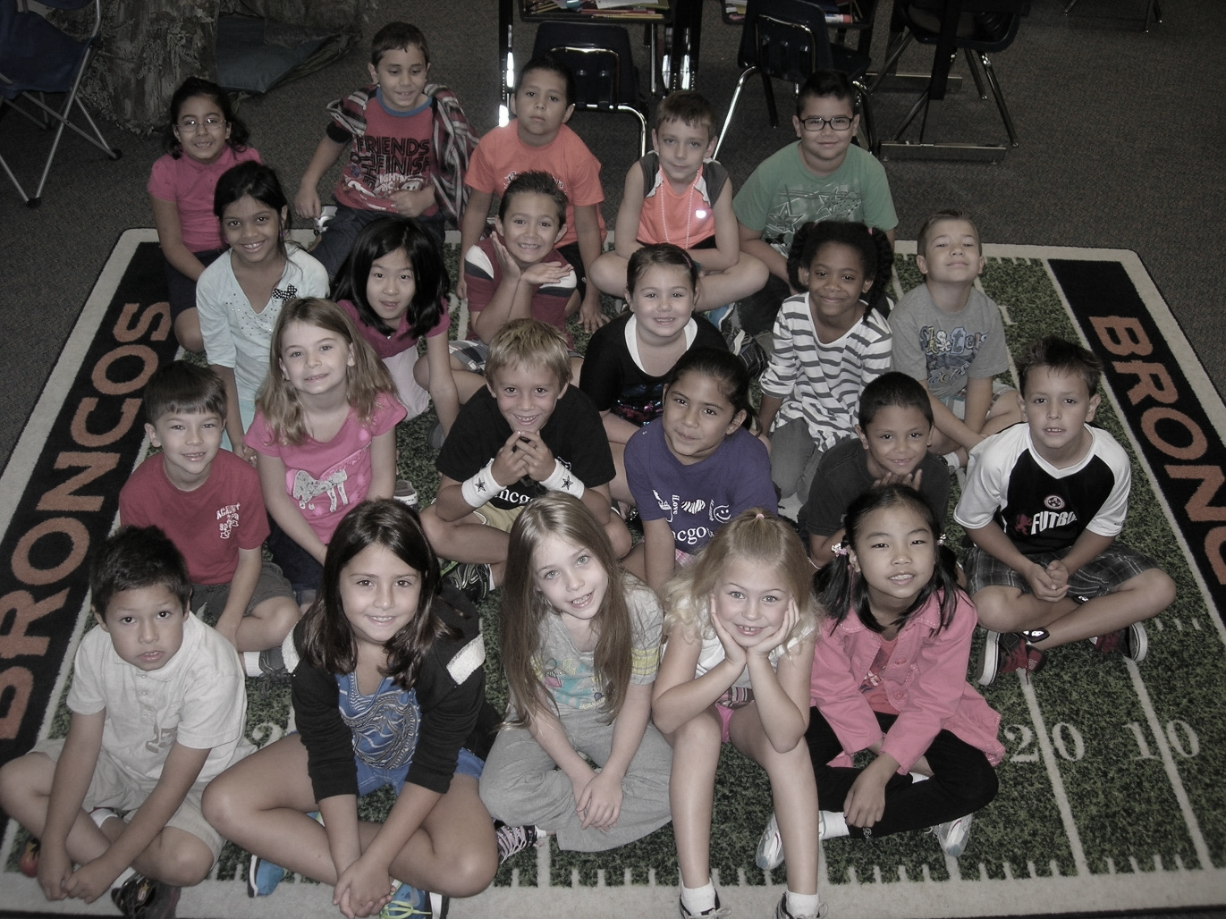
Student Produced Movies
Phase 1: Grouping
Phase 2: Idea Development
Phase 3: Script Treatment
Phase 4: Storyboard
Phase 5: Scripting
Phase 6: Preproduction Conference
Phase 7: Filming
Phase 8: Post-Production

Slide 25
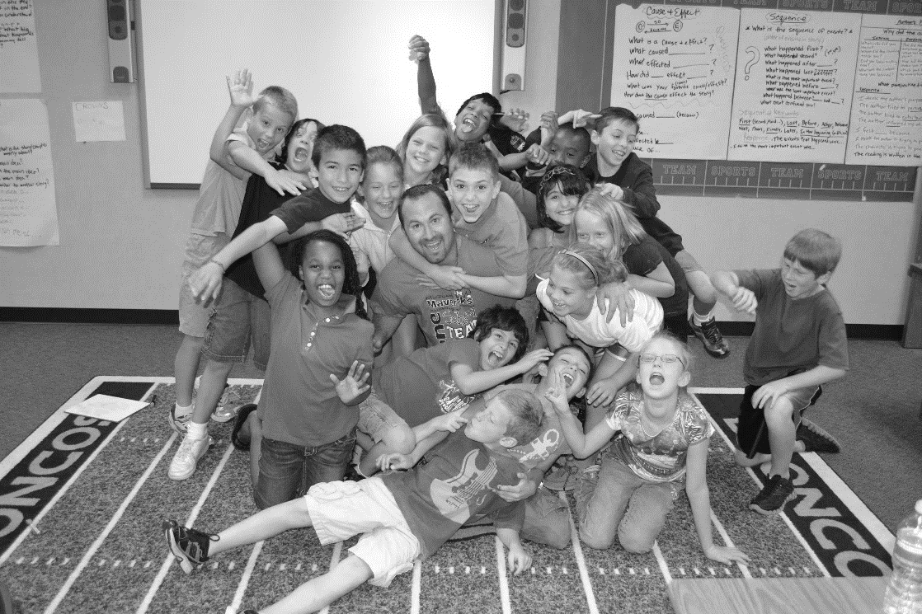
Phase 1: Grouping
(Risko & Walker-Dalhouse, 2011; Pachtman & Wilson, 2006)
Students groups are selected based preferred genre

Slide 26
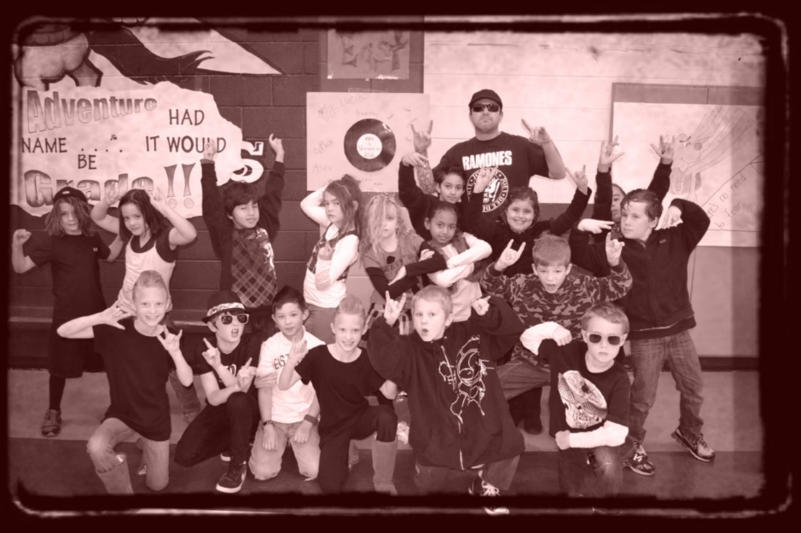
Phase 2: Idea Development
(Culham, 2011; Dorfman & Cappelli, 2007; Smith, 1994)
Students choose method for creating scripts: mentor, parody, or from scratch

Slide 27
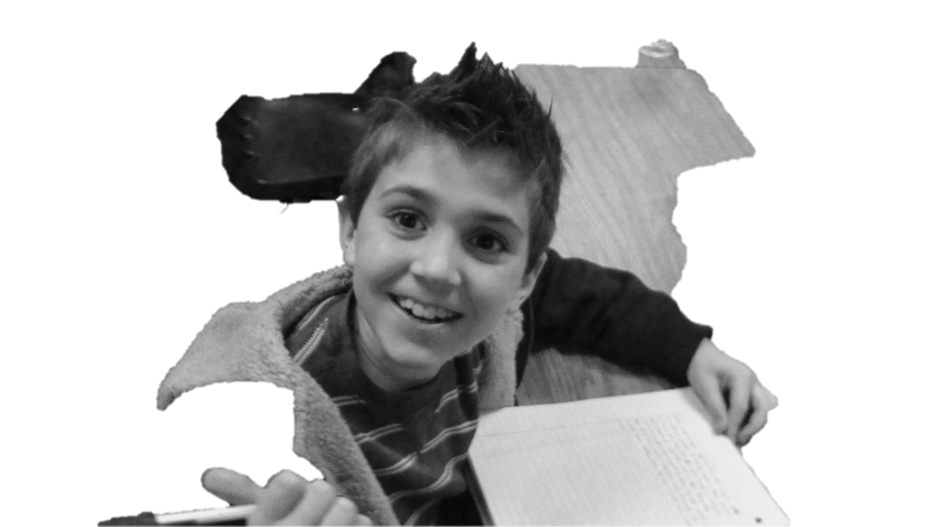
Phase 3: Script Treatment
(National Institute of Child Health and Human Development, 2000)
Students write a summary and assign roles

Slide 28
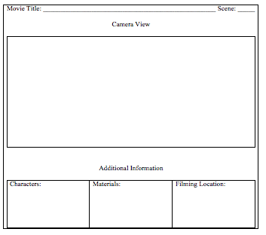
Phase 4: Storyboard
(Naughton, 2008)

Slide 29
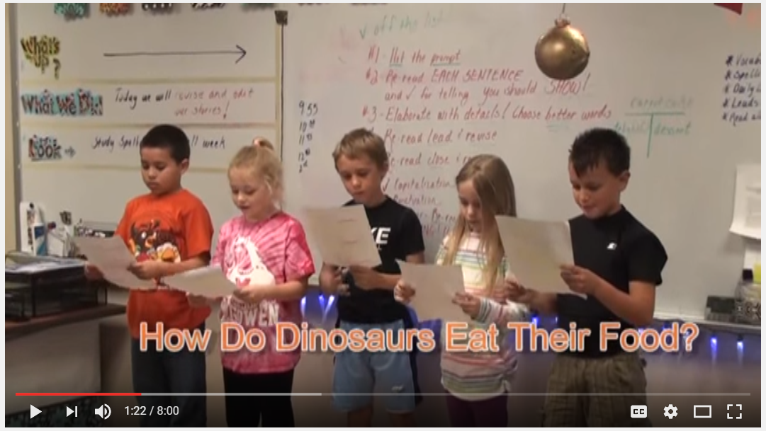
Phase 5: Scripting
(Culham, 2011; Dorfman & Cappelli, 2007; Smith, 1994; Young & Rasinski, 2011)

Slide 30
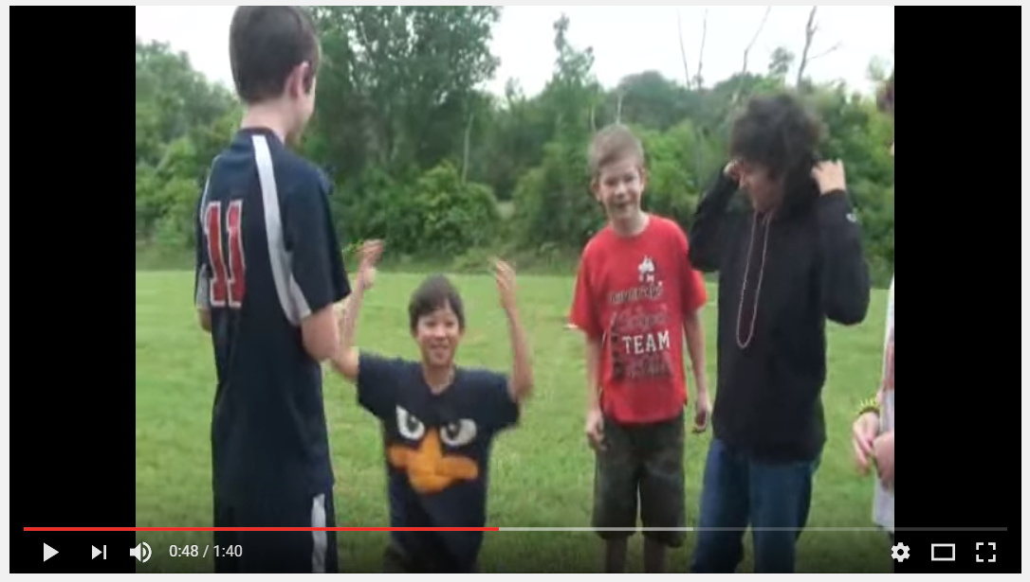
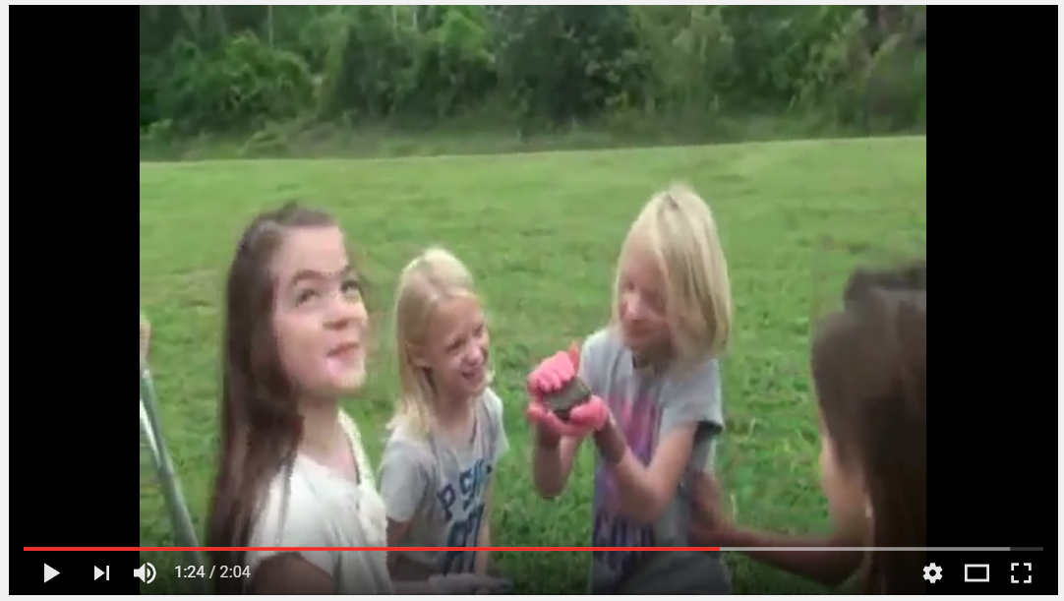
Enhancing Authors’ Voice Through Scripting (Young & Rasinski, 2011)
Mentor Text
Parody

Slide 31
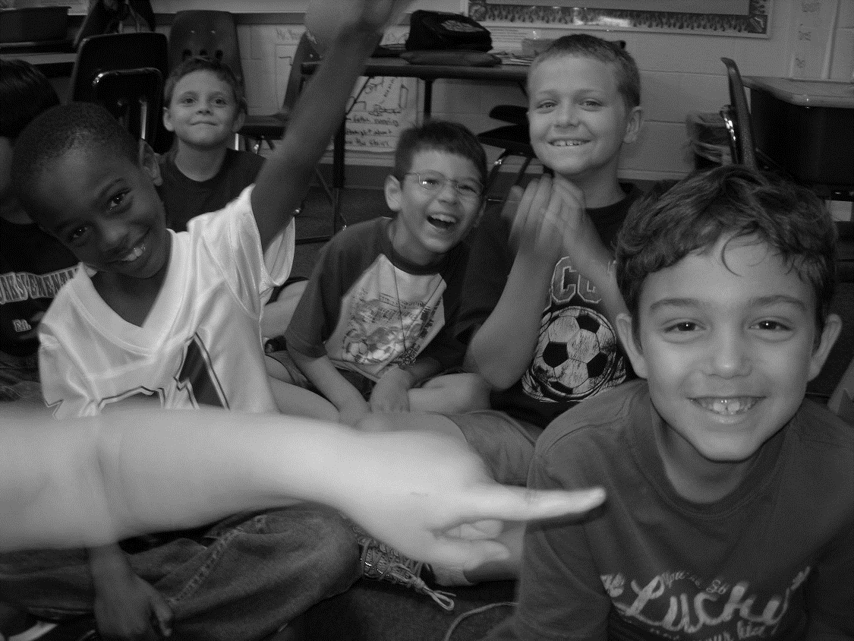
Phase 6: Preproduction Conference
(Young & Rasinski, 2013)
The production team meets with the teacher and discuss light edits, materials, and responsibilities.

Slide 32
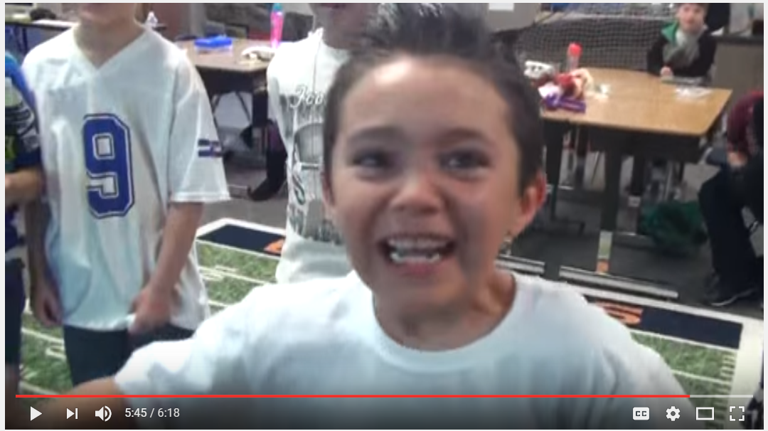
Rehearsal
(Griffith & Rasinski, 2004; Martinez, Roser, Strecker, 1998; Young
& Rasinski, 2009; Vasinda & McLeod, 2011; Worthy, 2005; Worthy & Prater, 2002)

Slide 33
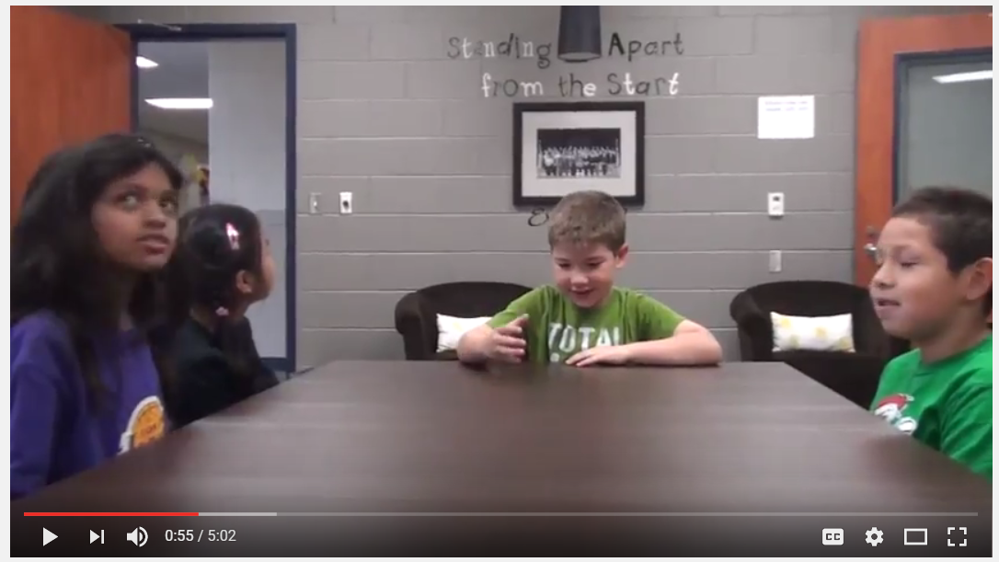
Phase 7: Filming

Slide 34
Phase 8: Post-Production
(National Governors Association for Best Practices & Council of Chief State School Officers, 2010)
Students learn how to upload the movies into the software, drop clips into the editing line, delete unused takes, reorder and cut clips, configure special effects, utilize transitions, add music, and create title and credit sequences.
Final

Slide 35
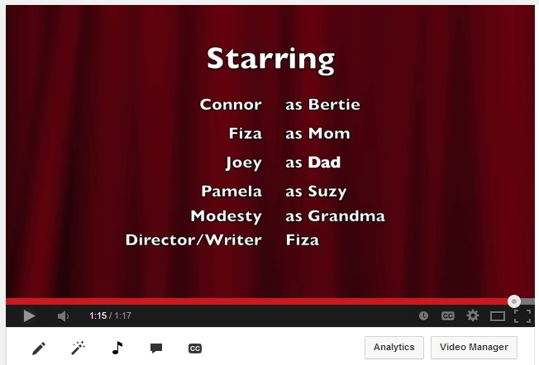
Literacy Skills and Processes
Consider reading preferences (Pachtman & Wilson, 2006)
Explore genres (Risko & Walker-Dalhouse, 2011).
Visually represent sequences of text (Naughton, 2008),
Compose summaries (NICHD, 2000)
Transform texts into dialogue ideal for movie production (Culham, 2011; Dorfman & Cappelli, 2007; Young & Rasinski, 2011)
Students utilize software to produce a movie (National Governors Association for Best Practices & Council of Chief State School Officers, 2010)

Slide 36
DISCUSS THE FOLLOWING WITH THE GOOD LOOKING PEOPLE AROUND YOU.
HOW MIGHT I IMPLEMENT THIS STRATEGY IN MY CLASSROOM?

Slide 37
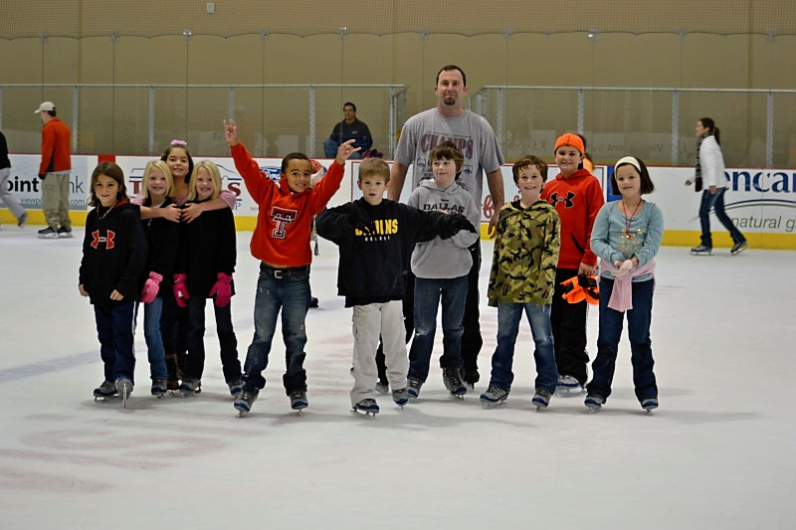
TIER II

Slide 38


CHORAL READING

Slide 39
CHORAL READING
Let’s Try!
Cinnamon, Aluminum, Linoleum
Cinnamon, Aluminum, Linoleum
Cinnamon, Aluminum, Linoleum

Slide 40

ECHO READING

Slide 41
ECHO READING
Let’s Try!
Kacy missed her husband,
so she reloaded and fired again.

Slide 42
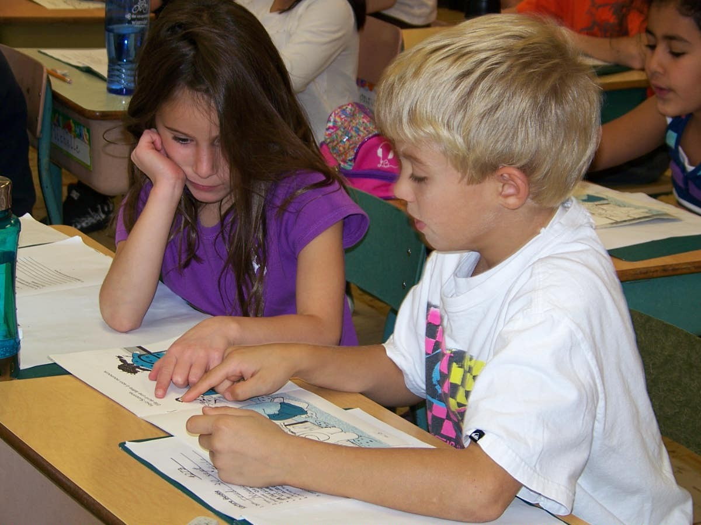
PAIRED READING
VIDEO

Slide 43
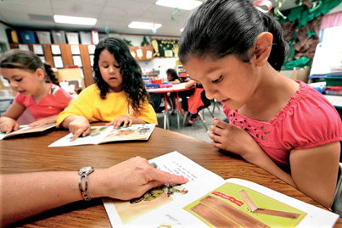
GUIDED READING

Slide 44
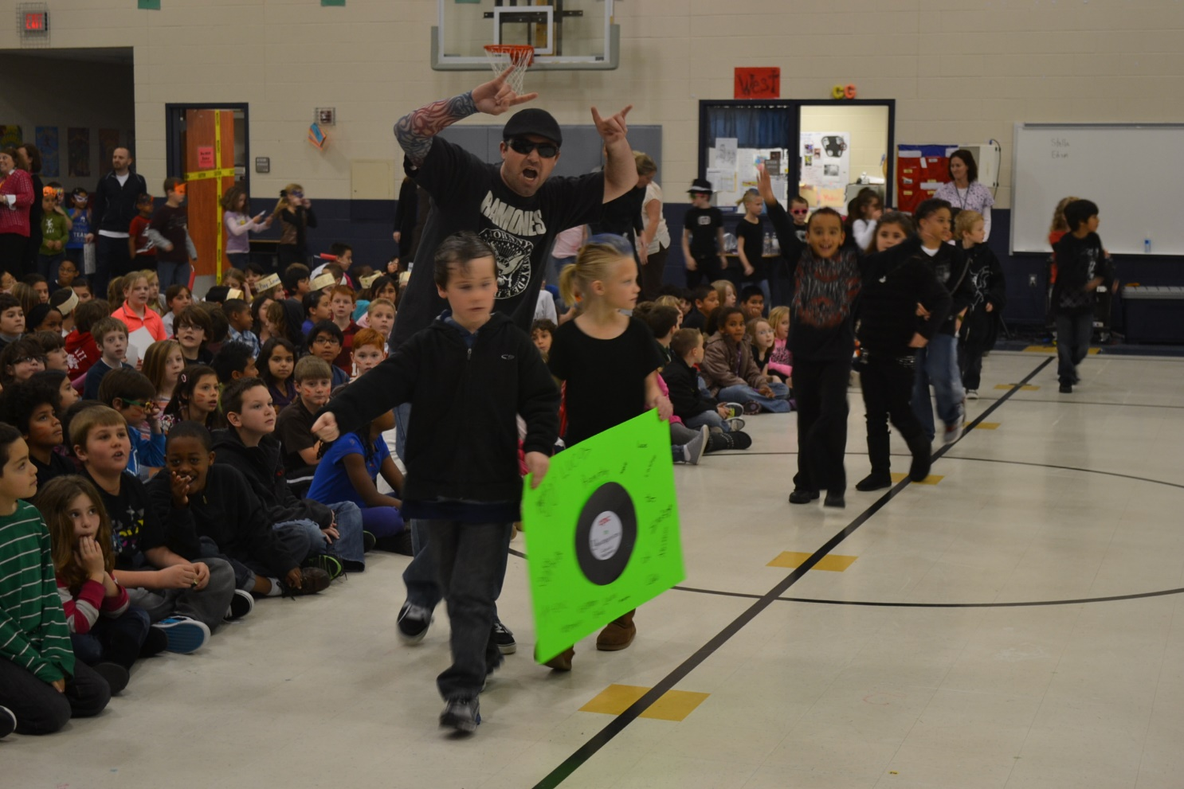
TIER III

Slide 45
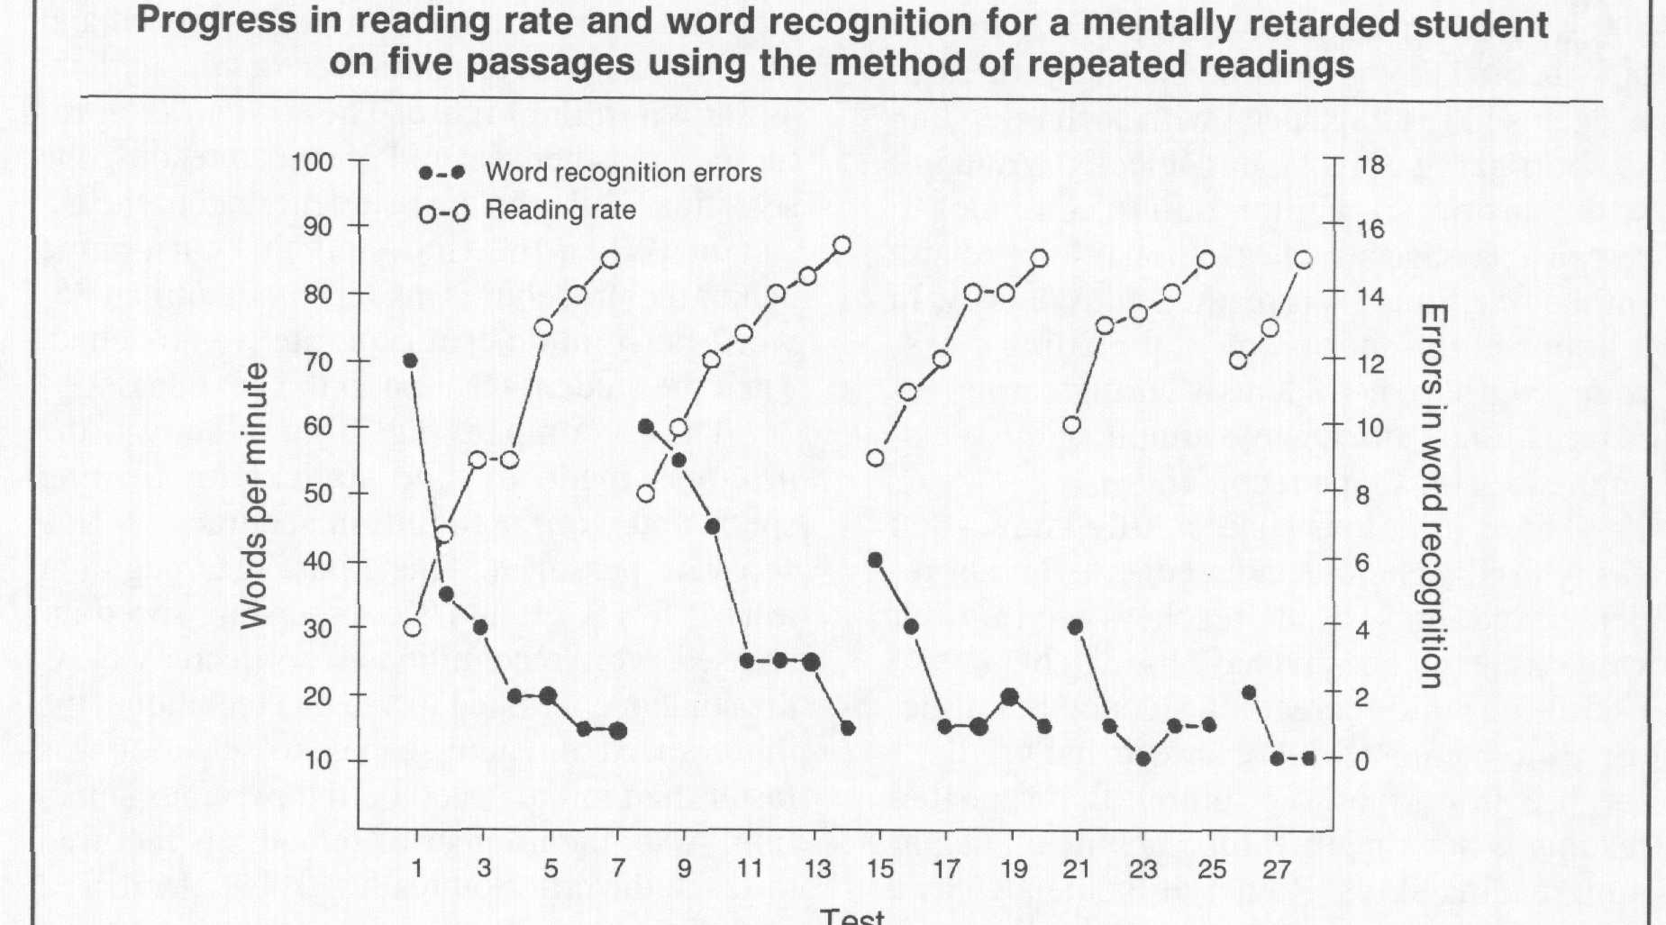
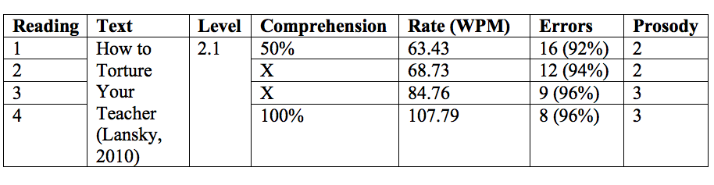
Repeated Reading
(Samuels, 1979)
REPEATED READINGS

Slide 46

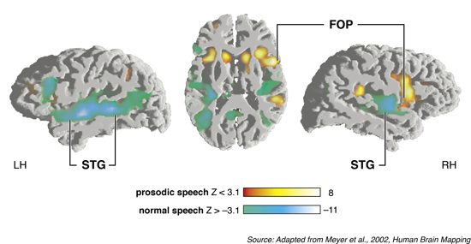

Slide 47



but I need another volunteer.
Trust me…
he’s not sorry.

Slide 48
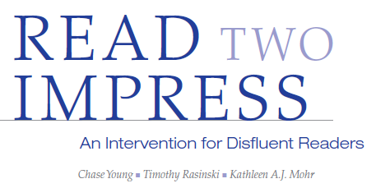
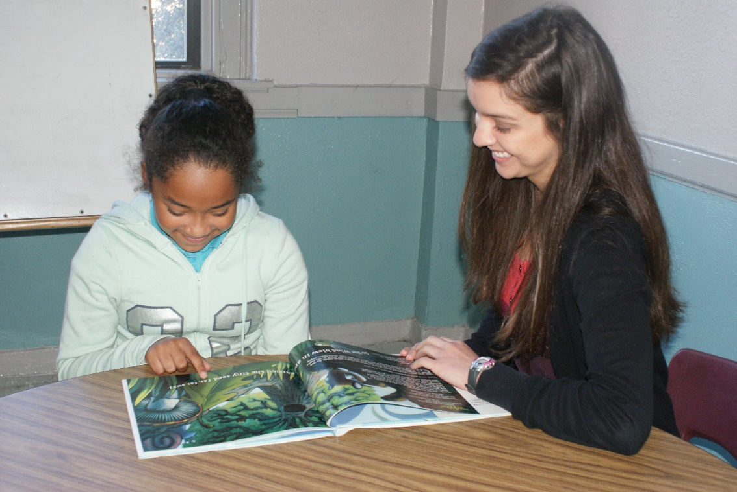

Slide 49


Slide 50



Slide 51


 | Pretest Meanª | Posttest Meanª | Z^{b} | Asymptotic Sig. (2 Tailed) | Effect Size^{c}
Control | 65.17 | 68.28 | .54 | .59 | .10
Treatment | 64.00 | 81.39 | 3.39 | < .01 | .57

Slide 52


Slide 53


A SOLUTION?
Vellutino, Scanlon, Sipay, Small, Pratt, Chen, & Denckla (1996)
1-1 expert instruction for kindergarteners who did not know all their letters after 3 weeks
After 12 weeks, 50% were ready for first grade
After 20 weeks, 80% were ready for first grade
The remaining 20% received 1-1 expert instruction in 1st grade
By the end of the first grade year, 98% were on grade level
In sixth grade, 86% were still on grade level.

Slide 54
be that teacher… who guides students to the edges of possibility;
who uses challenge as motivation;
who learns alongside their students;
who provides meaningful and authentic learning experiences;
who clearly loves to teach;
that teacher who students remember forever.

Slide 55







Thank you
chase@thebestclass.org www.thebestclass.org

