Slide 1
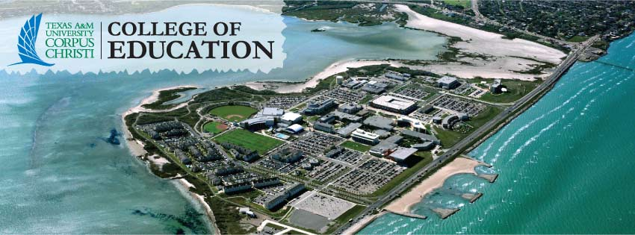
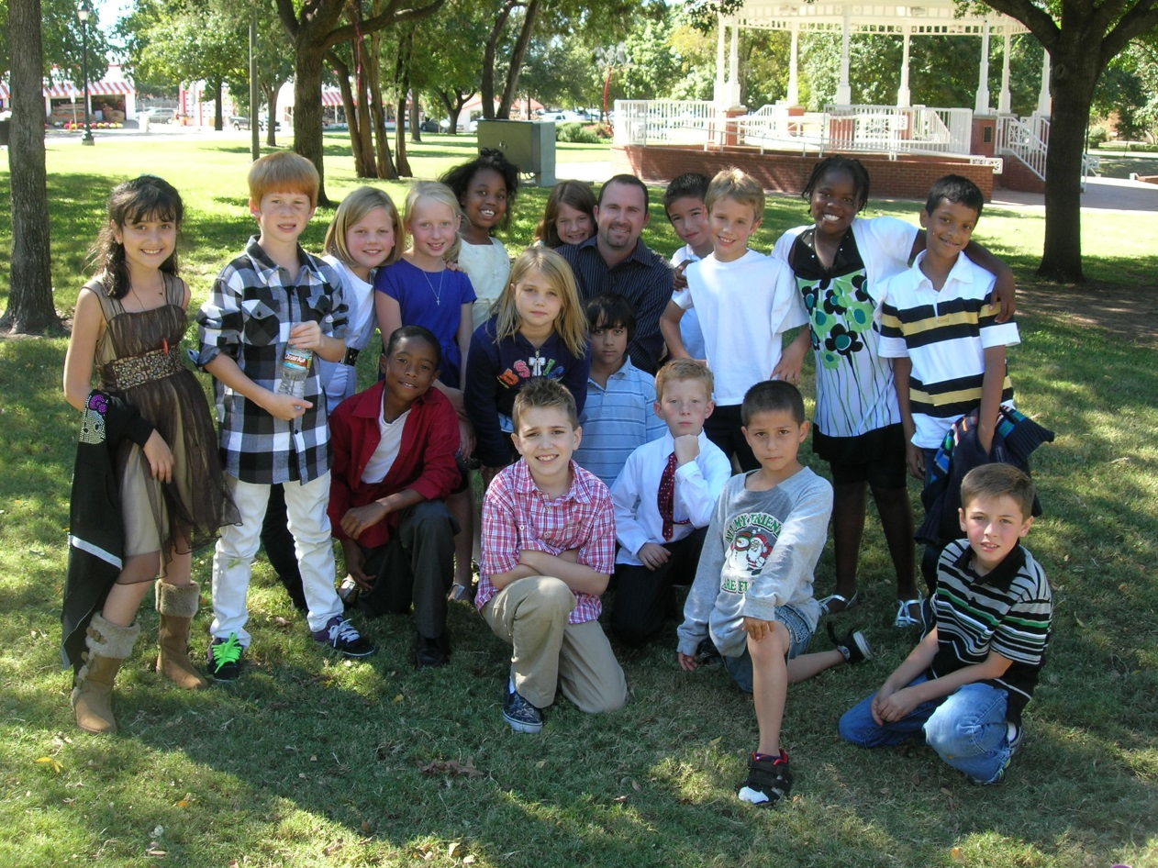
Planning Small Group Instruction
Chase Young, Ph.D.
Texas A&M University – Corpus Christi

Slide 3
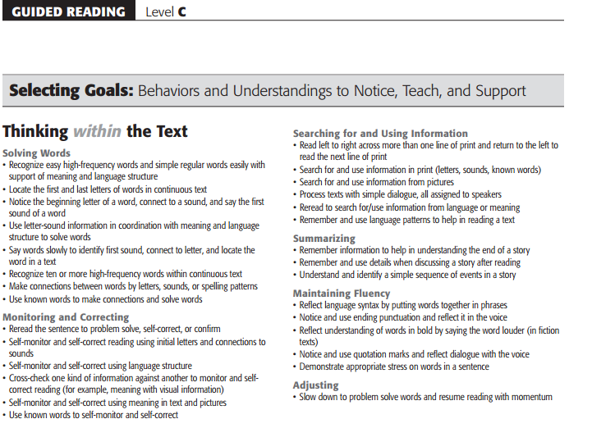

Slide 5
Let’s Do This

