Slide 1
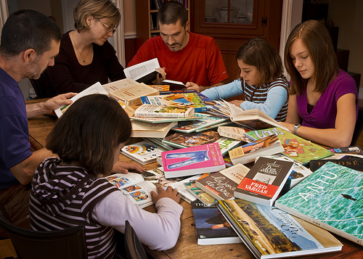
Motivating Students to Read at Home
Chase Young, Ph.D.
Texas A&M University – Corpus Christi

Slide 2
My Son Austin WILL read 20 minutes per night.

Slide 3
20 Minutes =
3600 min/year =
1.8 Million Words
1 Minute =
180 min/year =
8,000 Words

Slide 4
Variation In Amount Of Independent Reading
Min.
Books
Min.
Text
Words/Yr
Books
Words/Yr
Text
Percentile* Rank | Minutes of Reading per Day |  | Words Read Per year
 | Books | Text** | Books | Text**
2 | 0 | 0 | 0 | 8,000
10 | .1 | 1.0 | 8,000 | 51,000
20 | .7 | 2.4 | 21,000 | 134,000
30 | 1.8 | 4.3 | 106,000 | 251,000
40 | 3.2 | 6.2 | 200,000 | 421,000
50 | 4.6 | 9.2 | 282,000 | 601,000
60 | 6.5 | 13.1 | 432,000 | 722,000
70 | 9.6 | 16.9 | 622,000 | 1,168,000
80 | 14.2 | 24.6 | 1,146,000 | 1,697,000
90 | 21.2 | 33.4 | 1,823,000 | 2,357,000
98 | 65.0 | 67.3 | 4,358,000 | 4,733,000
Percentile
10
.1
1.0
8,000
51,000
50
4.6
9.2
282,000
601,000
90
21.2
33.4
1,823,000
2,357,000
*Percentile rank on each measure separately. **Books, magazines and newspapers. Adapted from “Growth in Reading and How Children Spend Their Time Outside of School” (1988) by R.C. Anderson, P.T. Wilson, and L.G. Fielding, Reading Research Quarterly 23 (3), p. 292. (5th graders)
Notes:
This slide shows data from a study of fifth grade reading habits.
The values for time spent reading text include reading newspapers and magazines as well as books. All reading includes comics and mail in addition to books, magazines and newspapers.
The principal conclusion of this study is that the amount of time a child spends reading boks is related to the child’s reading level in the fifth grade and grwoth in reading proficiency from the 2nd to the fifth grade.
We know that much of the growth in vocabulary comes from reading. Students learn the meanings of many words from seeing them a number of times in context. The differences in reading from low performing readers to high performing readers explains much of the difference in vocabulary growth rates examined on the previous slide.
This study was based on daily diaries that the children completed over a period of several months. Avg. child read only 4.6 minutes per day however, this is over six times as much as a child at the 20th percentile who read less than 1 minute daily. Yet a child at the 80th percentile was reading 14.2 minutes a day. Number of words that the children at various percentiles were reading in a year’s time. For example the avg. child at the 90 percentile in reading volume reads almost 2 ½ million words per year outside of school, over 46 times more words than the child at the 10th percentiles. Or to put it another way, the entire year’s out of school exposure of for the child at the 10th percentile amounts to just 8 days of reading for the child at the 90th percentile.
Even when performance is statistically equated for reading comprehension and general ability, reading volume is still a very powerful predictor of vocabulary and knowledge differences
There is a lot of data on this page. If you click once, your will get the column headings and the data for students at the 10th percentile. You can briefly explain each column in terms of the tenth percentile group, then click to show the 50th percentile, and click again to show the 90th percentile.
Column 1: Percentile in reading achievement
Column 2: Average number of minutes spent reading books,magazines, & newspapers per day
Column 3: Average number of minutes spent reading text books
Column 4: Words read per year in books,magazines, & newspapers
Column 5: Words read per year in text books
At 10%ile there is almost no reading done other than in textbooks.
At 50%ile the time spent reading text grows by a factor 9 from the 10%ile. The reading from other sources grows by a factor of 46. Much of this reading is of the self-selected voluntary type.
Only at the 90%ile does daily reading in books, magazines & newspapers exceed 15 minutes a day.
Keep in mind when looking at words per year that the higher readers are reading faster, and therefore, accumulate more words per unit of reading than lower readers.

Slide 5
How Many Words????
18 month needs to learn avg. of ___ new words a day to have avg. vocab. of approx. ______ words by the time he or she is 6 years old (Senechal & Cornell, 1993)
Avg. high school graduate knows approx. ______ words
To go from 8,000 to 40,000 in 12 years, a child needs to learn 32,000 words or ____ words a day.
Children typically learn _________ words a year (over 8 words a day) between 3rd and 12th grades
₅
_{8,000}
_{40,000}
₇₋₈
_{3,000}
Notes:
Handout: PPt slides for Vocab. and Comprehension
Have participants fill in the blanks on their handout or ppt. whichever is easier for them to use.
1. 18 month needs to learn avg. of 5 new words a day to have avg. vocab. of approx. 8,000 words by the time he or she is 6 years old (Senechal & Cornell, 1993)
2. Avg. high school graduate knows approx. 40,000 words (Nagy & Herman, 1985)
3. To go from 8,000 to 40,000 in 12 years, a child needs to learn 32,000 words or 7 words a day.
4. Children typically learn 3,000 words a year (over 8 words a day) between 3rd and 12th grades (Nagy & Anderson, 1984)

Slide 6
The Value of Reading
Brain
Stress
Knowledge
Memory
Thinking
Focus
Writing
Entertainment

Slide 7
“Students who read independently become better readers, score higher on achievement tests in all subject areas, and have greater content knowledge than those who do not.”

Slide 10
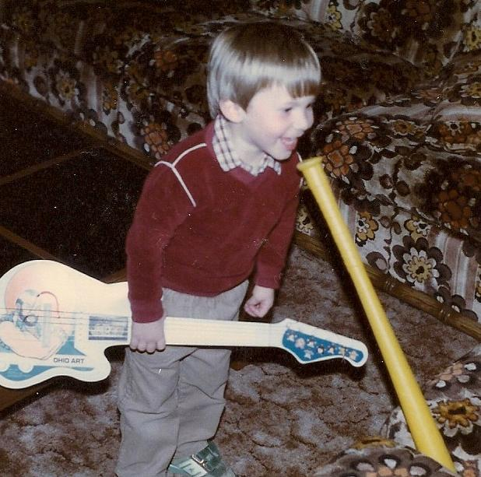

Slide 13
chase.young@tamucc.edu - www.thebestclass.org
Thank you.

