Slide 1
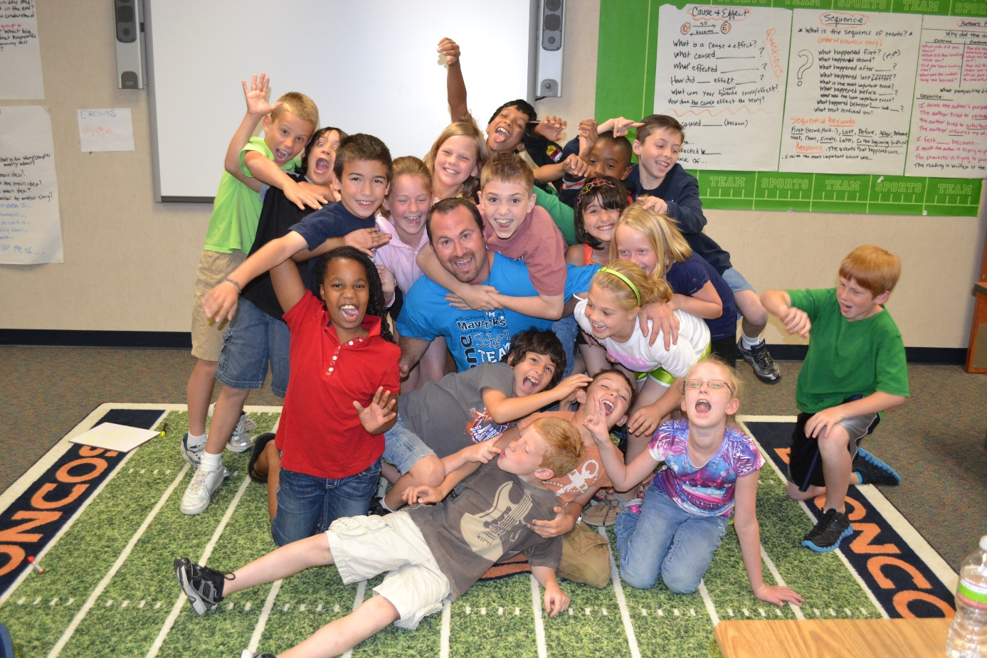
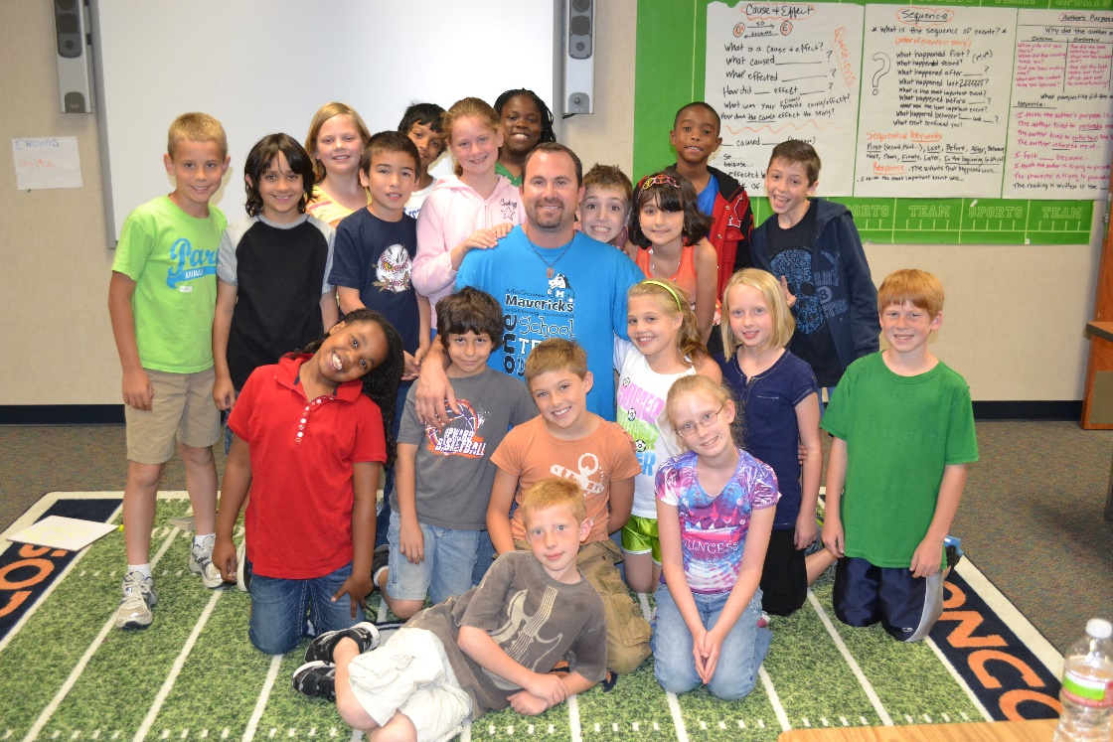
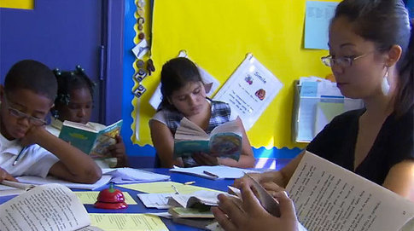
Unbalanced Literacy
Chase Young, Ph.D.

Slide 2
Listen child…
…and you shall read.
Farrell (1966)

Slide 3
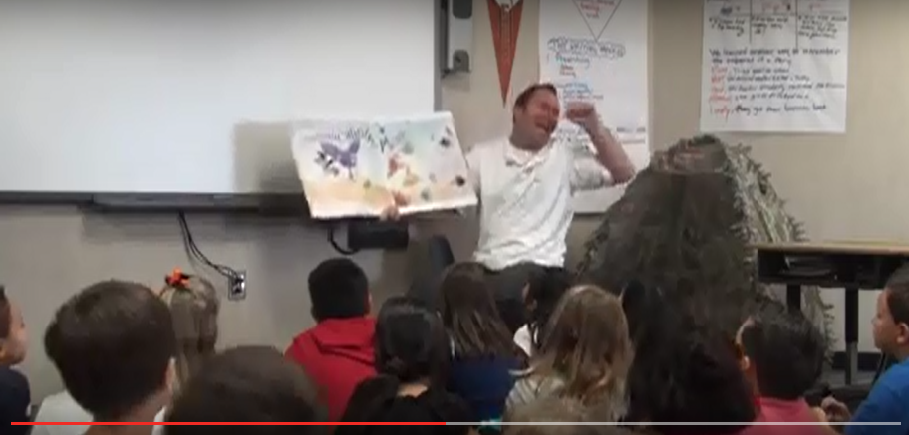
THE BOOK
THE READER

Slide 4
Interactive Reading
Let’s Create a Lesson!
Choose a text
2. Pick a strategy/objective
3. Plan an Anchor Chart

Slide 5

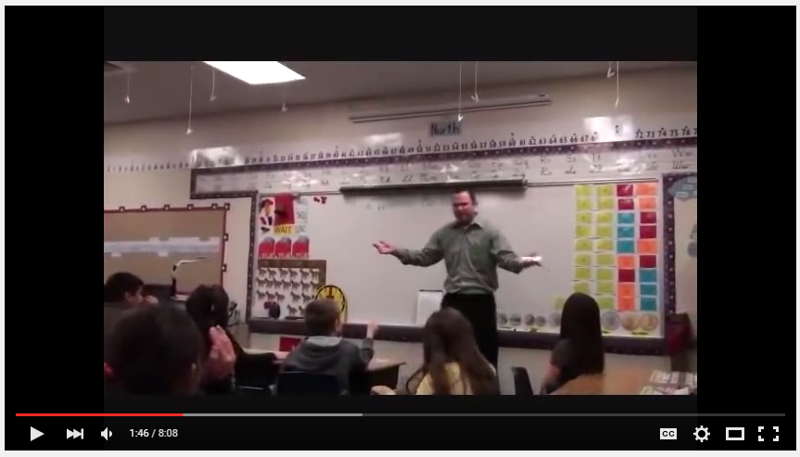
Mini-Lesson
Vertically Aligned Example

Slide 6
Guided Reading Review
Like old times!

Slide 7


Slide 8
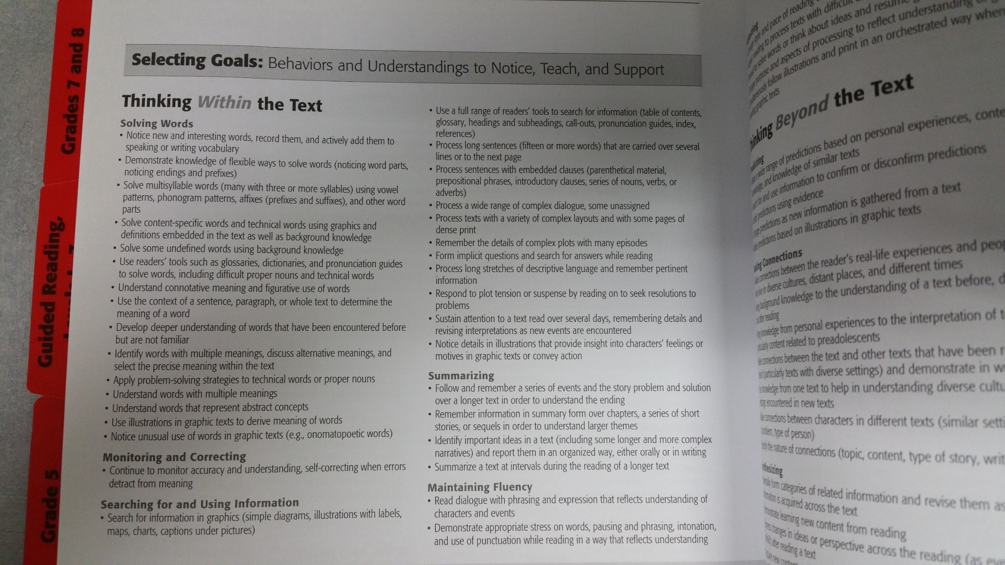

Slide 9
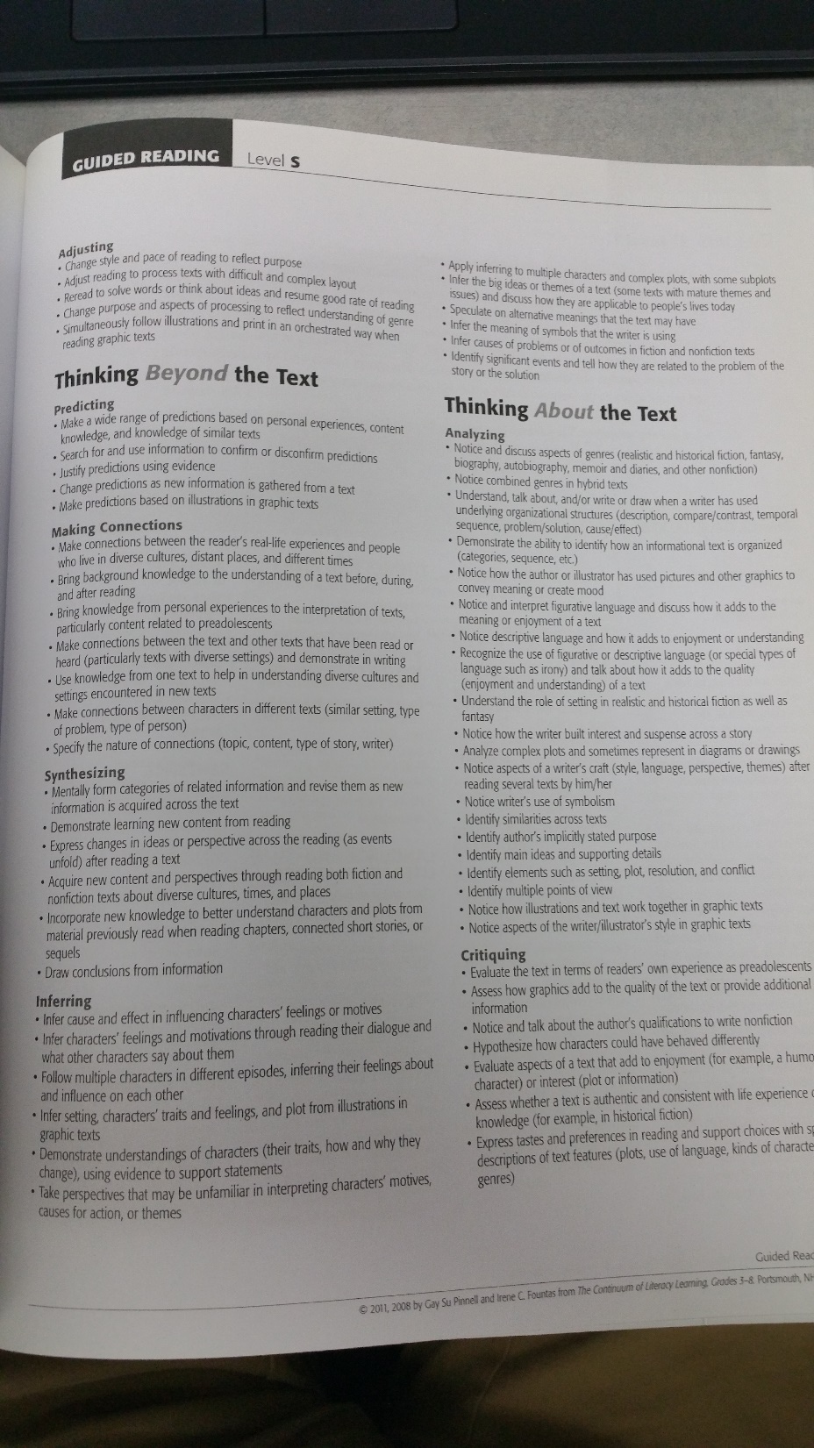

Slide 10
Planning the Lesson
(Higher-Level-Text
Plan

Slide 11
Planning the Lesson
(Lower-Level-Text)
Plan

Slide 12
Guided Reading
Example and Reflections

Slide 13
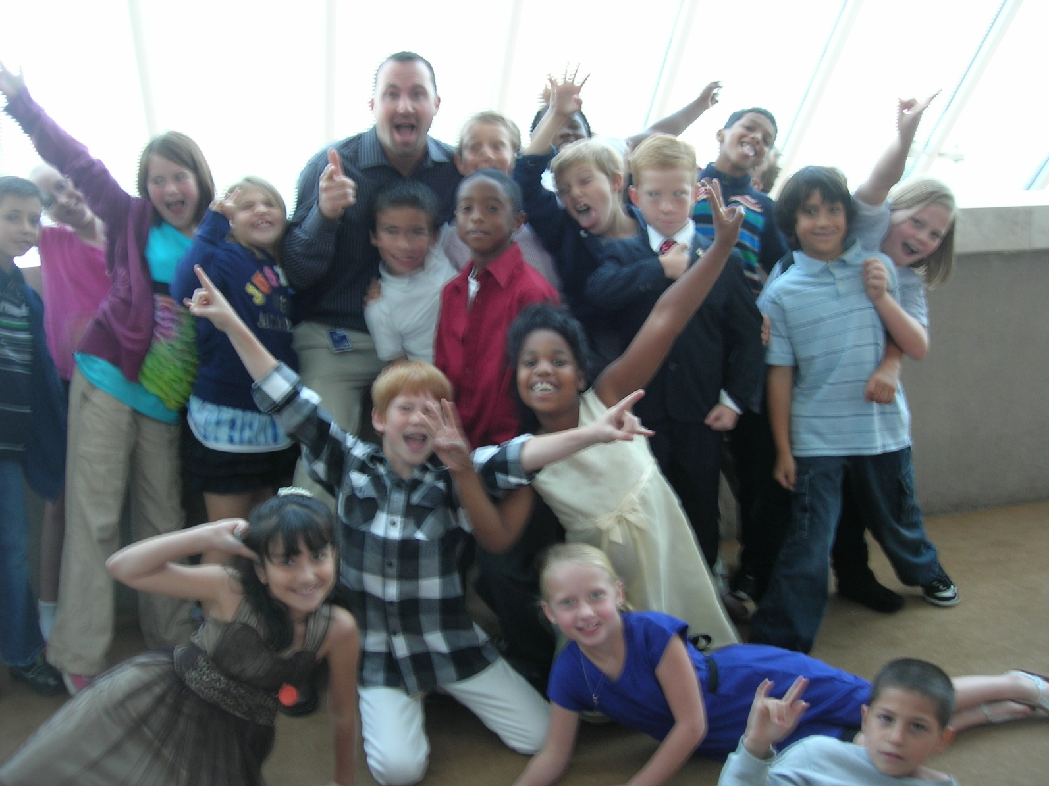
Reflections?

Slide 14
Situating Guided Reading in the BLP Classroom

Slide 15
My Goal for All Stations
Reading and/or Writing
No Grading
Never Ending
Easy For Me
Practice for Them

Slide 16
Workstation Groups?
(not guided reading groups)

Slide 17
NAME | LEVEL
Chase | L
Tim | M
Robin | M
Carol | M
Ryan | O
Randy | O
Donna | O
Leonard | P
Corinne | Q
Faye | Q
Danny | R
Pete | R
Rosa | R
Lynn | R
Kacy | T
Austin | T
Kristen | U
Jose | U
Lars | Z
How might we group these students?

Slide 18

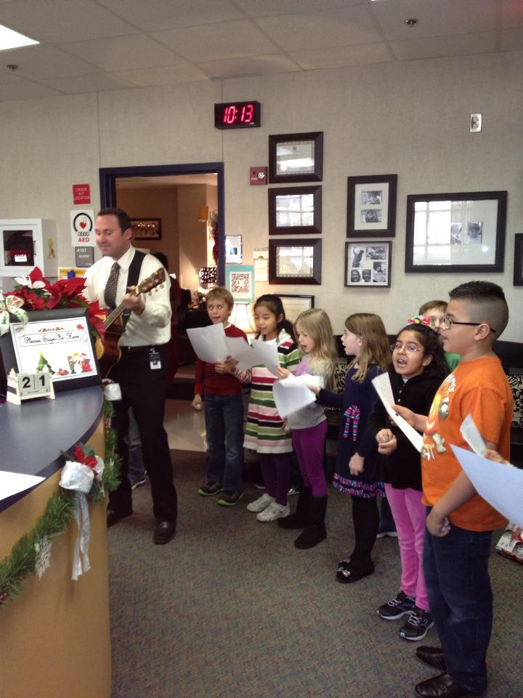
Questions?

Slide 19


Your Choice

Slide 20
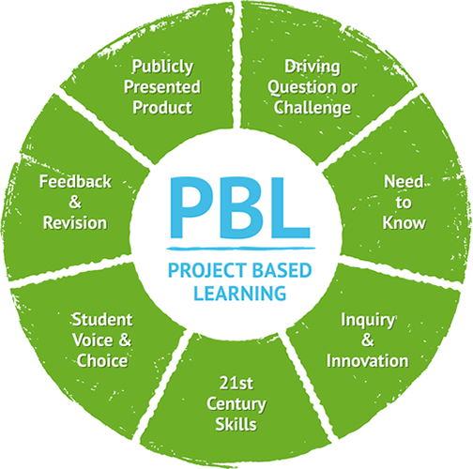
Works Great with PBL

Slide 21
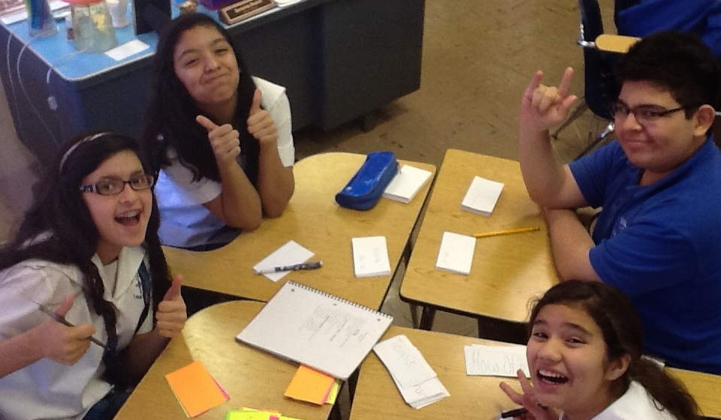
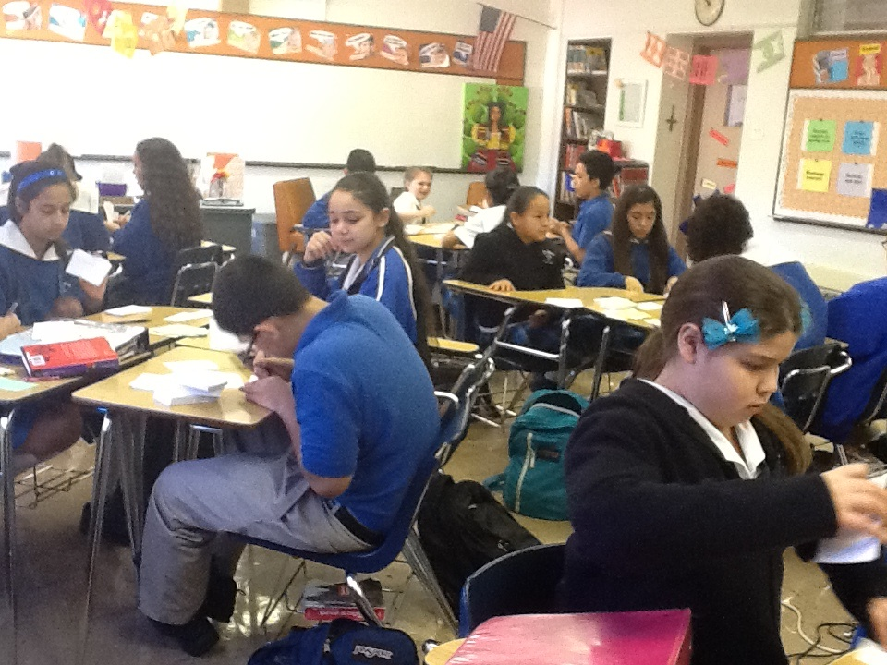
Workstations

Slide 22
My Goal for All Stations
Reading and/or Writing
No Grading
Never Ending
Easy For Me
Practice for Them

Slide 23
Buddy Reading Station
Yup, they read together. It’s more fun.

Slide 24
Computer Station
Tumble Books, Starfall, ABC Mouse, iStation, etc.

Slide 25
Advanced Computer Station
Reading/Writing Games, Research Projects, Webquests, etc.
http://clinton.k12.wi.us/maptest_sites/map_reading_rit.html

Slide 26
Listening Stations
Books on “tape”

Slide 27
Making/Writing Words
Magnetic letters, playdough, stamps, etc.

Slide 28
Art Station
‘Cause it’s a good time!
(of course you’ll have to get creative to add rigor)

Slide 29
Writing Station
Write. Write. Write.
Story cubes, prompts, mailbox, wonderbox, etc. Revisers Tool Box has some cool stuff.

Slide 30
Comprehension Stations
Examples from my 2nd Grade Class

Slide 31
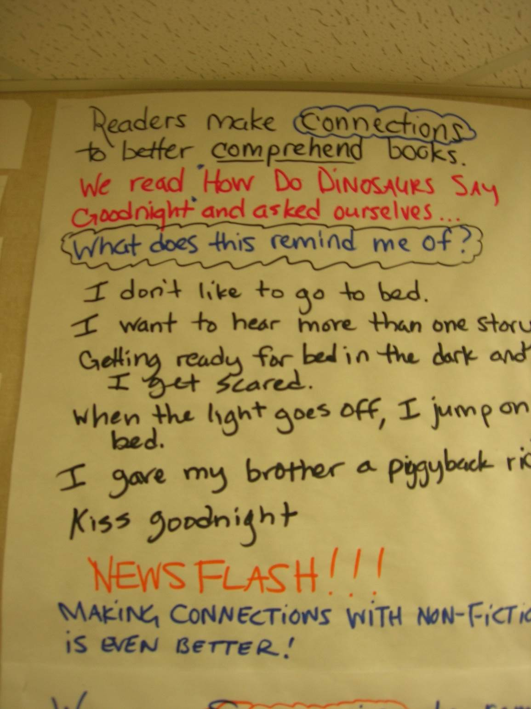

Slide 32
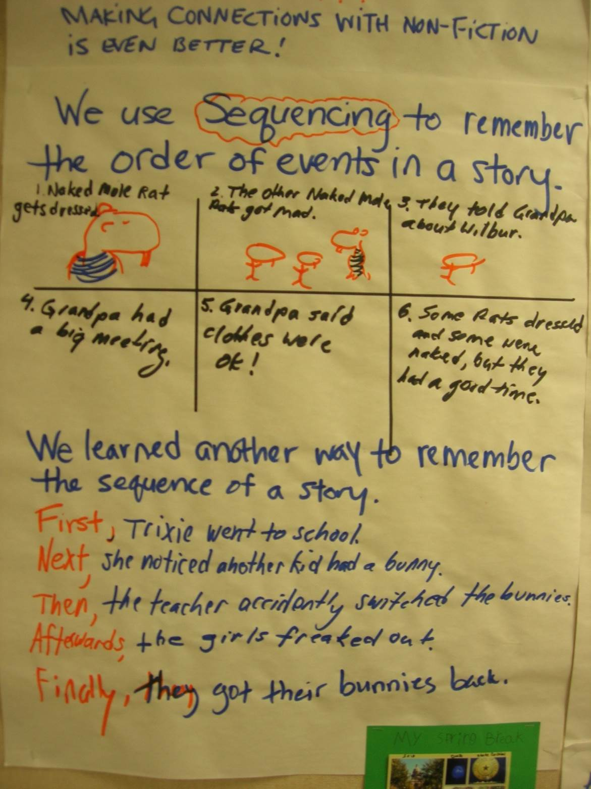

Slide 33
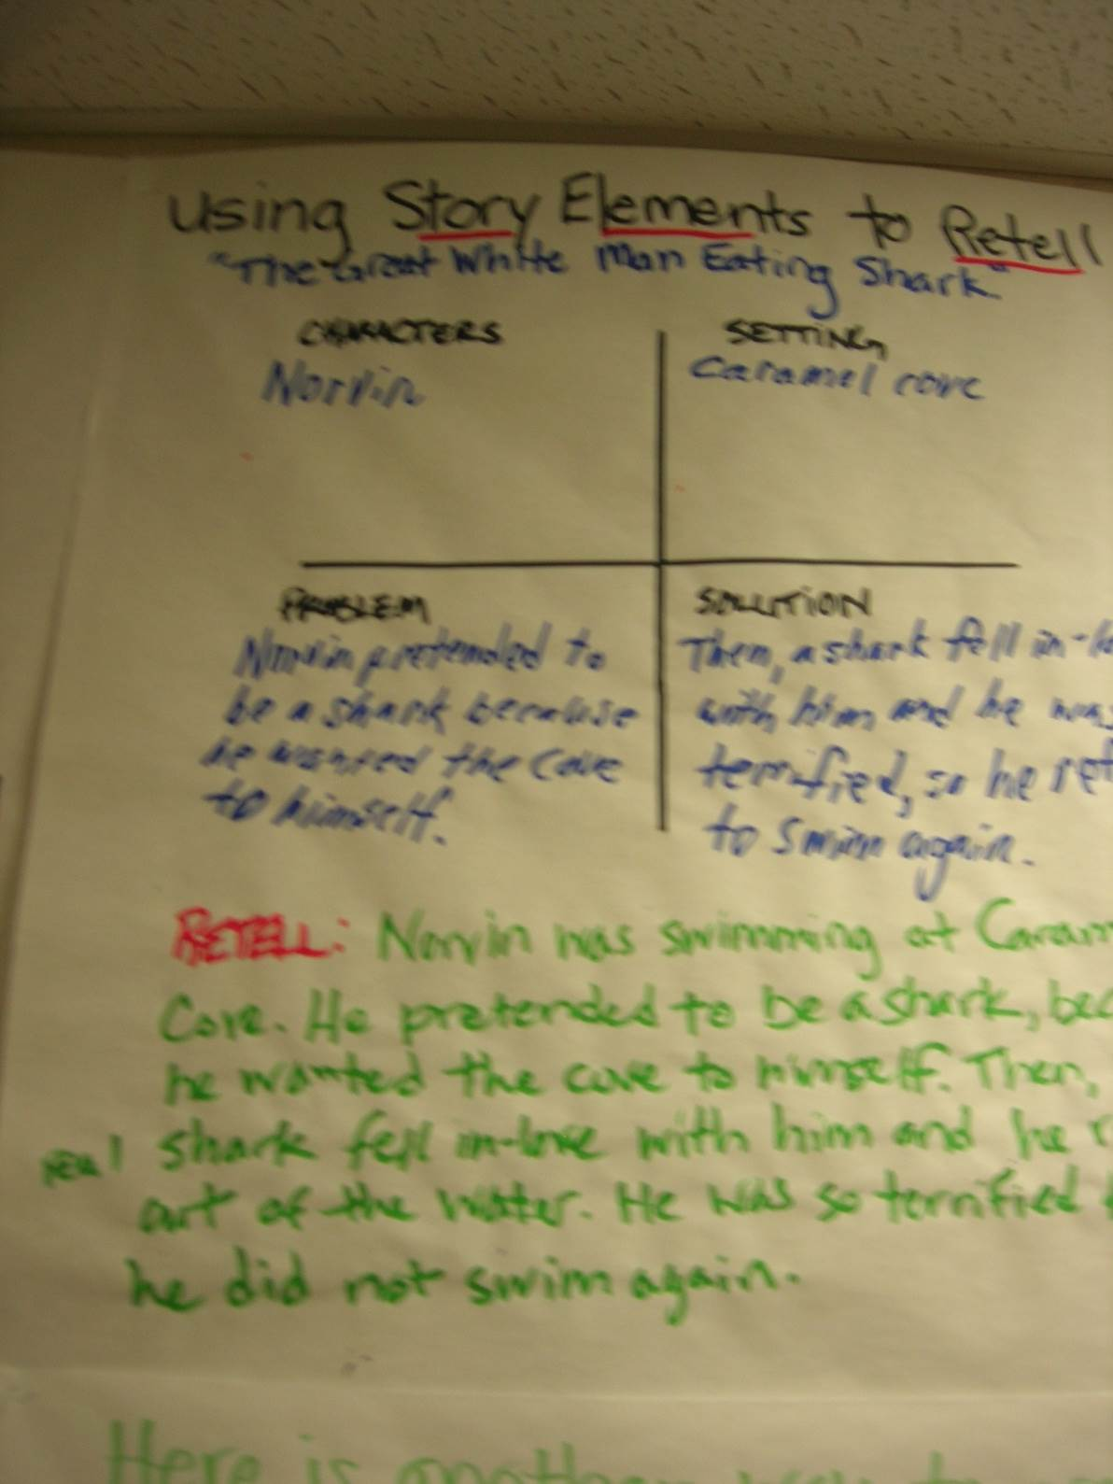

Slide 34
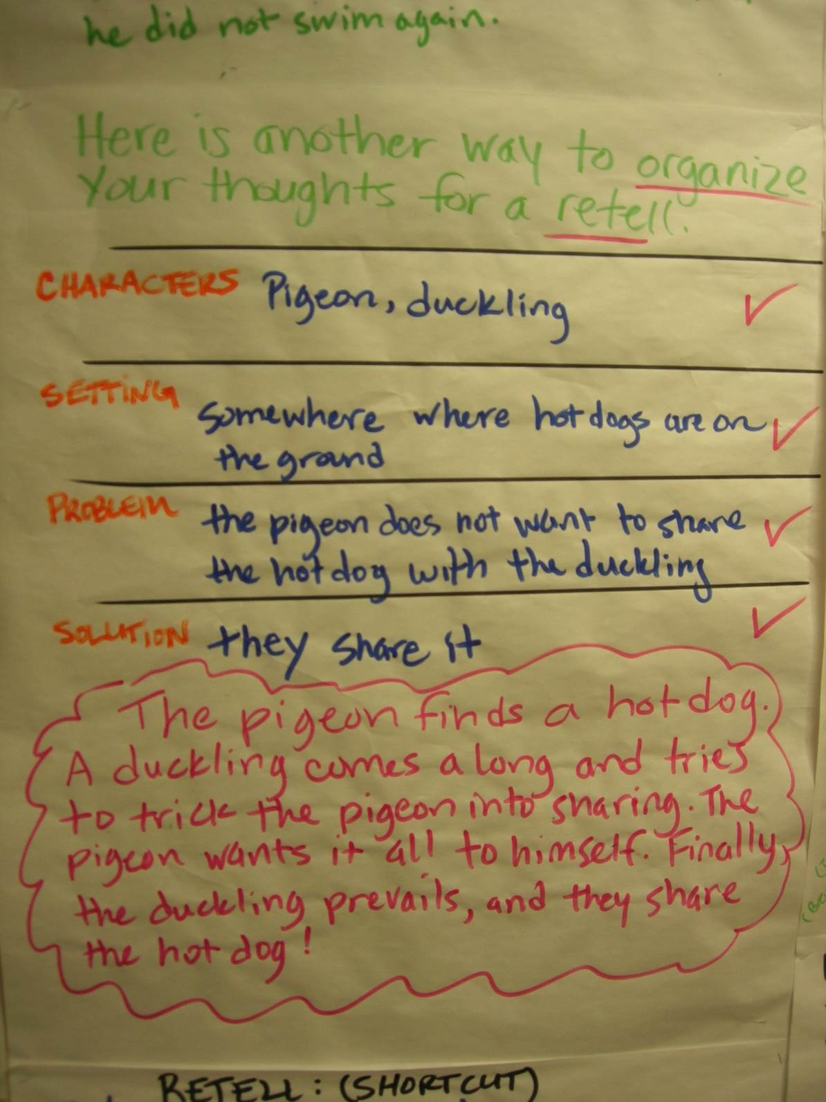

Slide 35
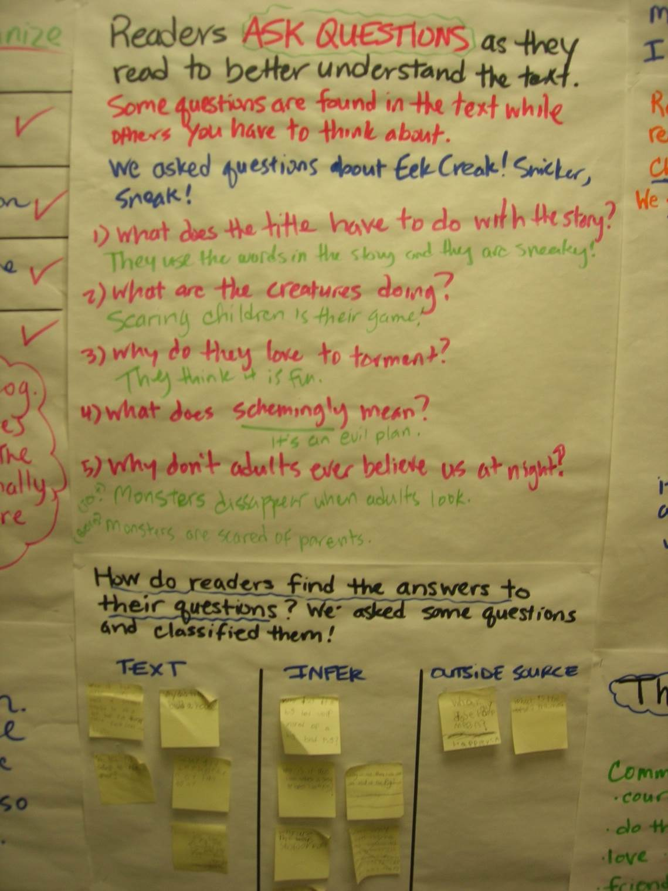

Slide 36
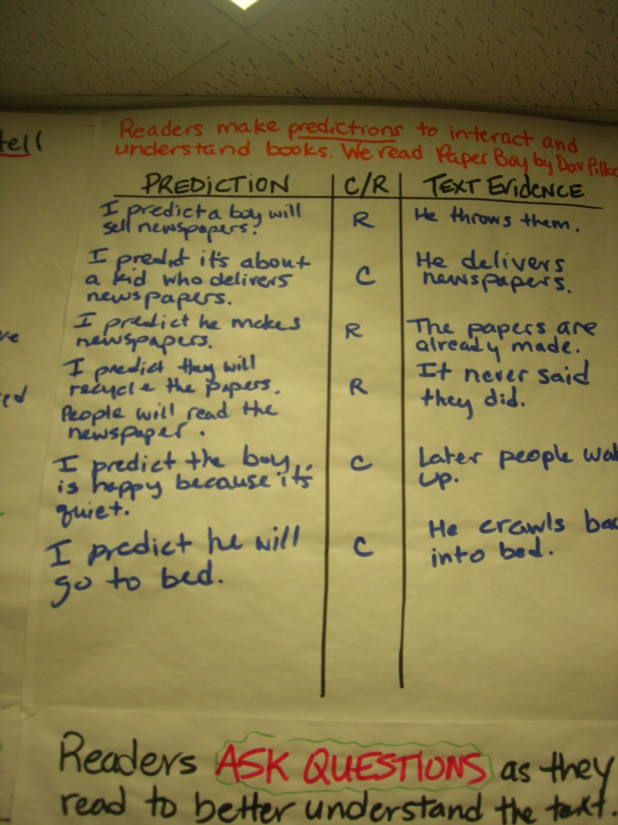

Slide 37
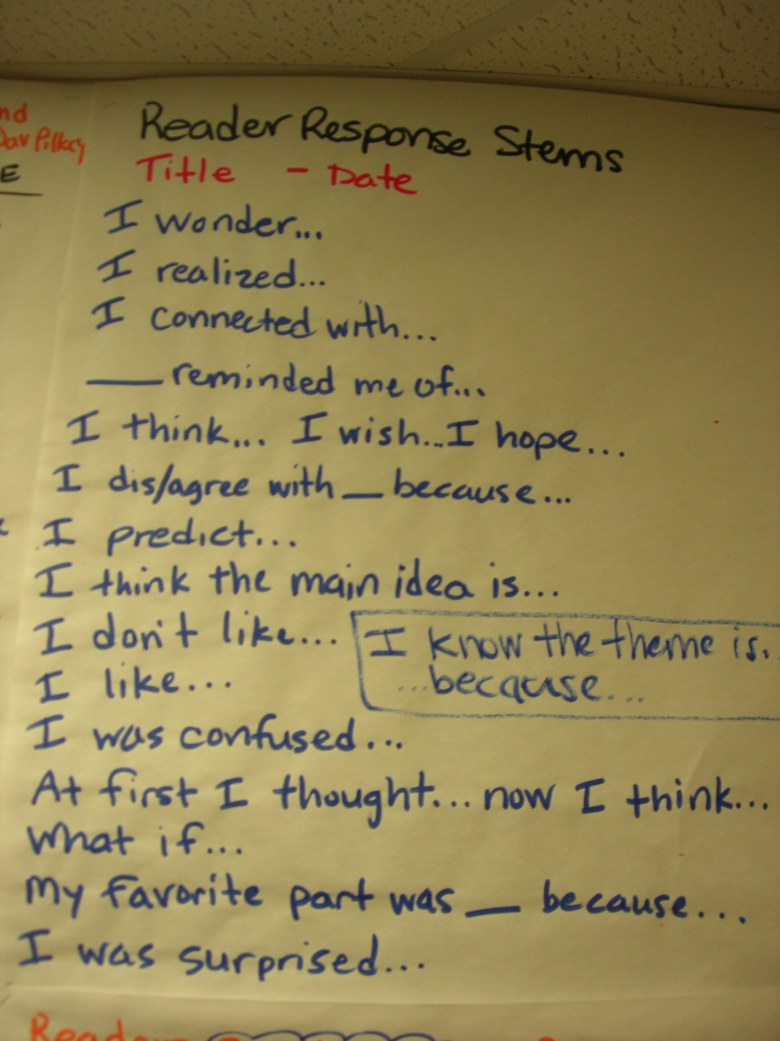

Slide 38
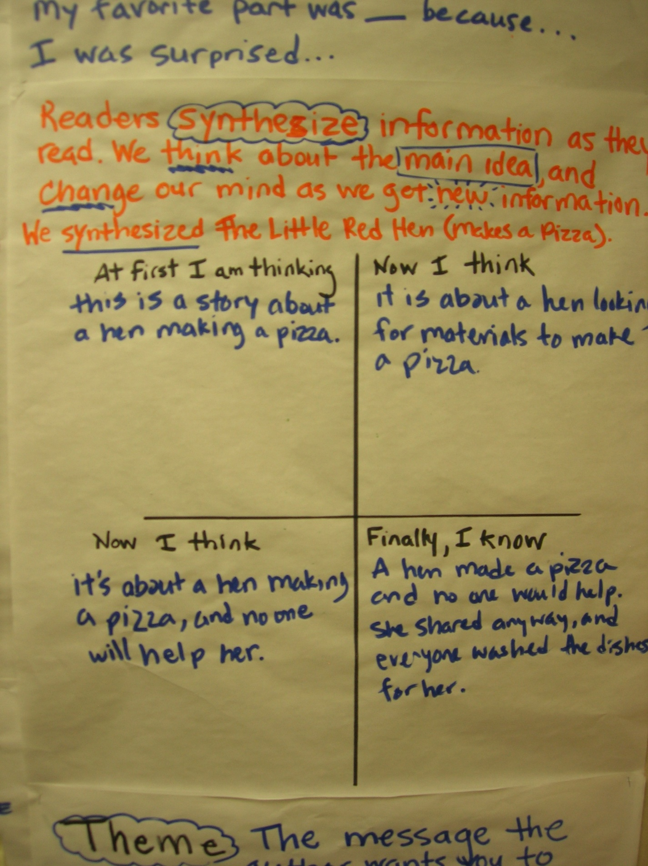

Slide 39
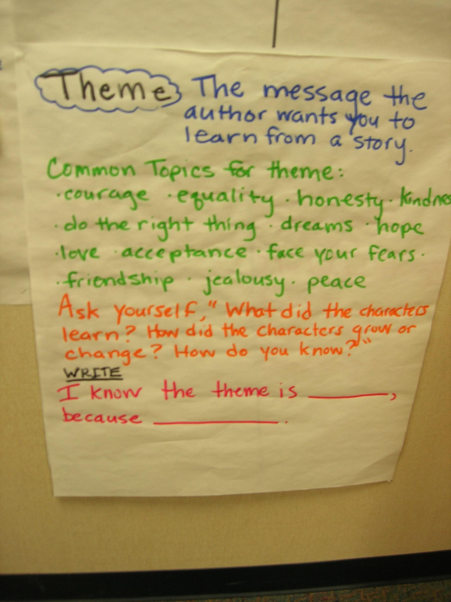

Slide 40
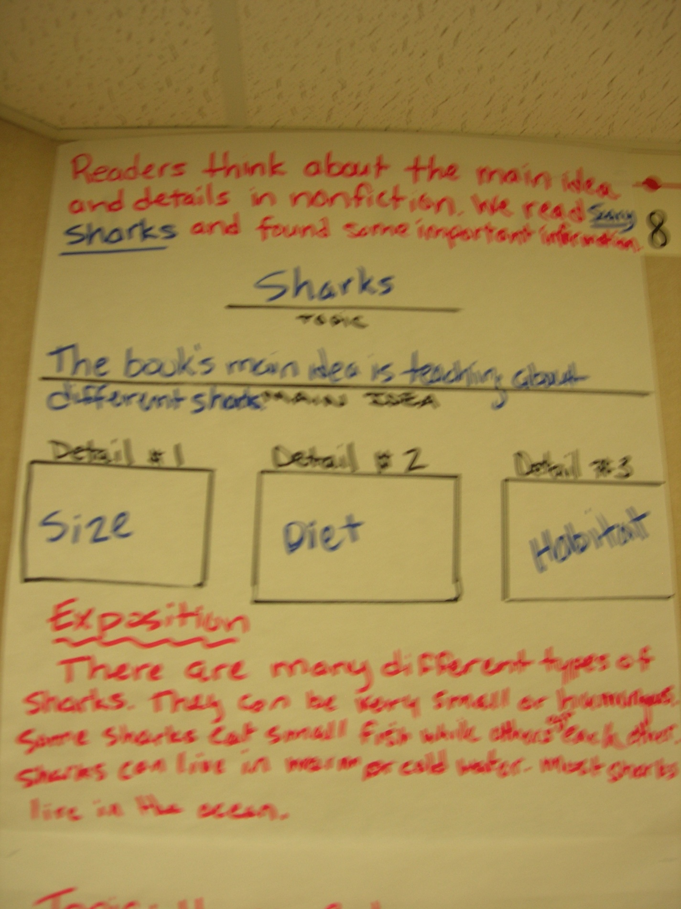

Slide 41
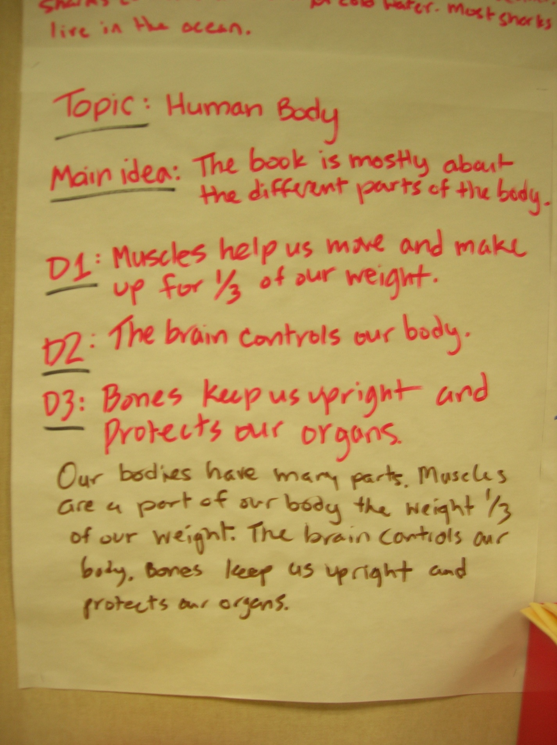

Slide 42
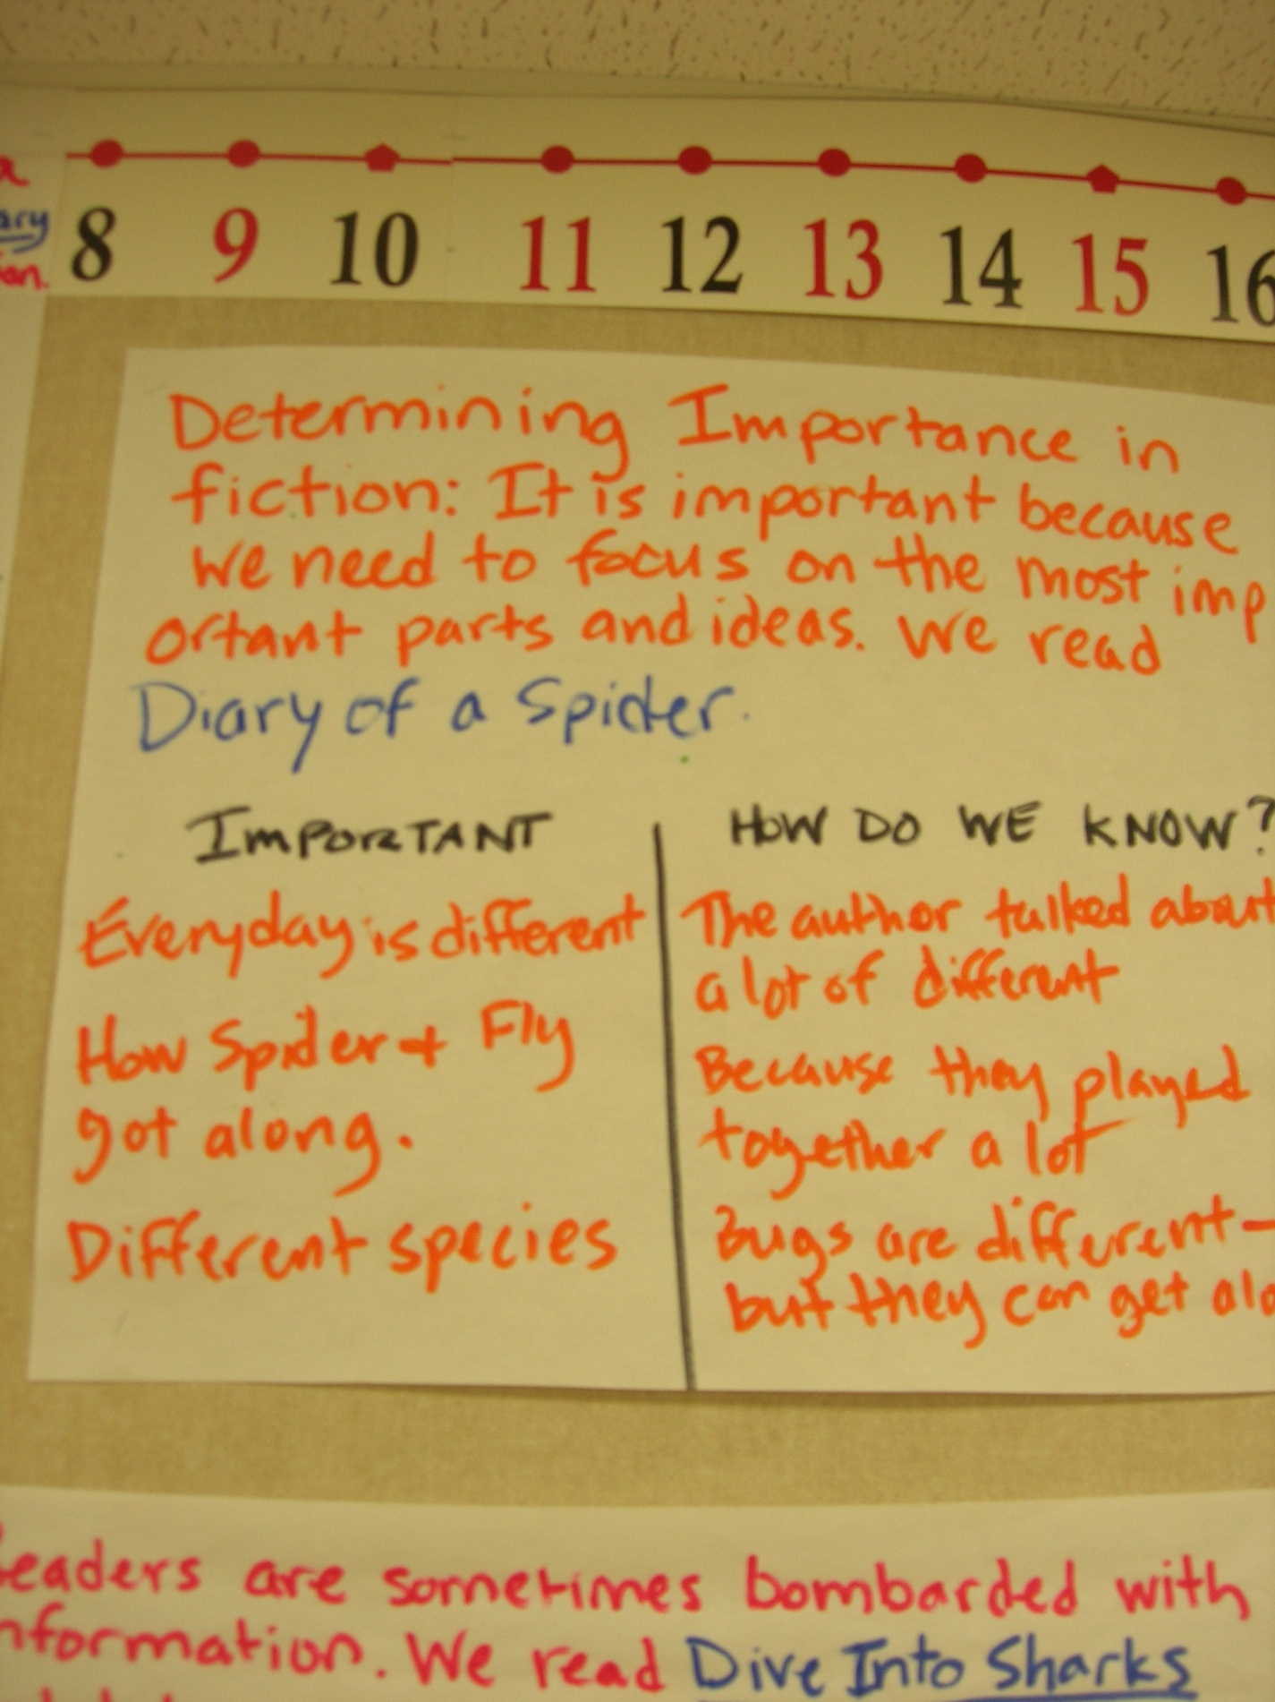

Slide 43
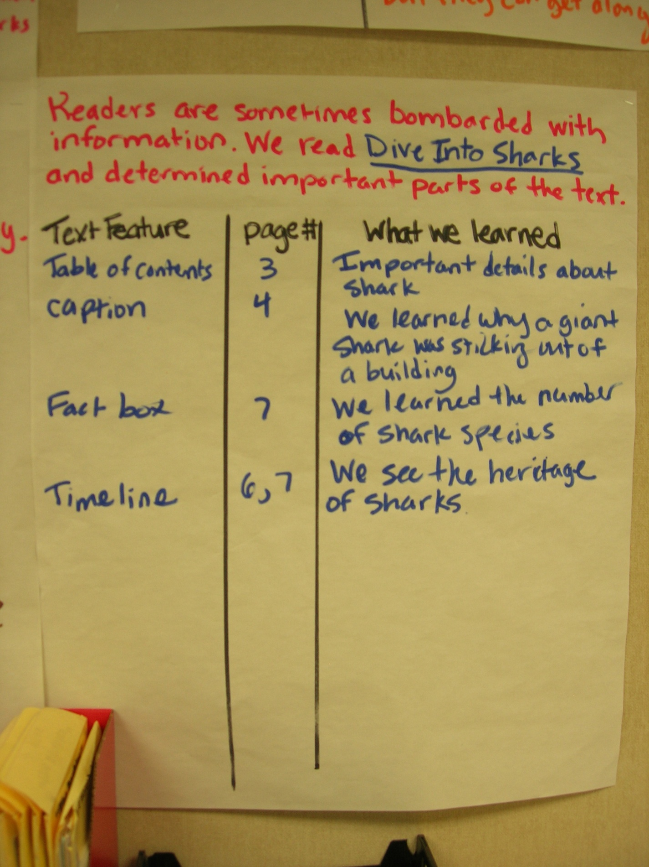

Slide 44
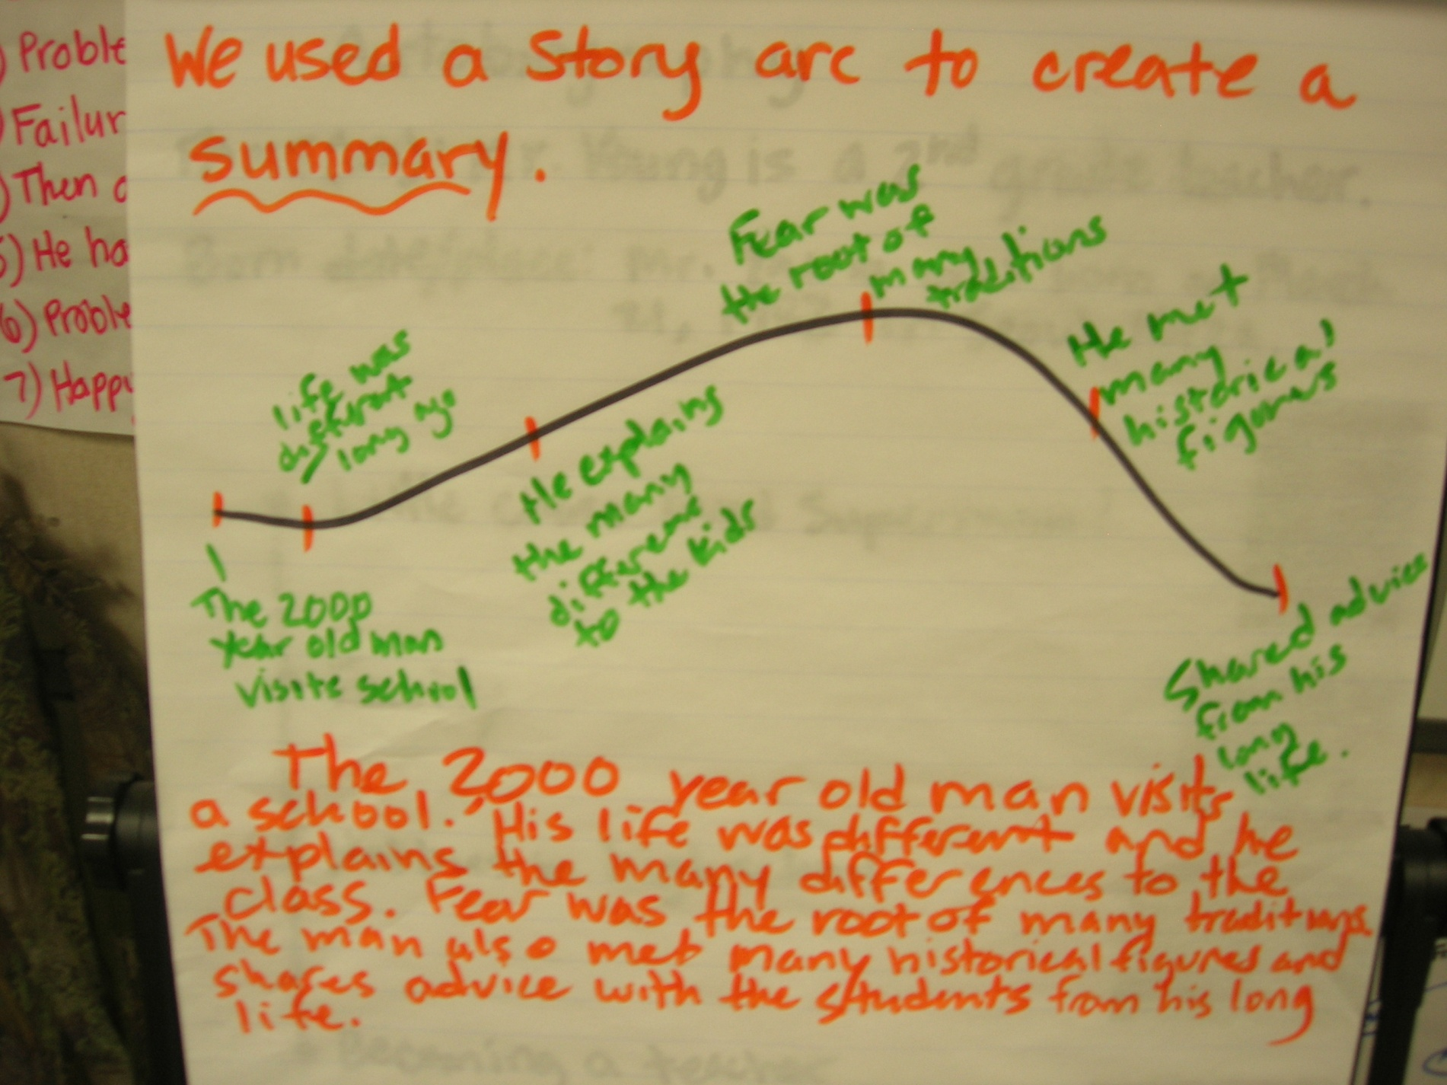

Slide 45
Add Rigor and Complexity
Use the objectives from Thinking Beyond and About the Text
For example…

Slide 46
Critique
Research the author’s qualifications to write nonfiction
or
Assess whether a text is authentic and consistent with life experience or prior knowledge

Slide 47
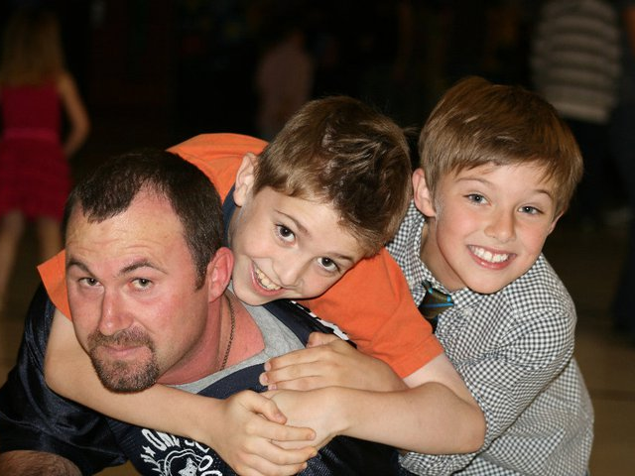

Questions?

Slide 48
Literature Circles?
Candid Camera

Slide 49
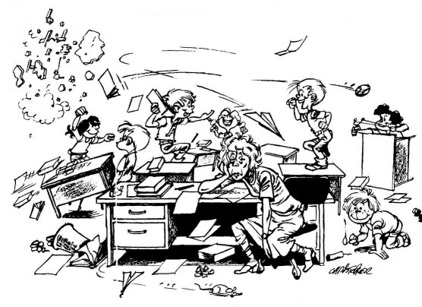
The Problem

Slide 50
MY Question
How did students facilitate peer-led literature circle discussions?

Slide 51
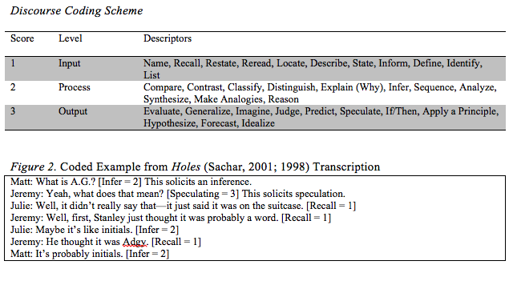
Calculating QVE

Slide 52
Qualitative Results
The researcher observed students facilitating discussions in five ways:
Exploratory Talk
  Asking questions that are open ended that expect high-level responses and statements that allow for debate
Elaborative Feedback
  Agreeing or disagreeing and providing reasoning or text evidence
Topic Management
  Introducing important topics and big ideas as well as changing topic through facilitation
Confessionals
  Admitting when meaning breaks down and asking for help from group members
Accountability
  Making sure all group members participate and back up their contributions and questions with text-evidence

Slide 53
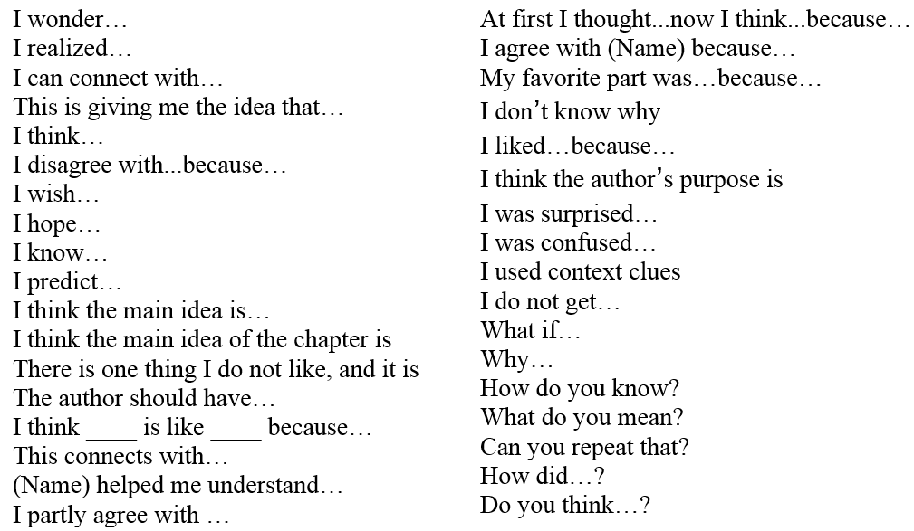

Slide 54
Example Discussions
4th graders tackling tough topics

Slide 55
Example Routine
Read, Question, Discuss, Respond, Share

Slide 56
Great for ELL Classrooms
Anansi the Spider

Slide 57
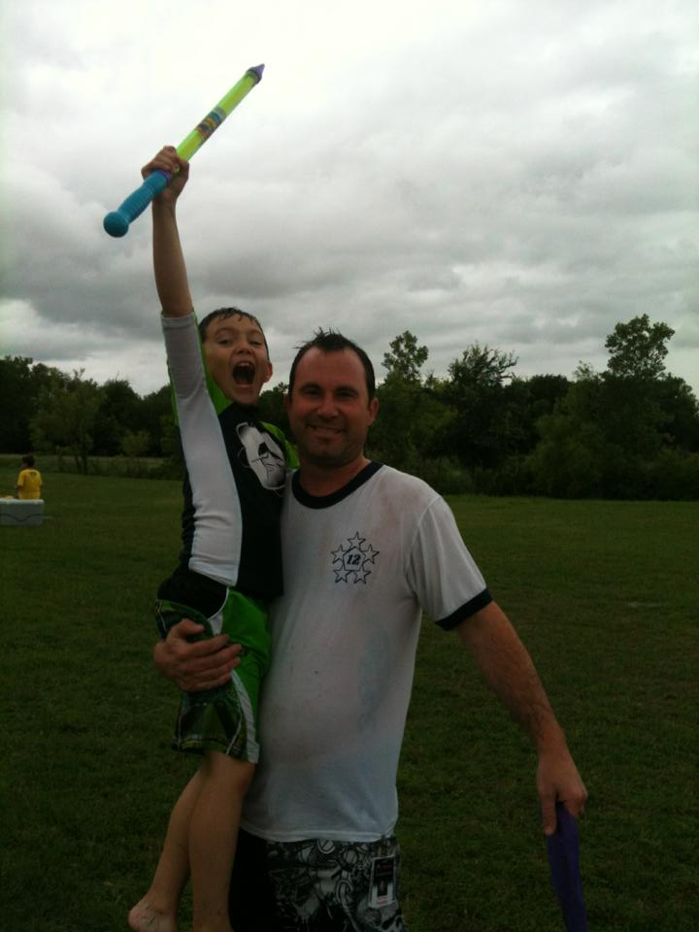
Questions?

Slide 58

Thebestclass.org

Slide 59
The Five Day Format (Young & Rasinski, 2009)
Day 1: Read scripts and form groups
Day 2: Focus on word recognition
Day 3: Focus on expressive reading
Day 4: Practice Performance
Day 5: Performance
      Your Turn!

Slide 60
There Was An Old Woman – 4 Parts
Narrator 1: There was an old woman
Who lived in a shoe;
Narrator 2: With so many children,
What else could she do?
Narrator 3: Their home had no windows,
No doors, and no locks—
Narrator 4: The kids were all happy
But smelled like old socks.

Slide 61
Pee Ew! Is That You Bertie?
Readers Theater Performance

Slide 62
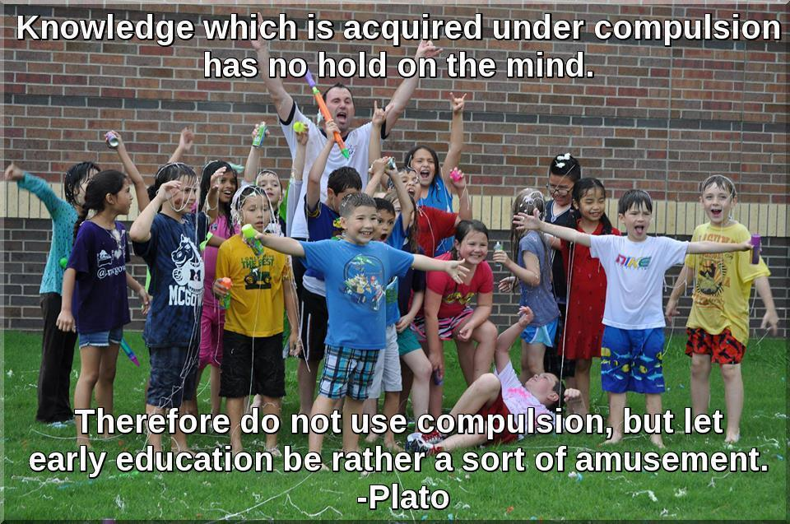
chaseyoung@shsu.edu www.thebestclass.org
Q&A

