Slide 1
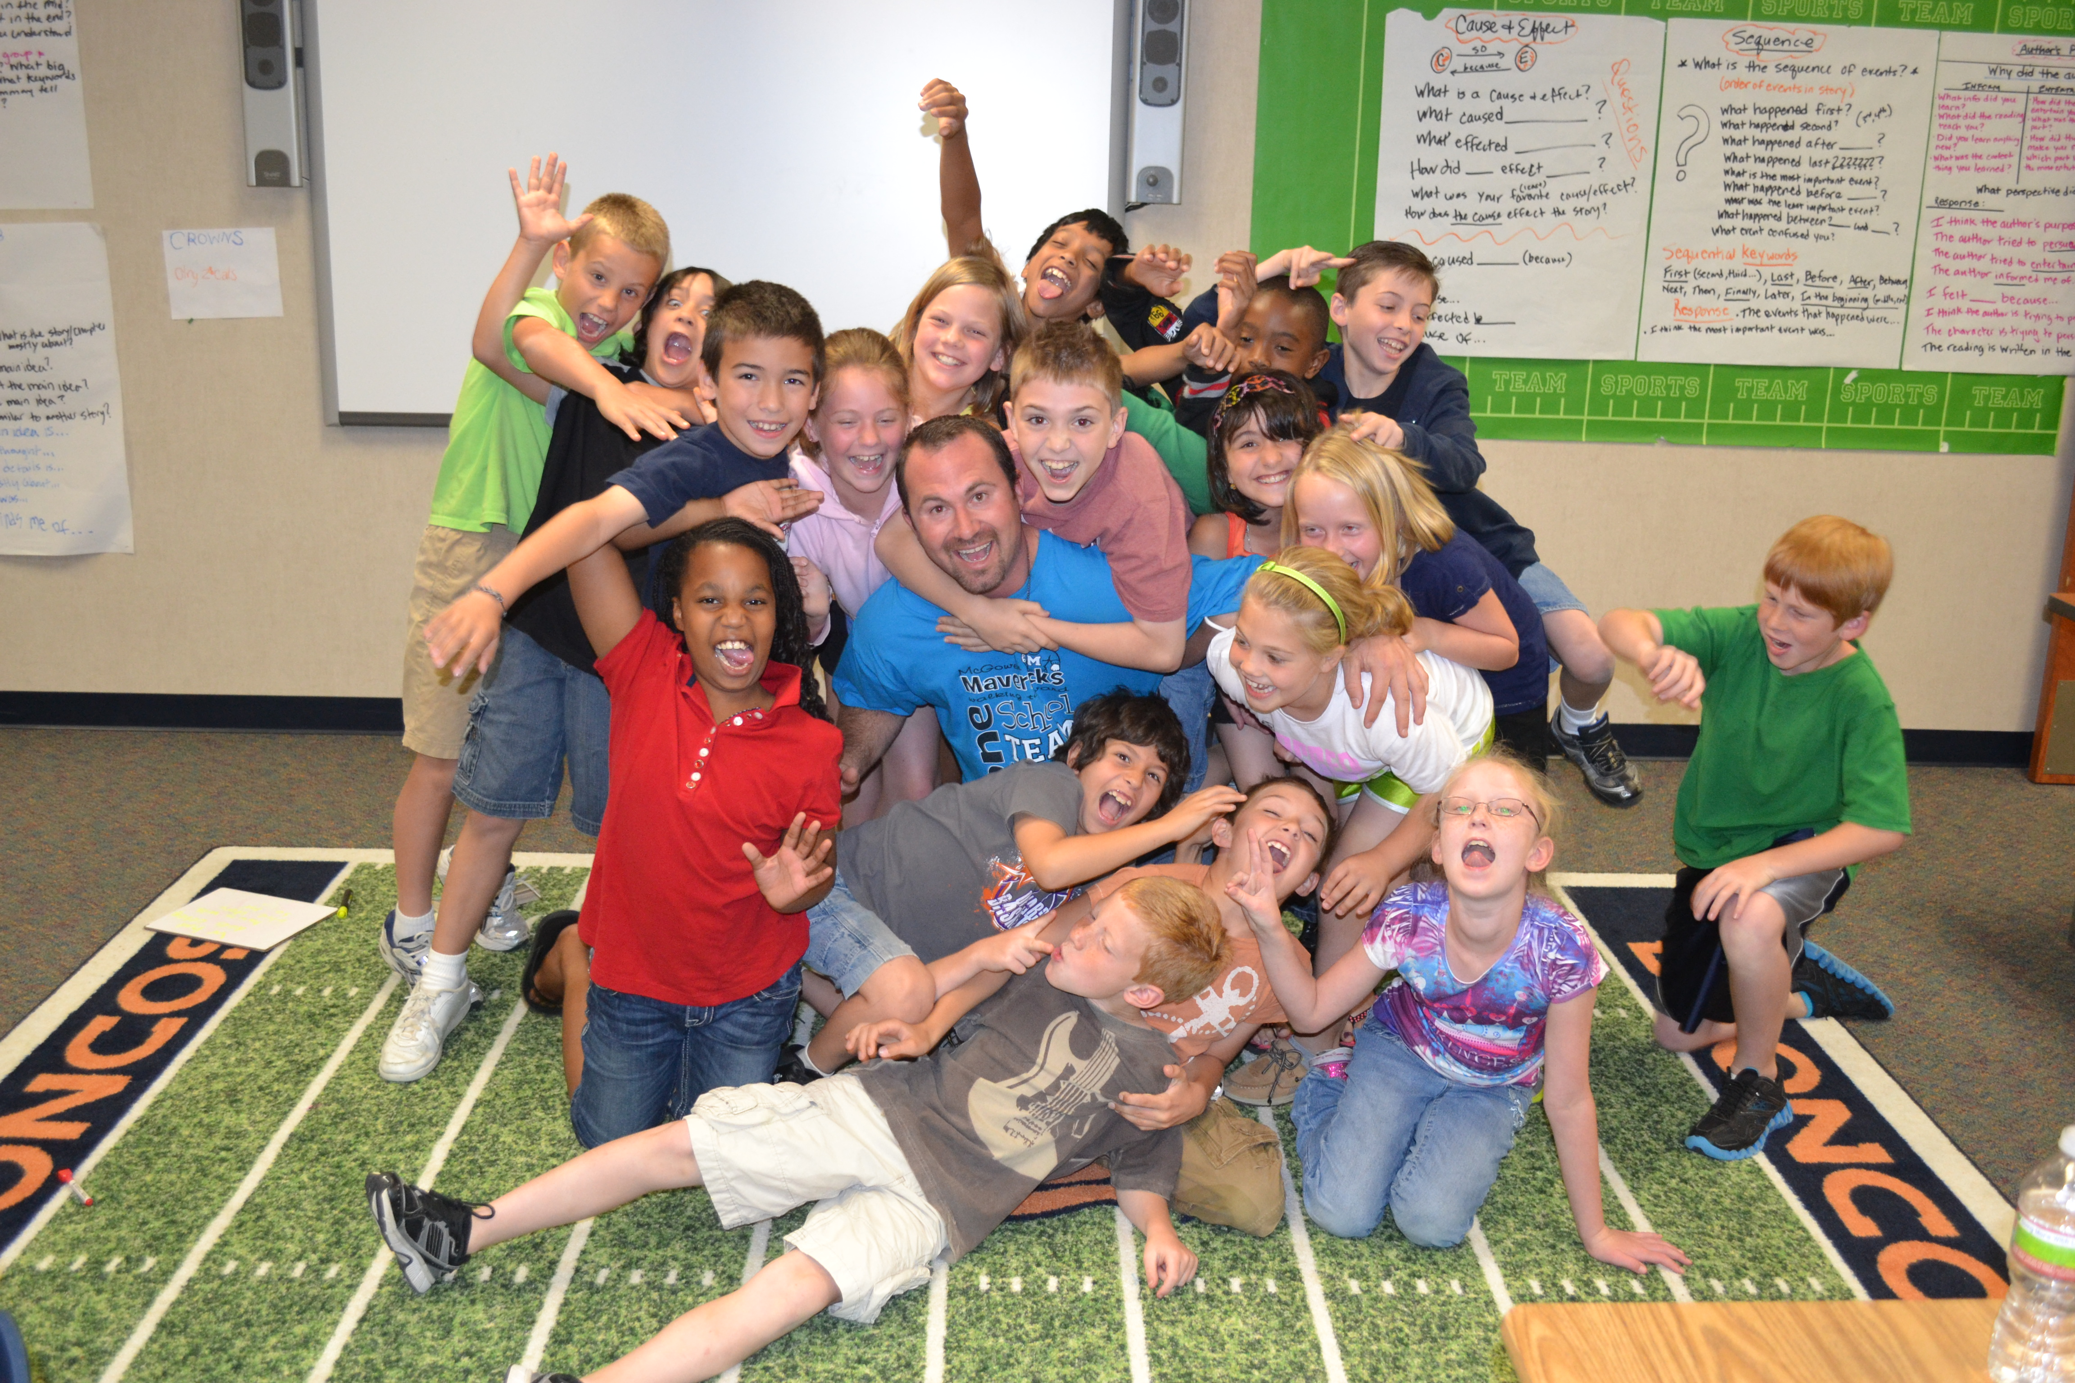

UNBALANCED LITERACY
Chase Young, Ph.D. – Sam Houston State University

Slide 2
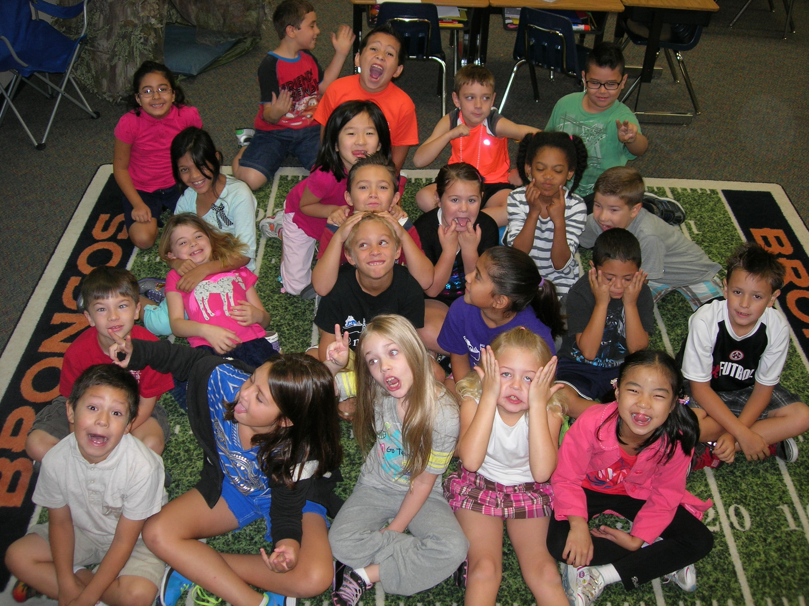
Introduction by Dylan

Slide 3
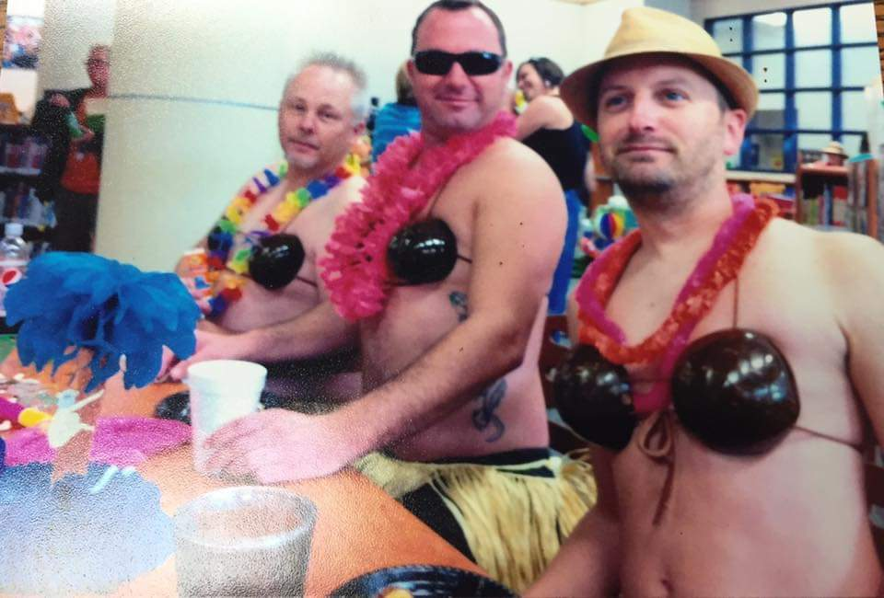

Slide 4


Slide 5
Take our Test

Slide 6
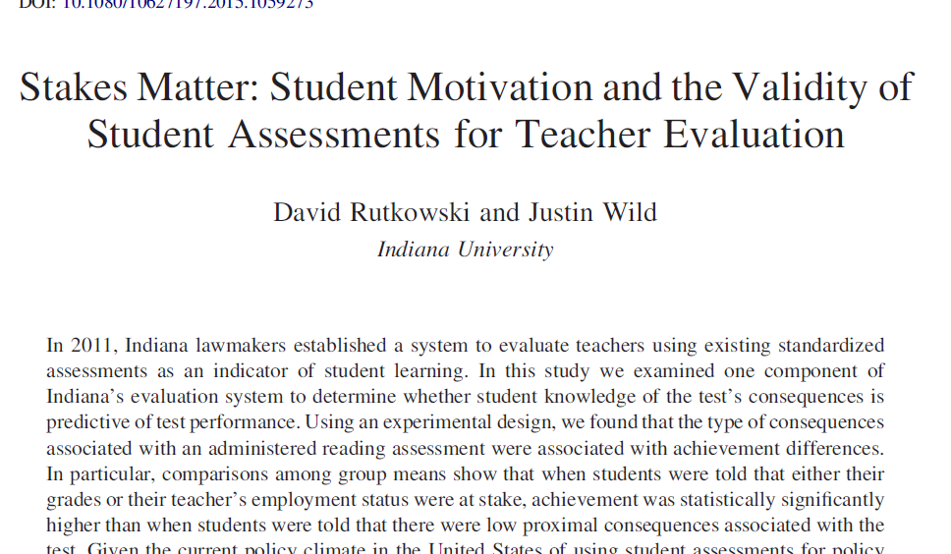

Slide 8
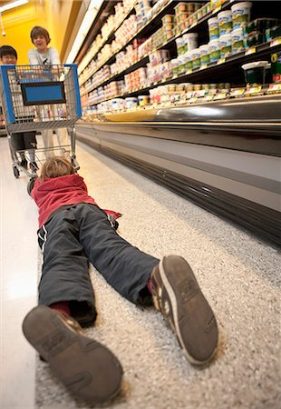
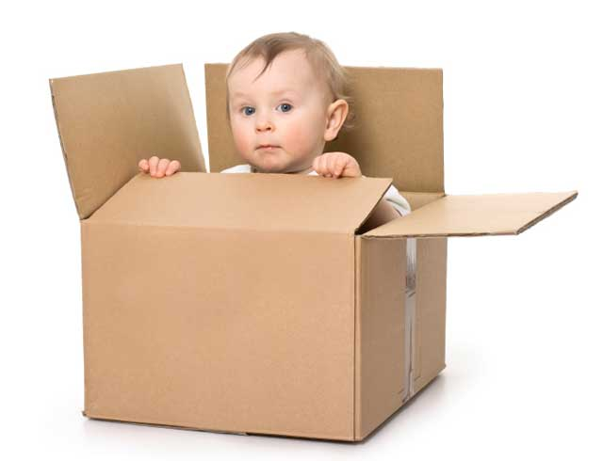
Moving Kids
The purpose of
guided reading.

Slide 9
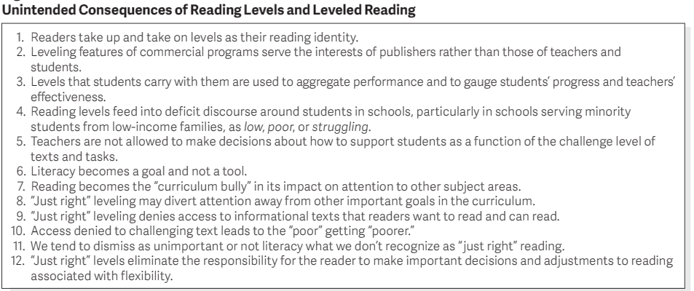

Slide 10
Let’s Practice
https://youtu.be/8_MFjDPjszE

Slide 11
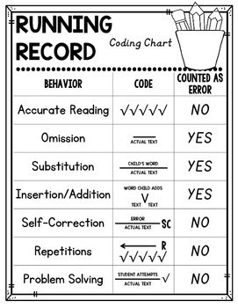
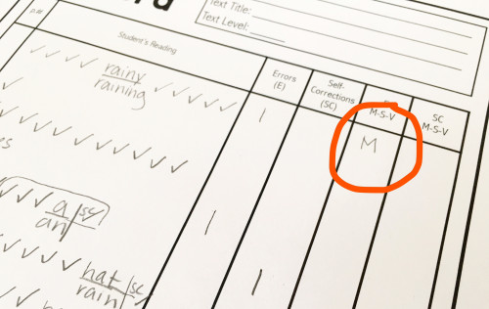

Slide 12
Talk with some people about what questions or insights you have…
I’ll know you are done when you give someone a high five and tell them they look fabulous.

Slide 13

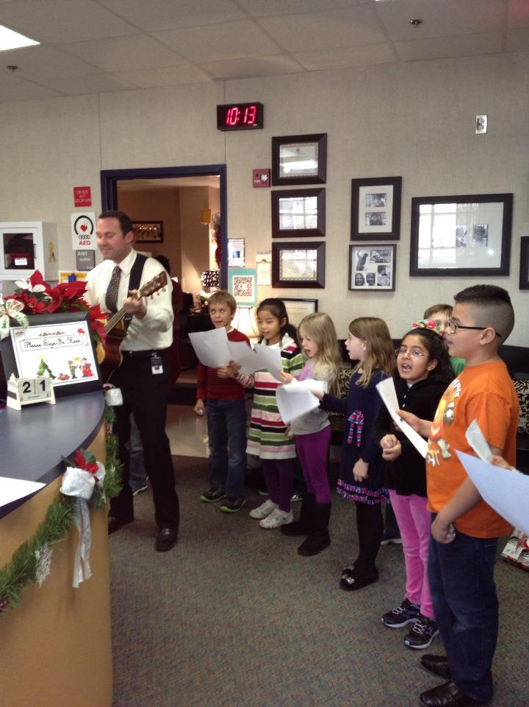
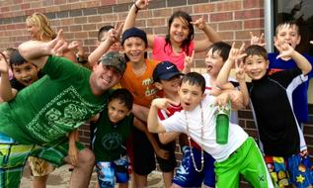
Questions?

Slide 14
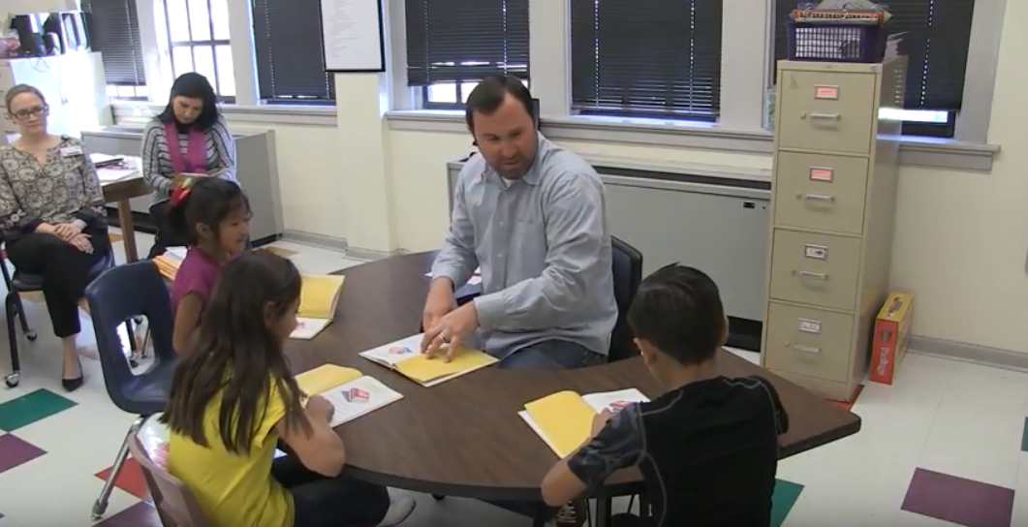
OBSERVATION
K OBSERVATION

Slide 15
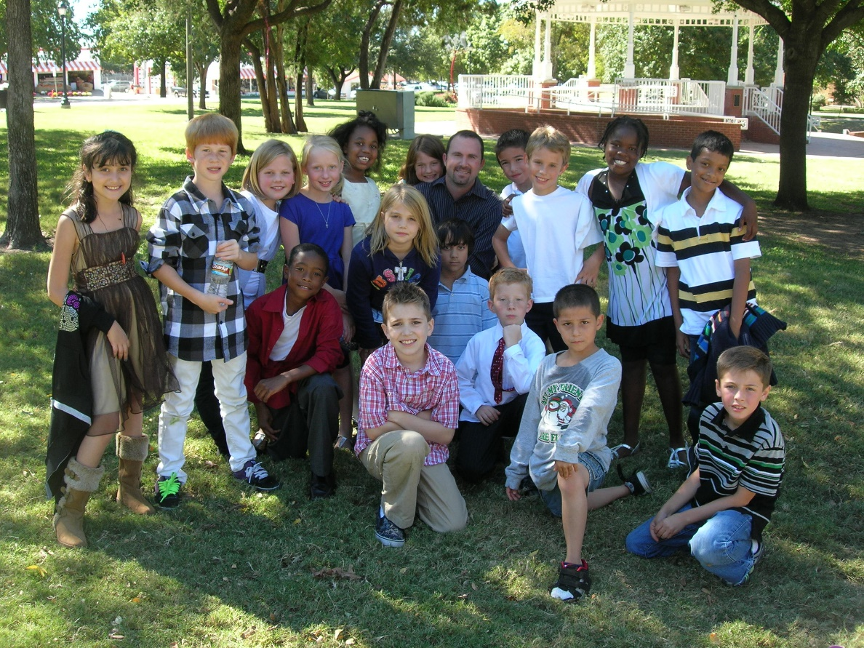
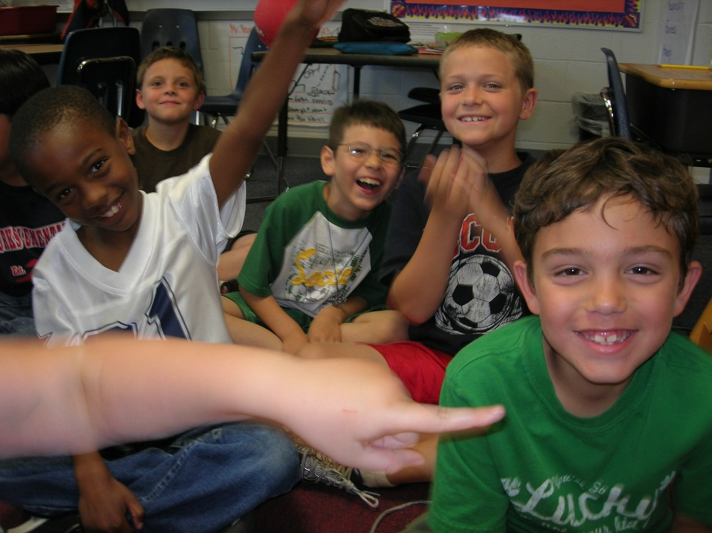
Reflections?

Slide 16
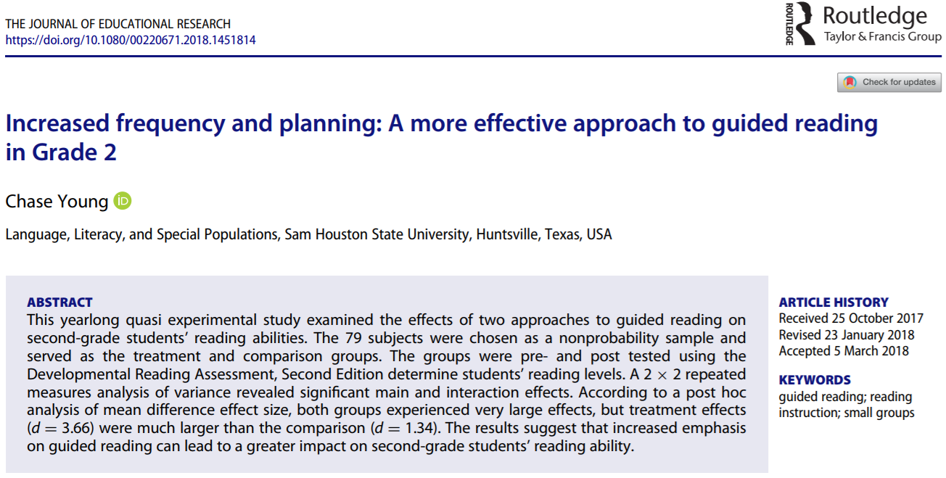

Slide 17
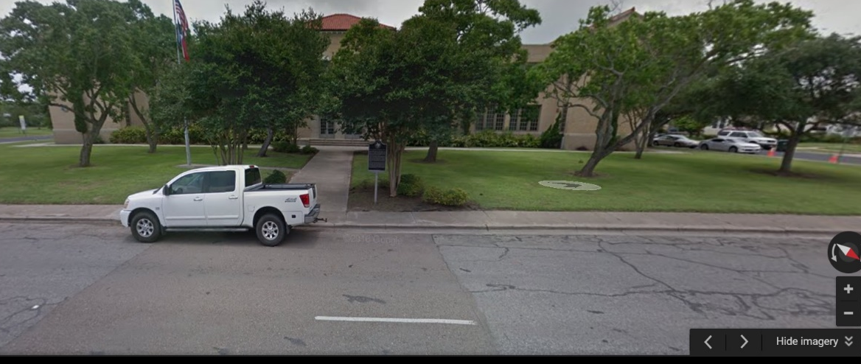

Slide 18
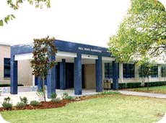
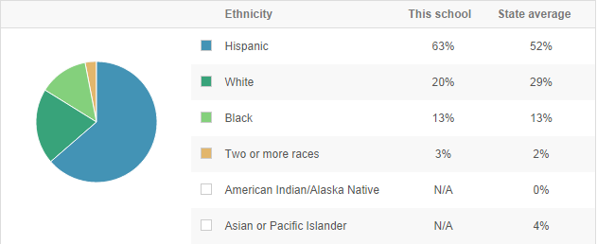
Title 1

Slide 19

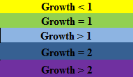
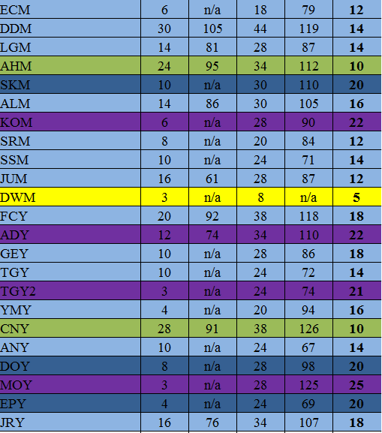
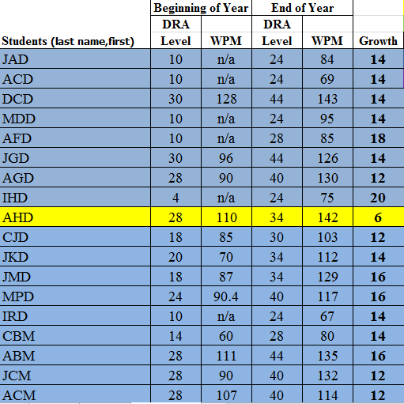

Slide 20


Slide 21
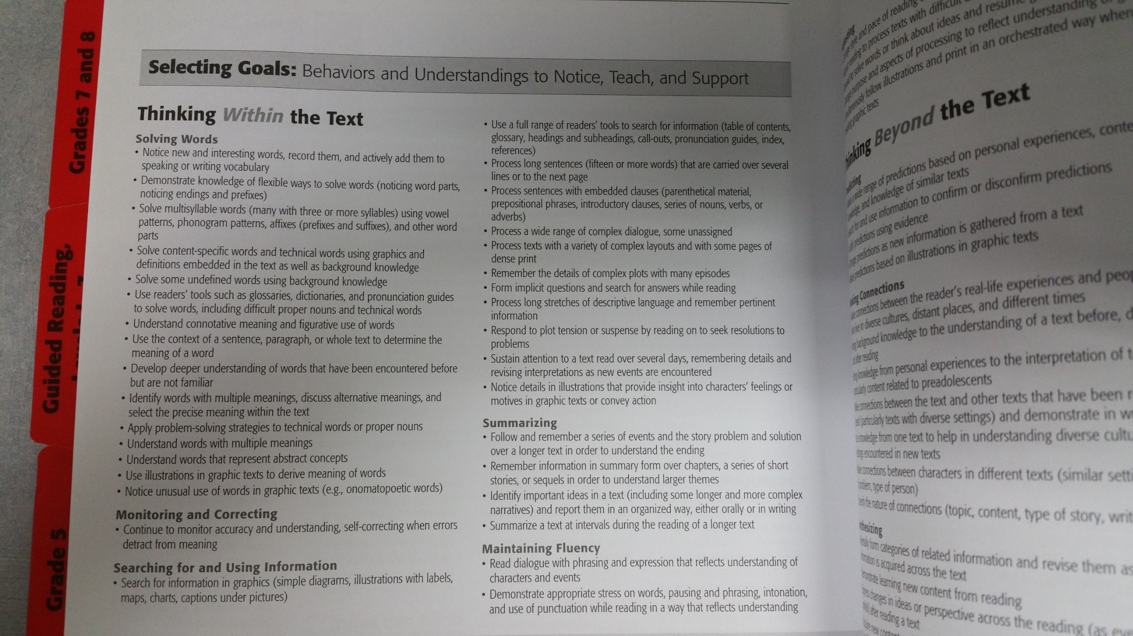

Slide 22
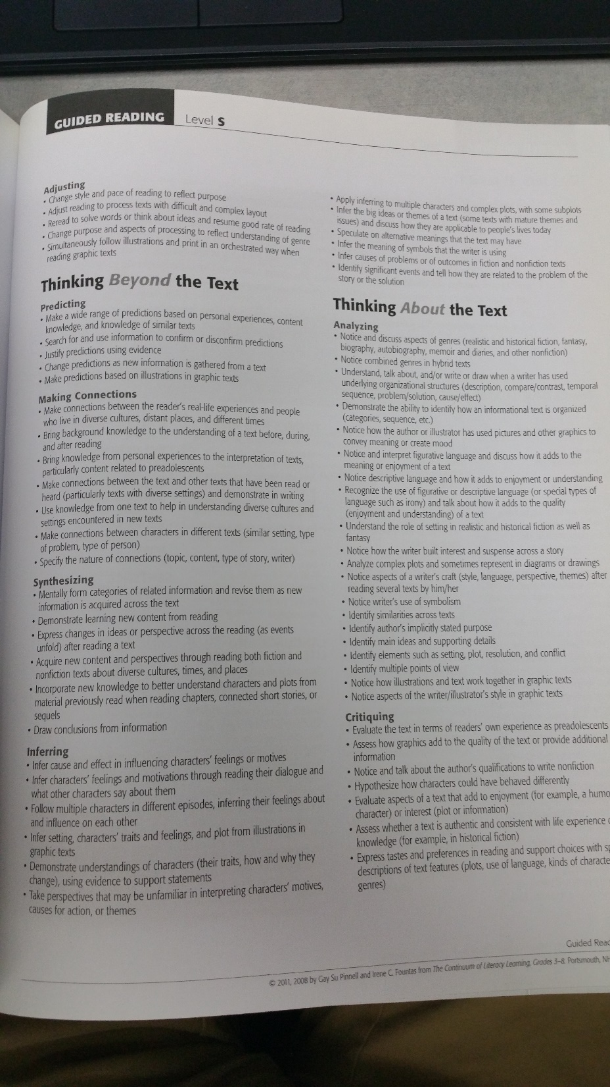

Slide 23
Creating the Lesson
www.thebestclass.org

Slide 24
Talk with some people about what questions or insights you have…
I’ll know you are done when you give someone a handshake and say, “You are an amazing teacher.”

Slide 25
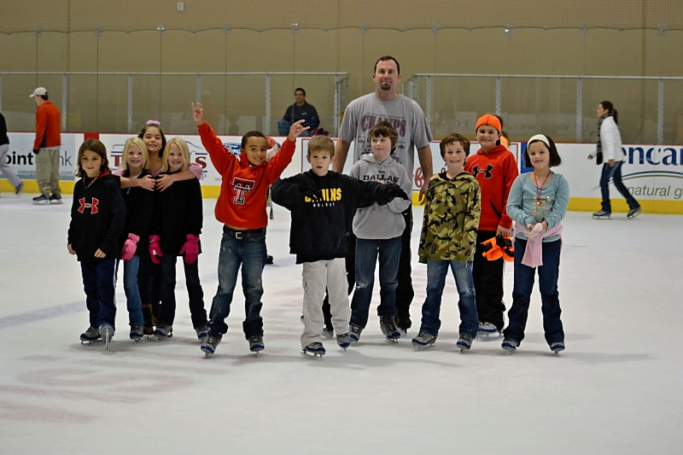
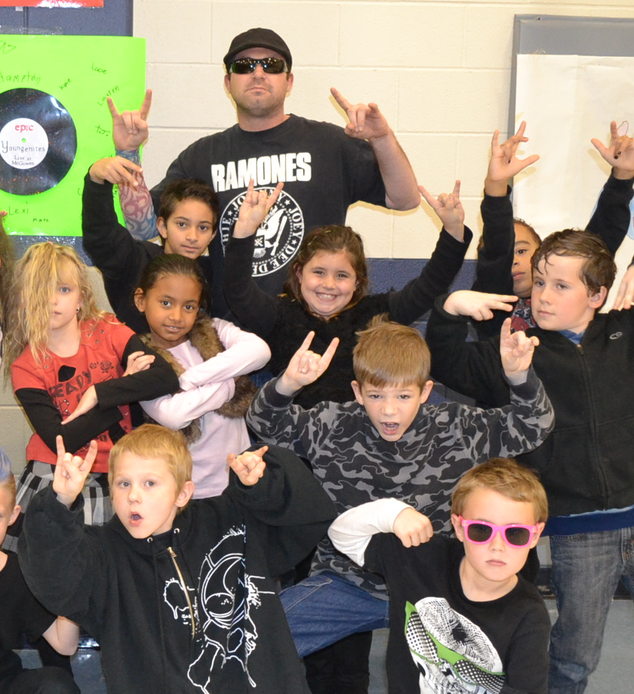
Questions?

Slide 26
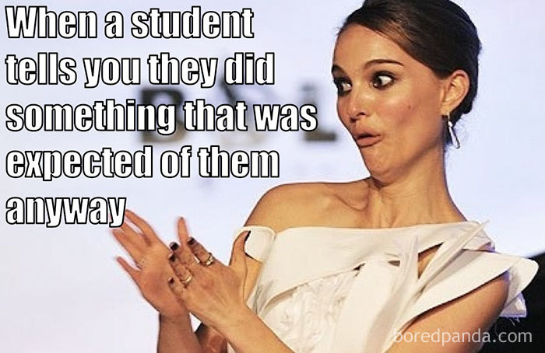

Slide 27
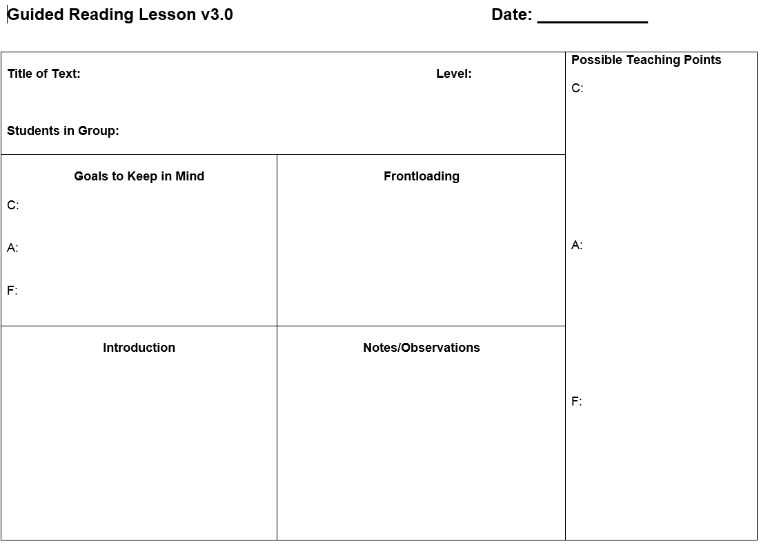

Slide 28
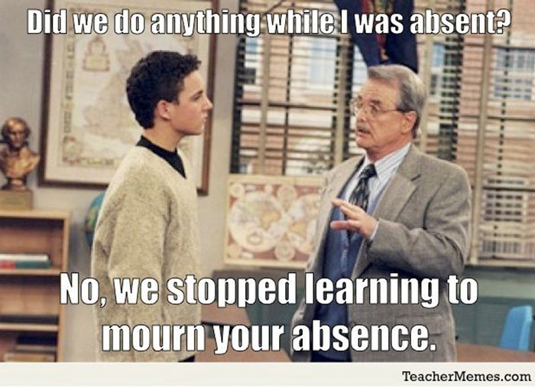

Slide 29


Slide 30
Situating Guided Reading in the BLP Classroom
Objective: Teachers will remain sane.

Slide 31


Your Choice

Slide 32
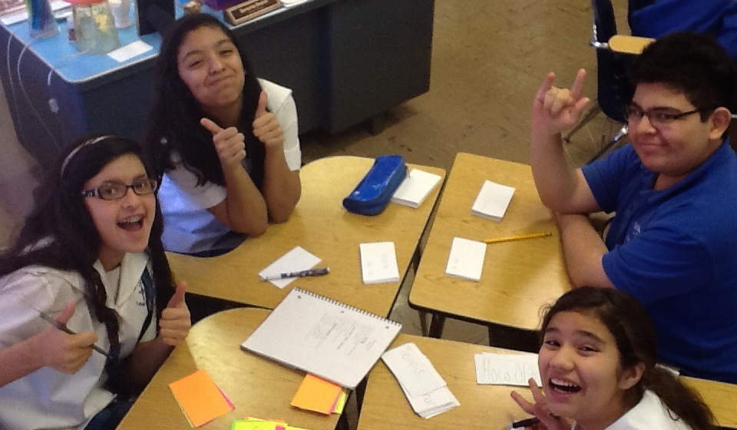
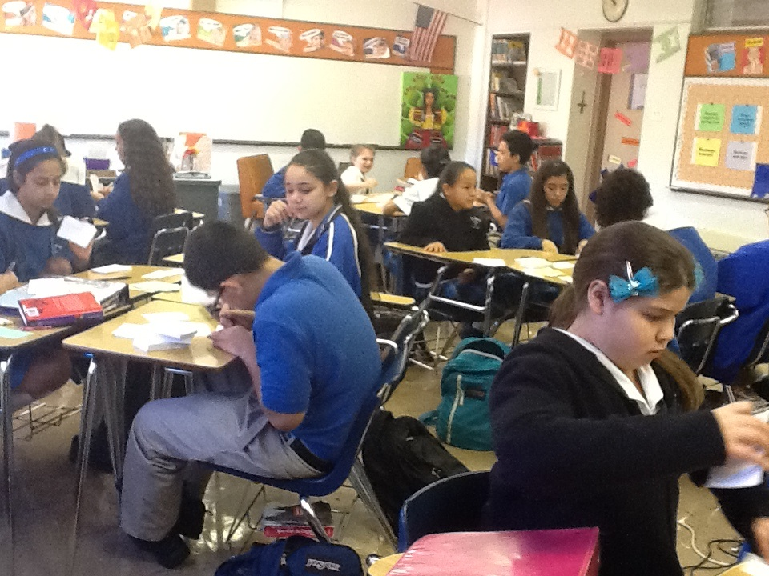
Workstations

Slide 33
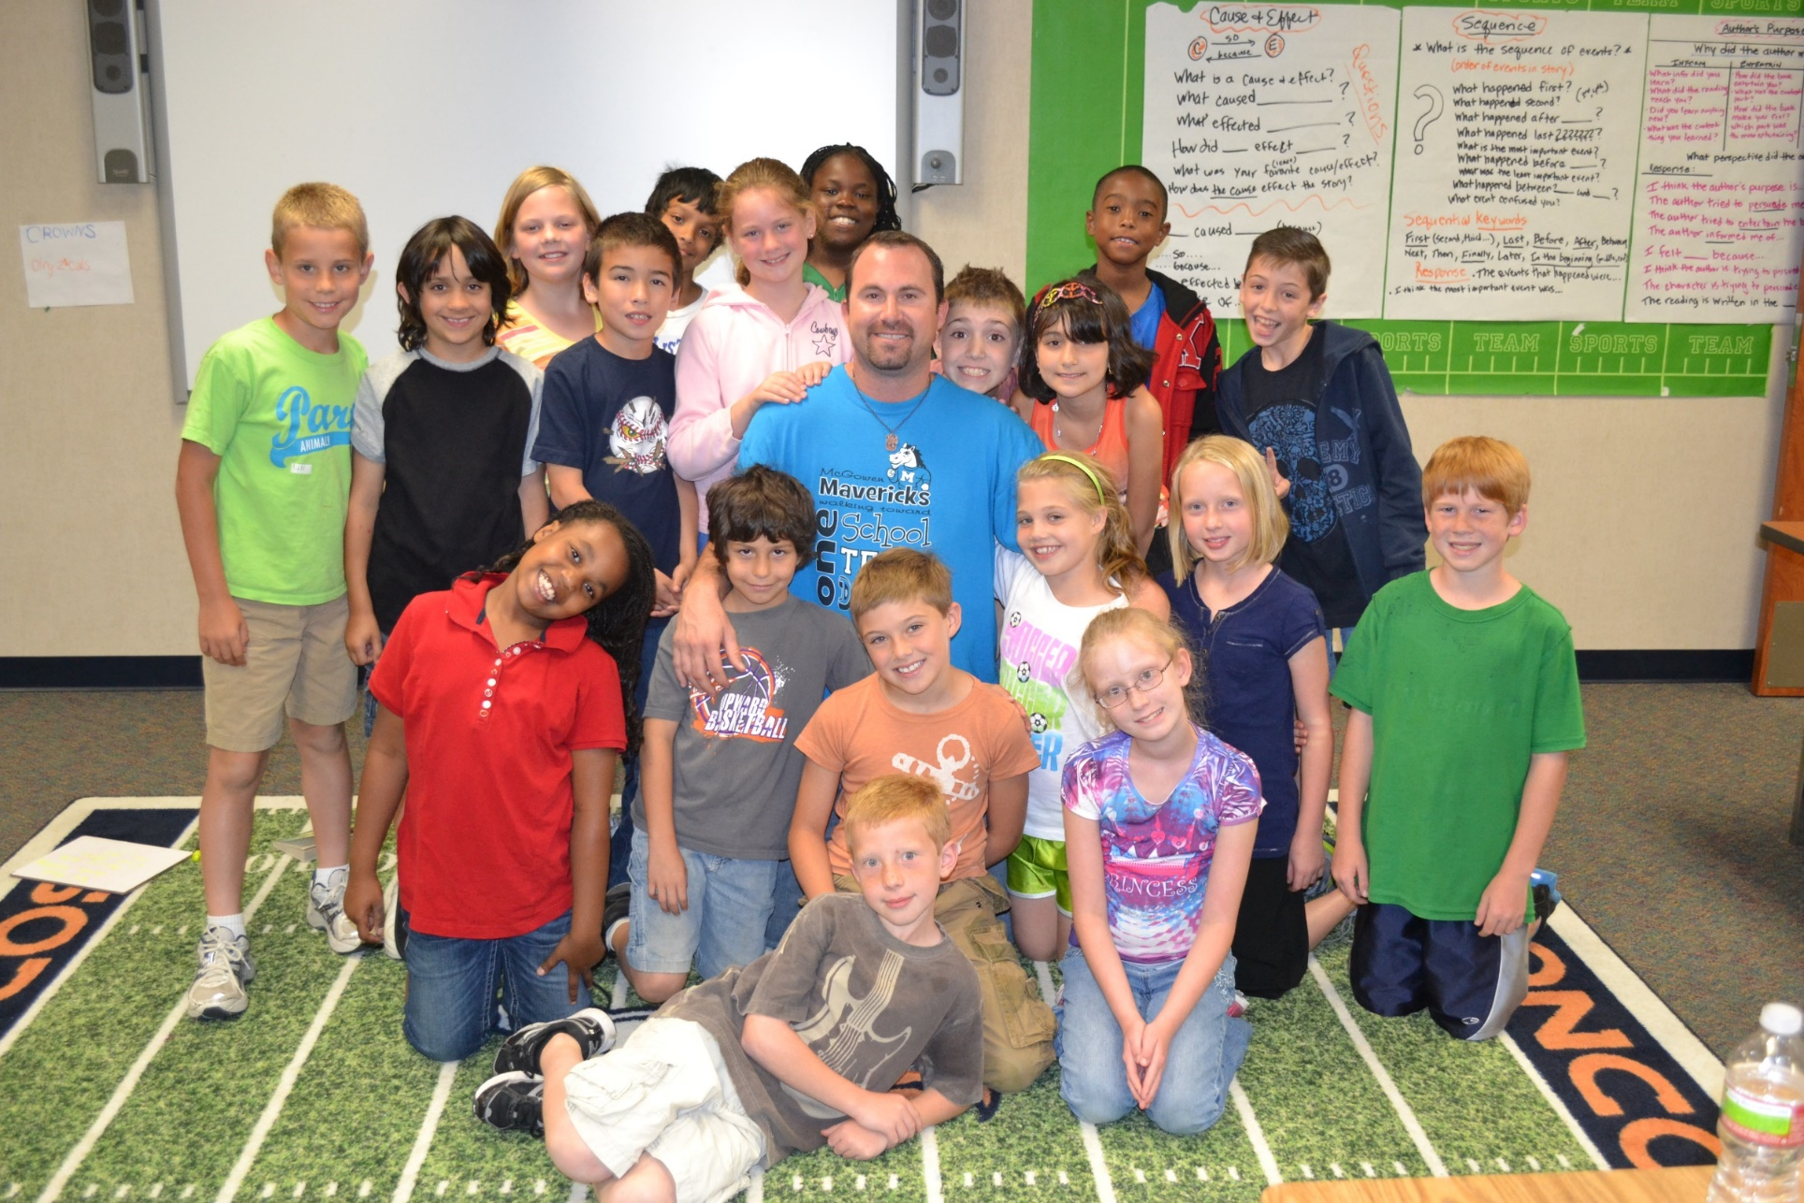
MY GOAL
Reading and/or Writing
No Grading
Never Ending
Easy For Me
Practice for Them

Slide 34
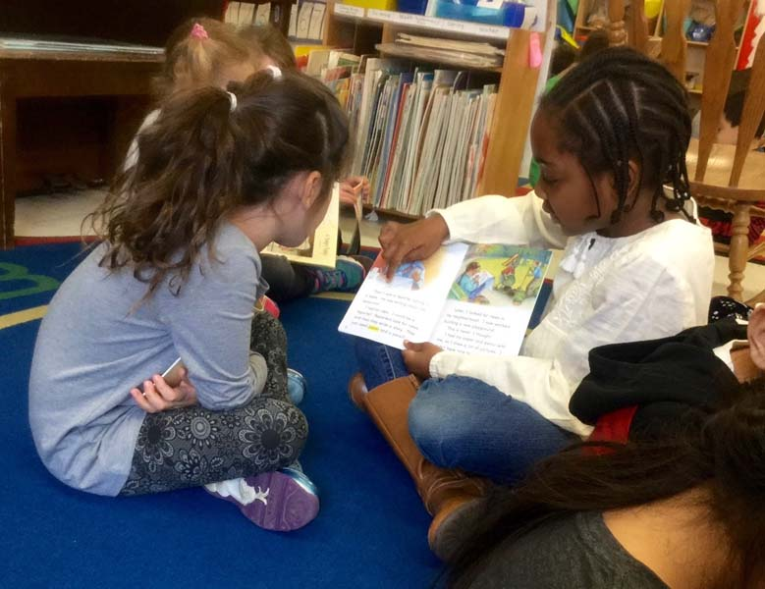
Buddy Reading Station
Yup, they read together. It’s more fun.

Slide 35

Computer Station
Tumble Books, Starfall, ABC Mouse, iStation, District stuff, AR, etc.

Slide 36

Advanced Computer Station
Reading/Writing Games, Research Projects, Webquests, etc.

Slide 37

Listening Stations
Books on “tape”

Slide 38

Making/Writing Words
Magnetic letters, playdough, stamps, word ladders, crossword puzzles, etc.

Slide 39
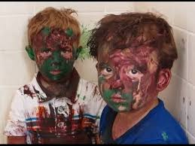
Art Station
‘Cause it’s a good time!
(of course you’ll have to get creative to add rigor)

Slide 40
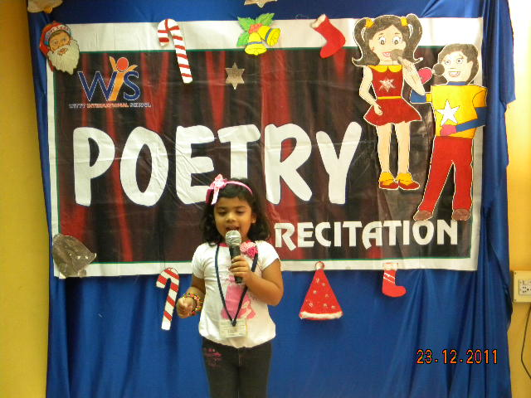
Poetry Station
Rehearse and recite poetry

Slide 41
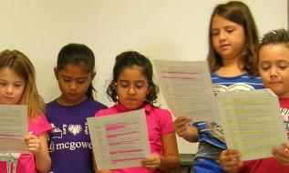
Readers Theater
Groups rehearse and perform scripts (more on this later)

Slide 42
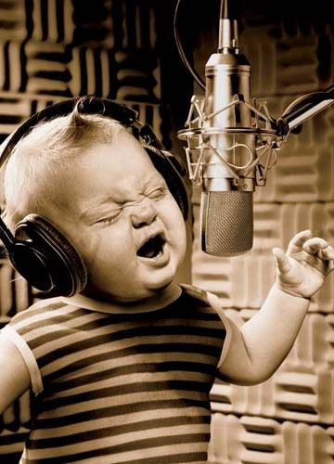
Song Writing
Yeah, about anything. One time I had a social studies theme. Here’s an example…
We also had a rolling potty break song…we loved it. Everyone else hated it.

Slide 43
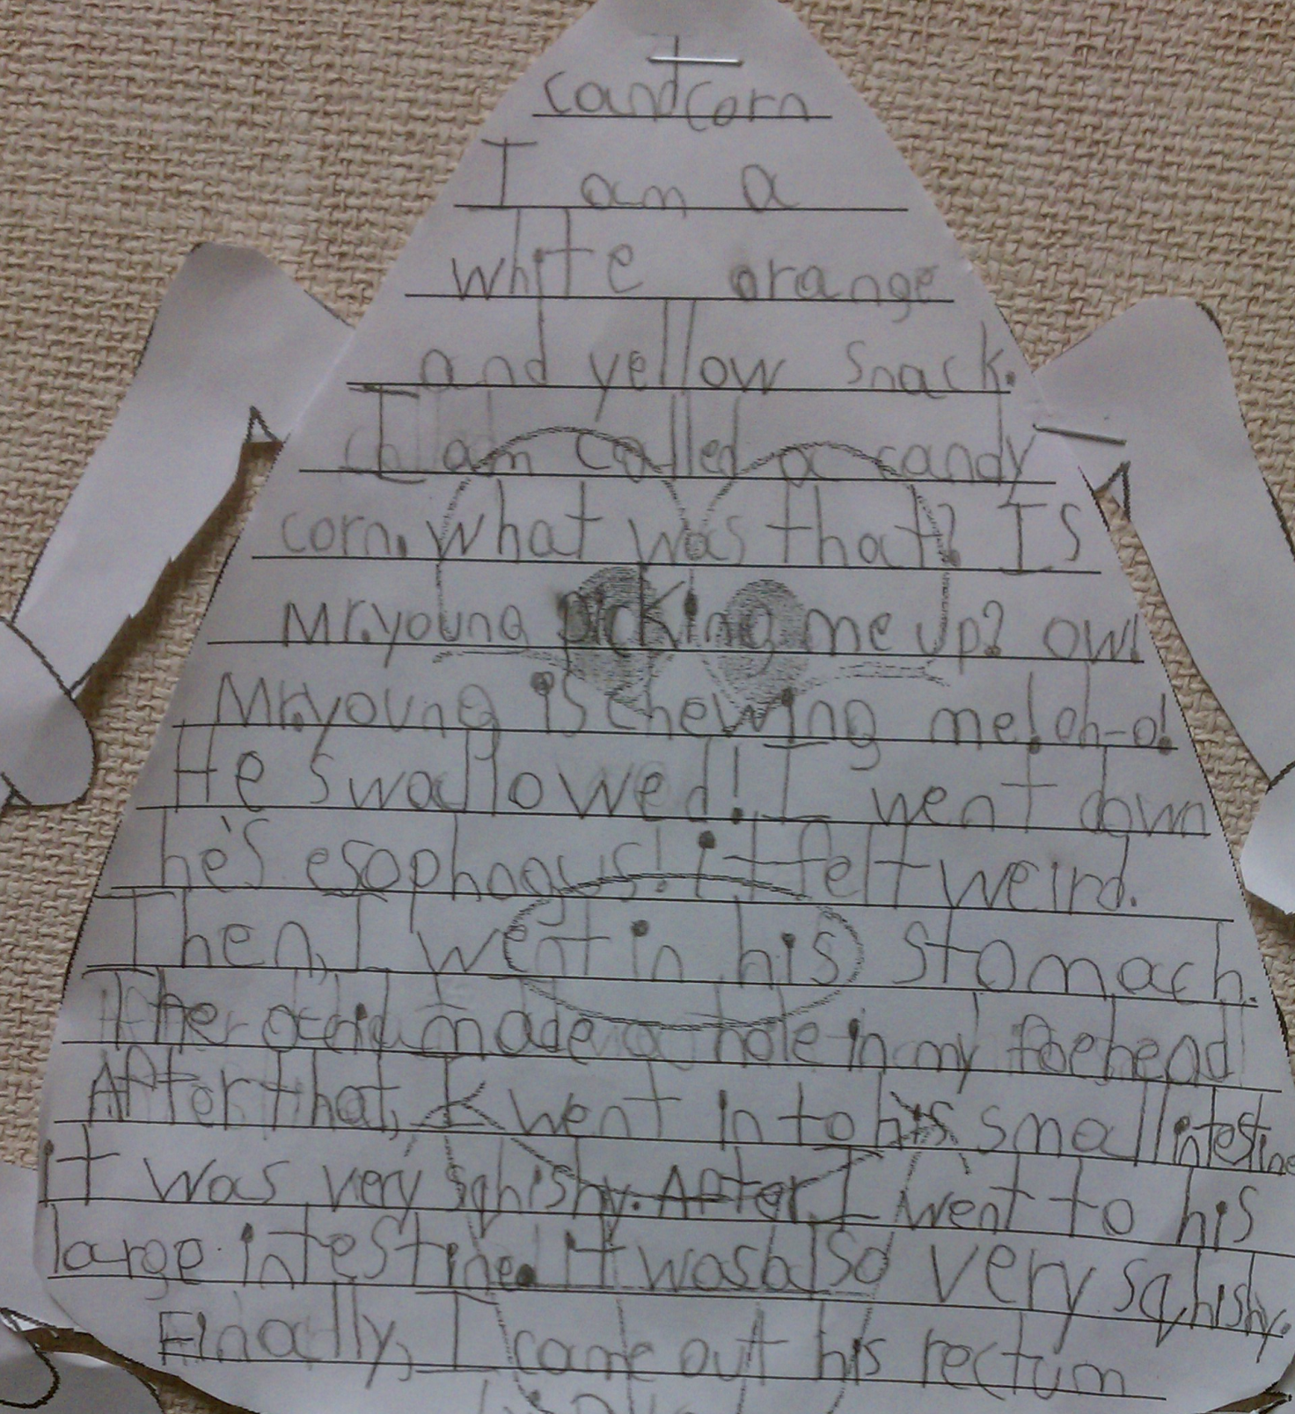
Writing Station
Write. Write. Write.
Story cubes, prompts,
mailbox, wonderbox, etc.

Slide 44
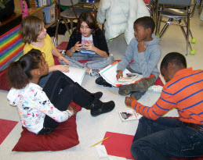
Literature Circles
Candid Camera

Slide 45
Comprehension Stations
Examples from my 2nd Grade Class

Slide 46
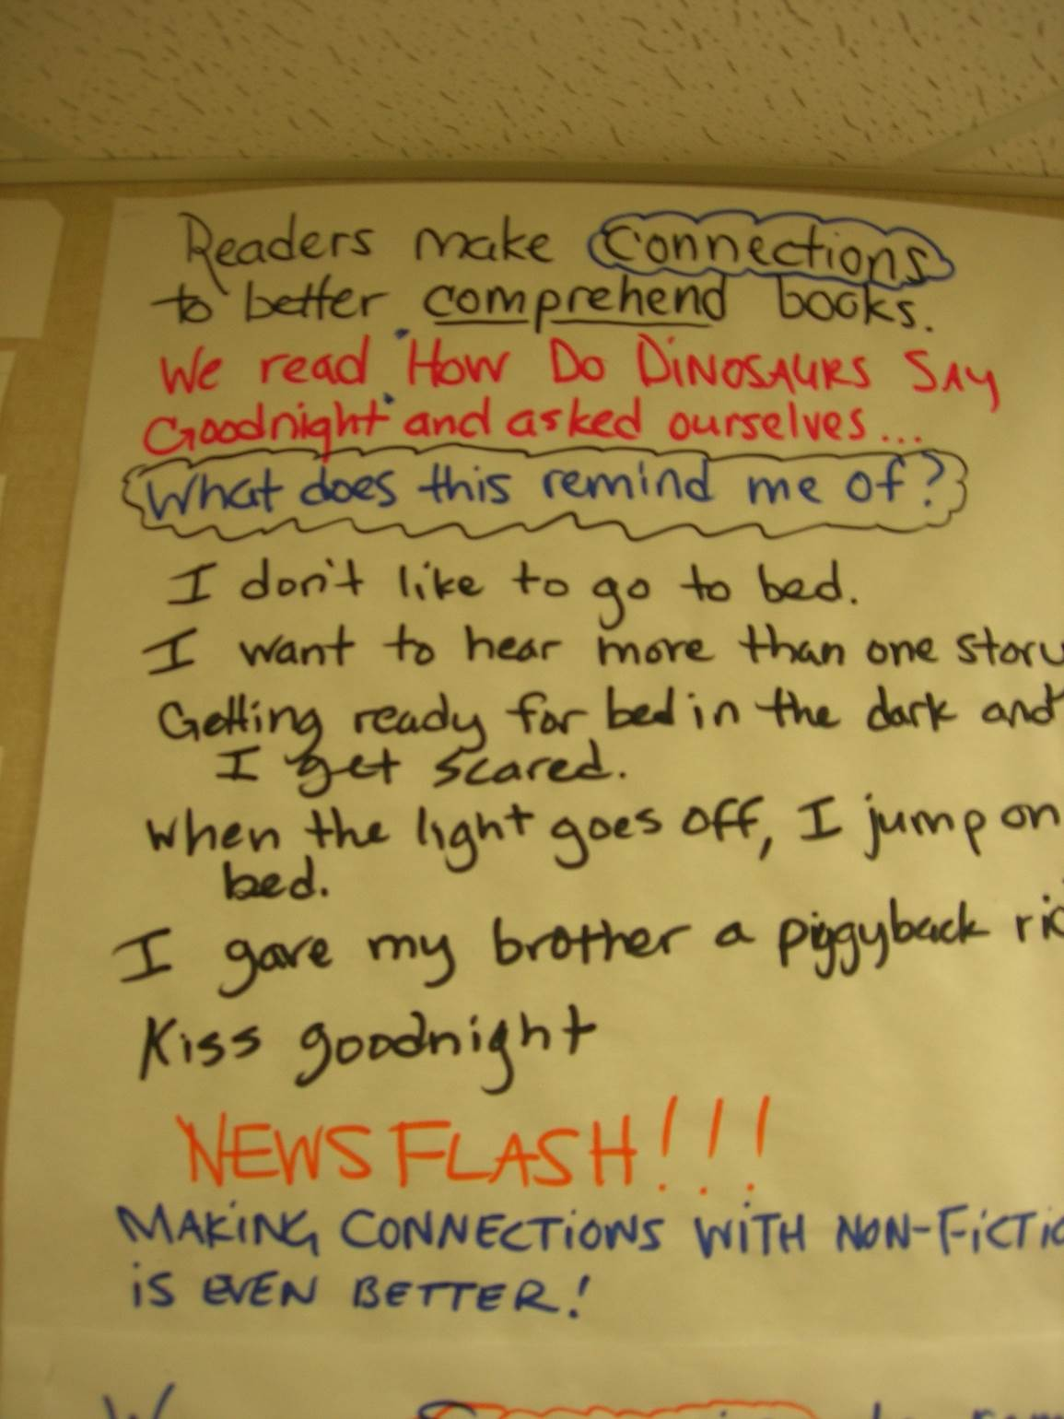

Slide 47
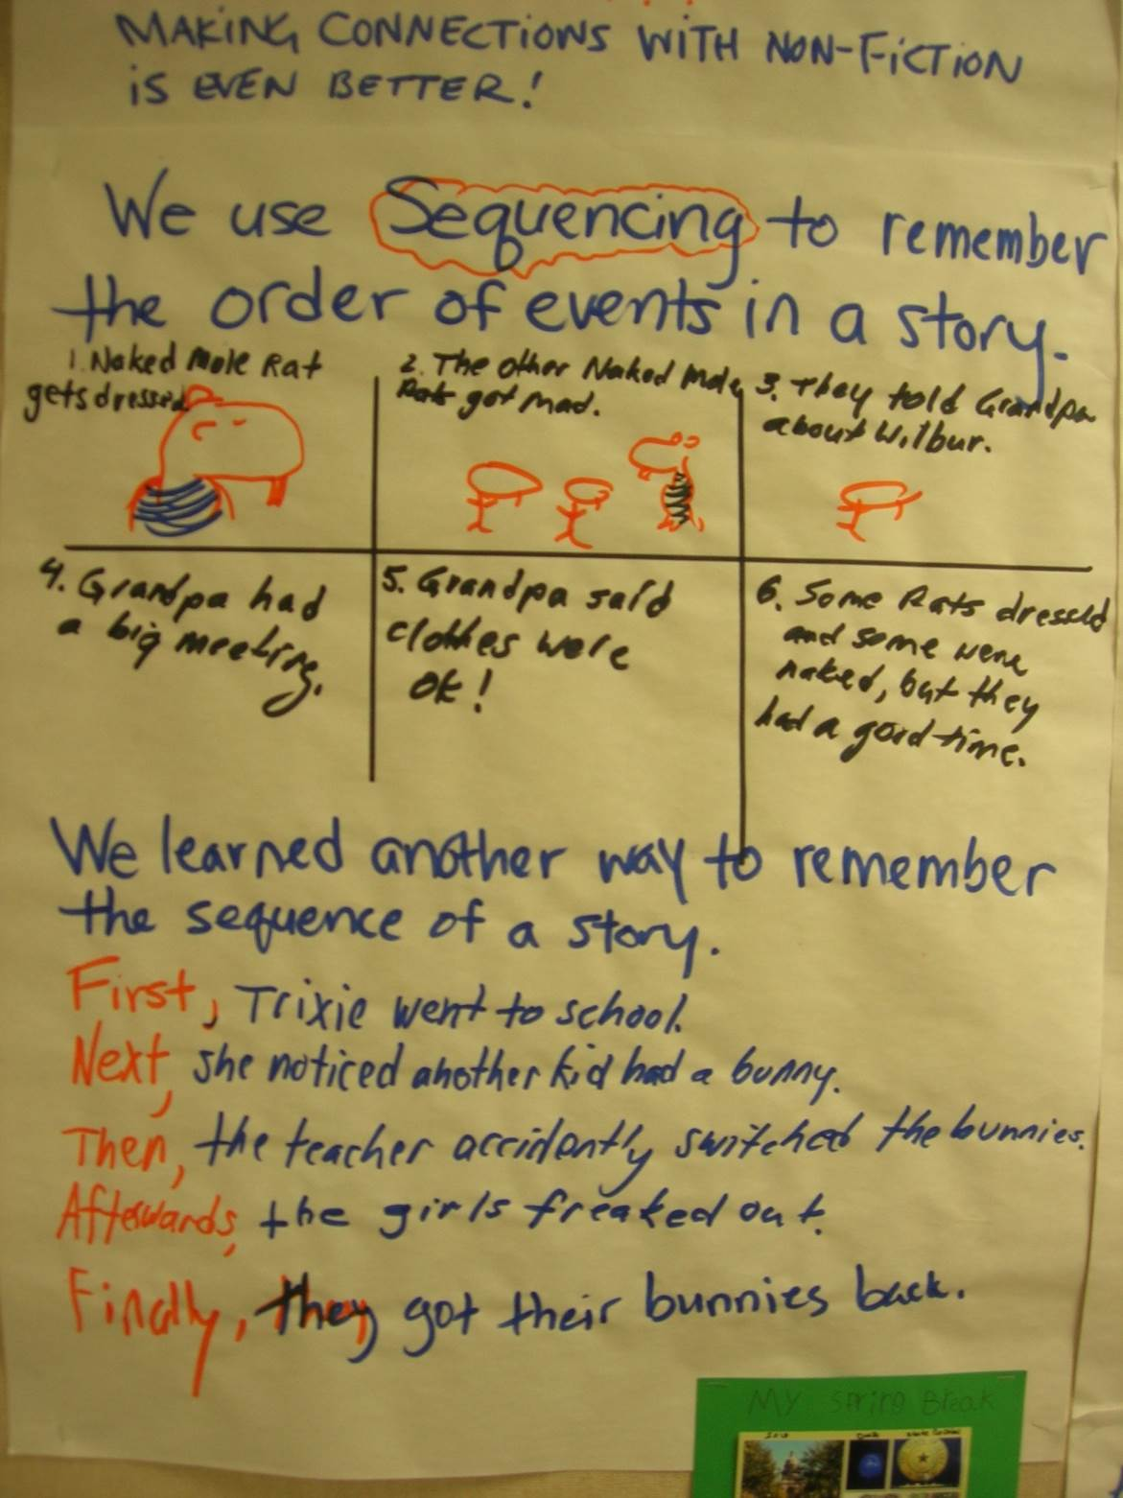

Slide 48
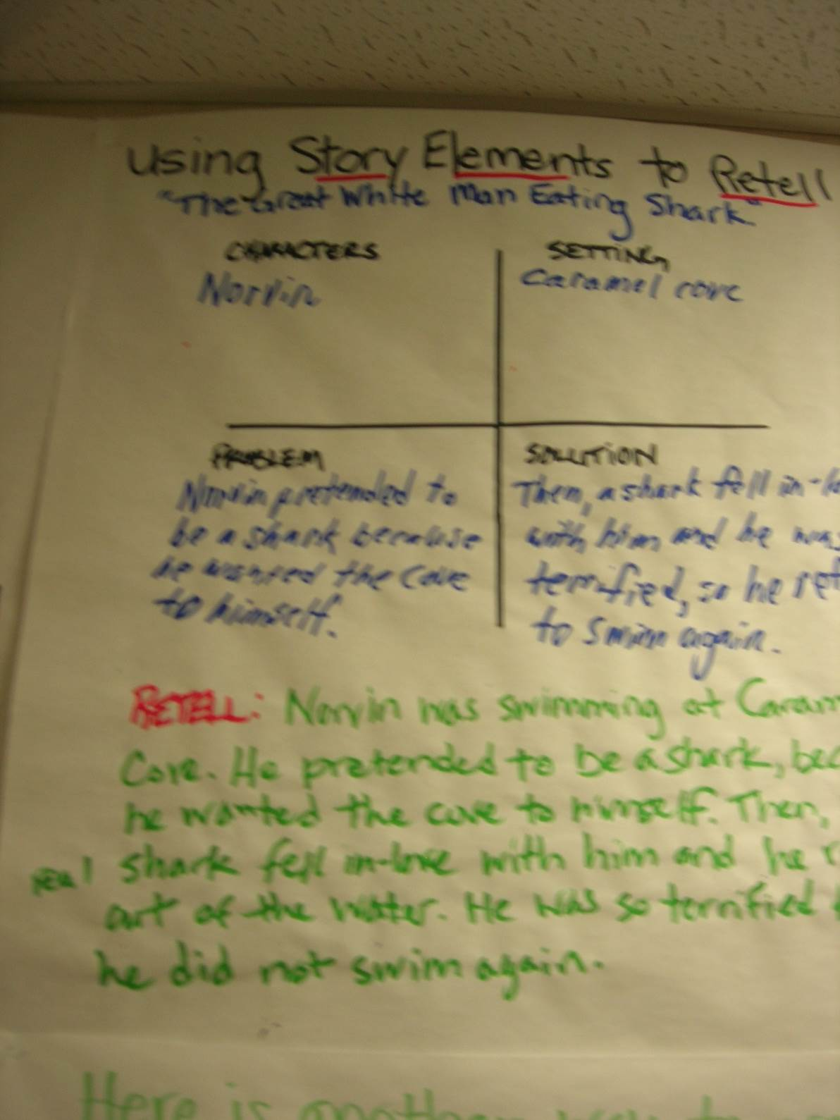

Slide 49
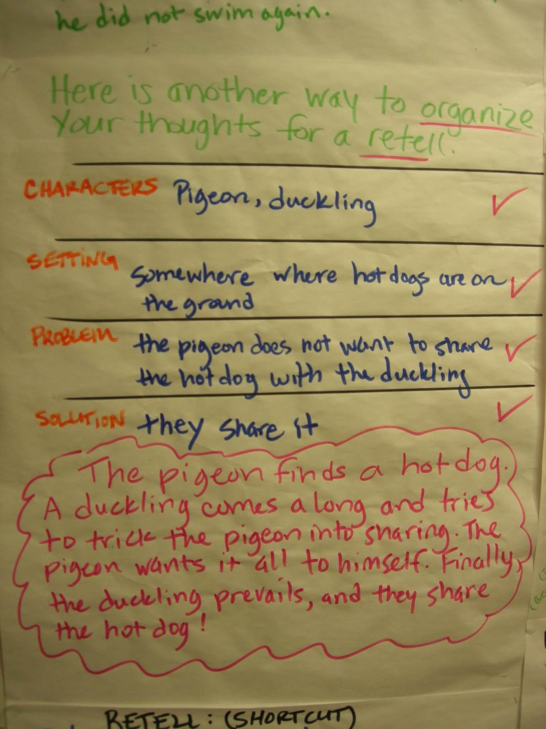
Bonus Video!

Slide 50
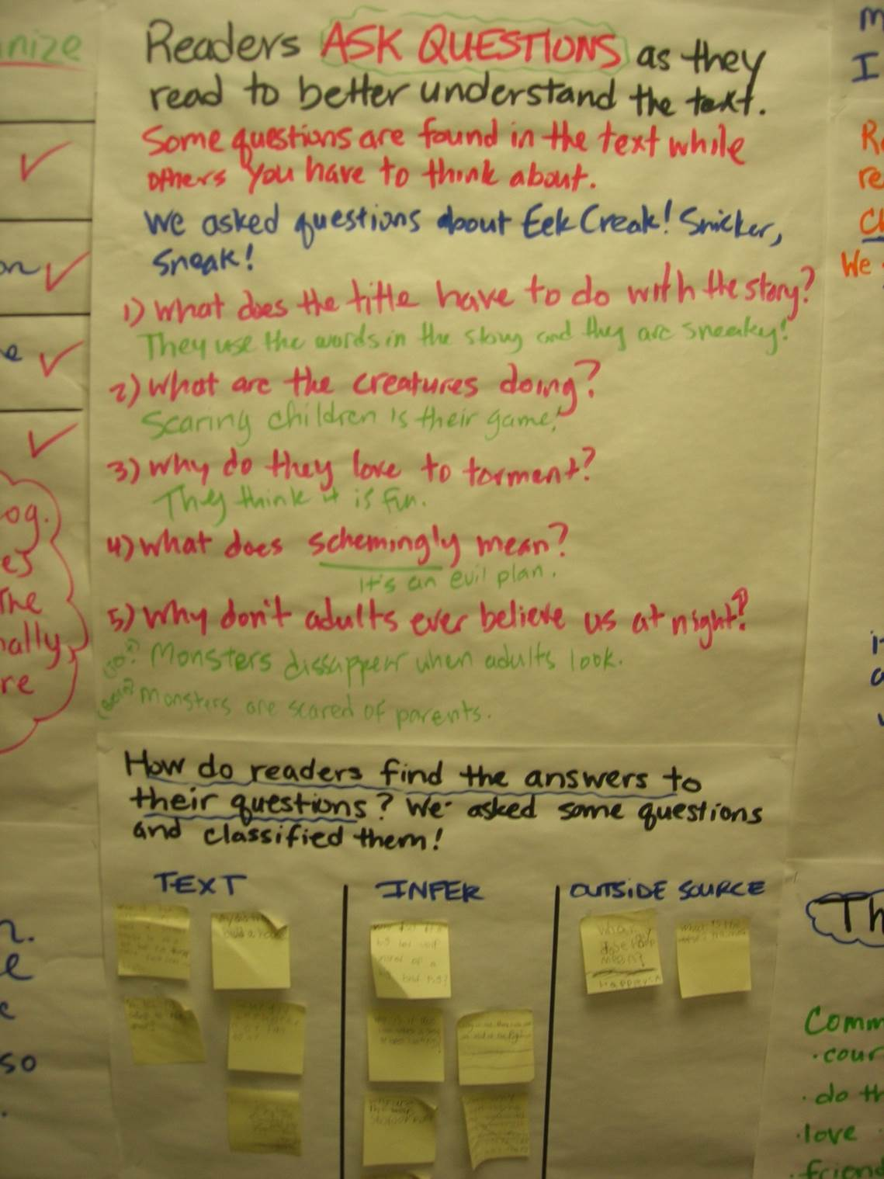

Slide 51
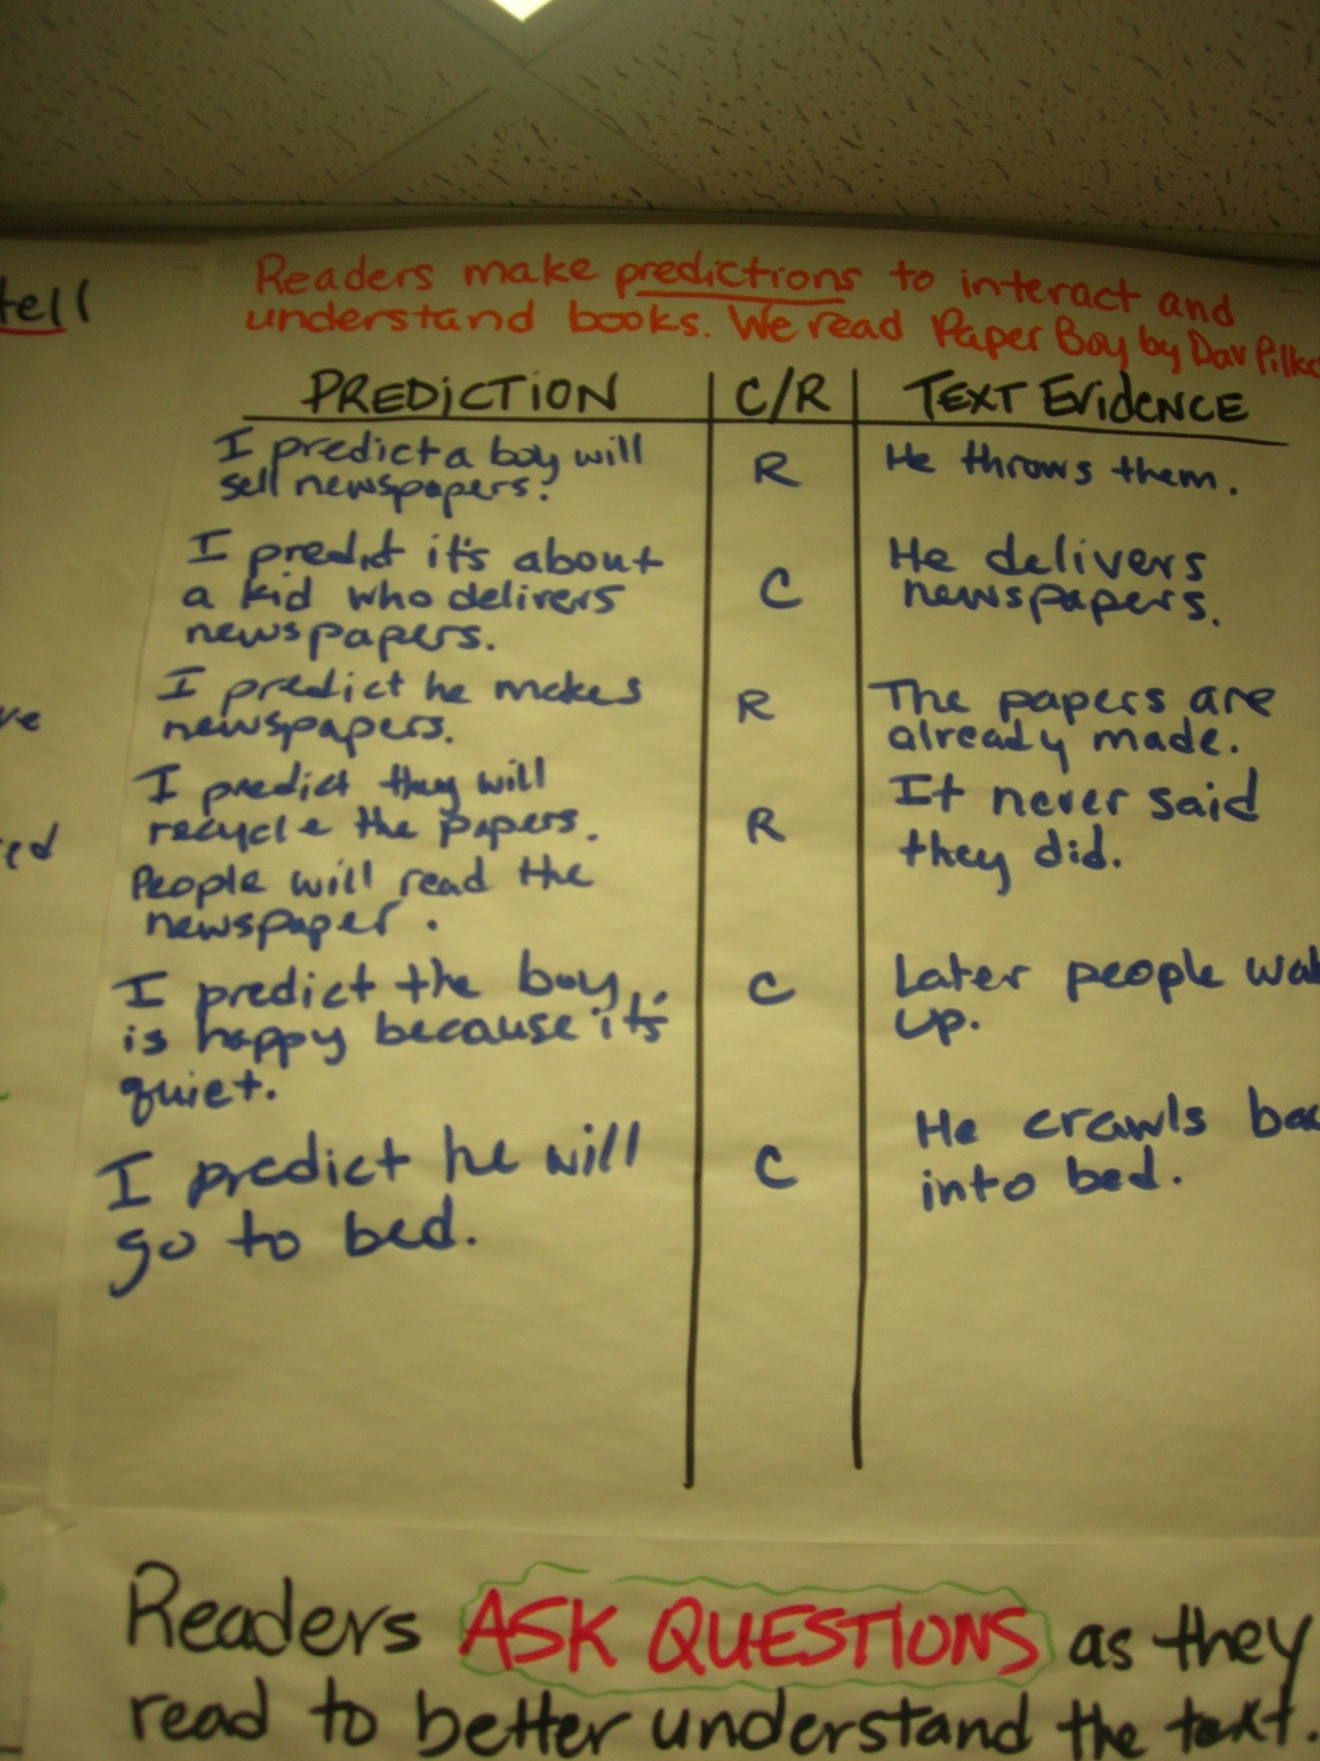

Slide 52
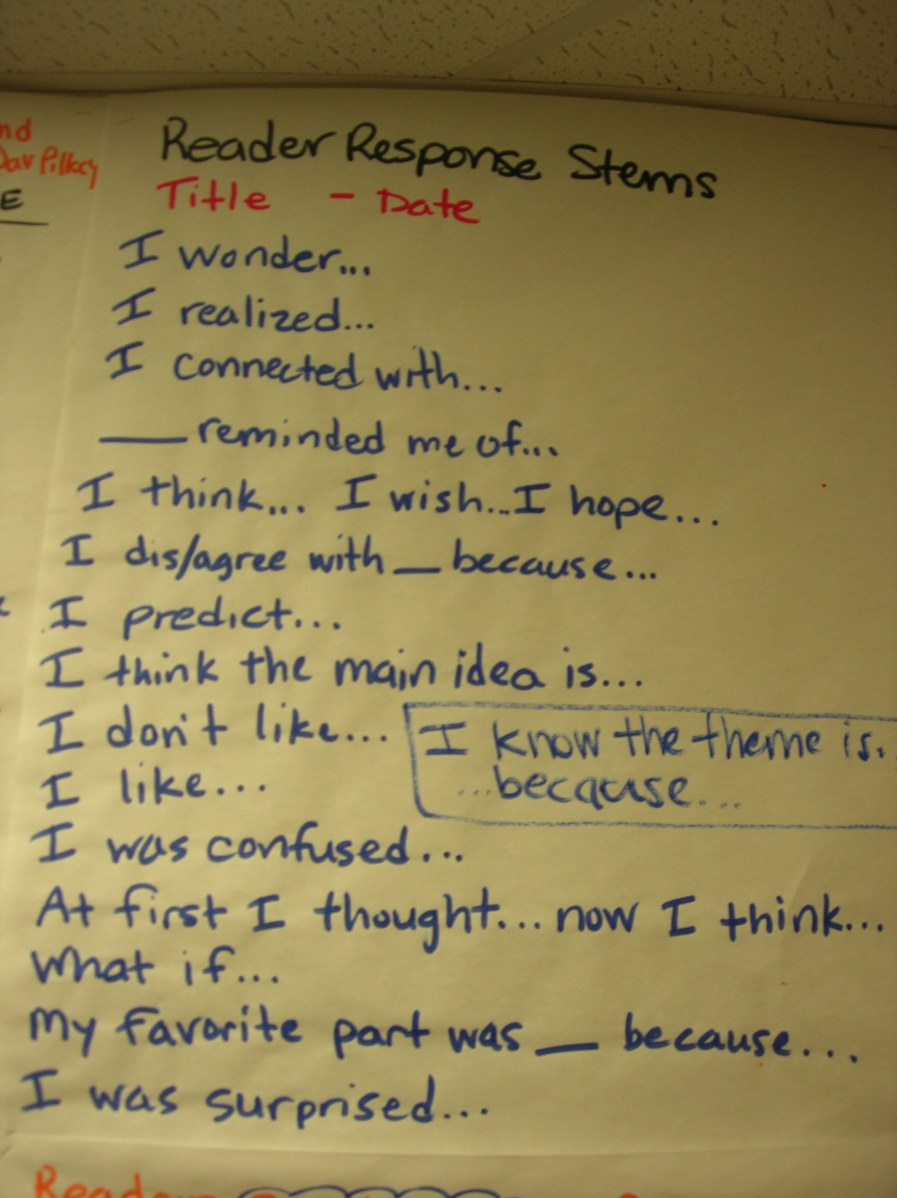

Slide 53
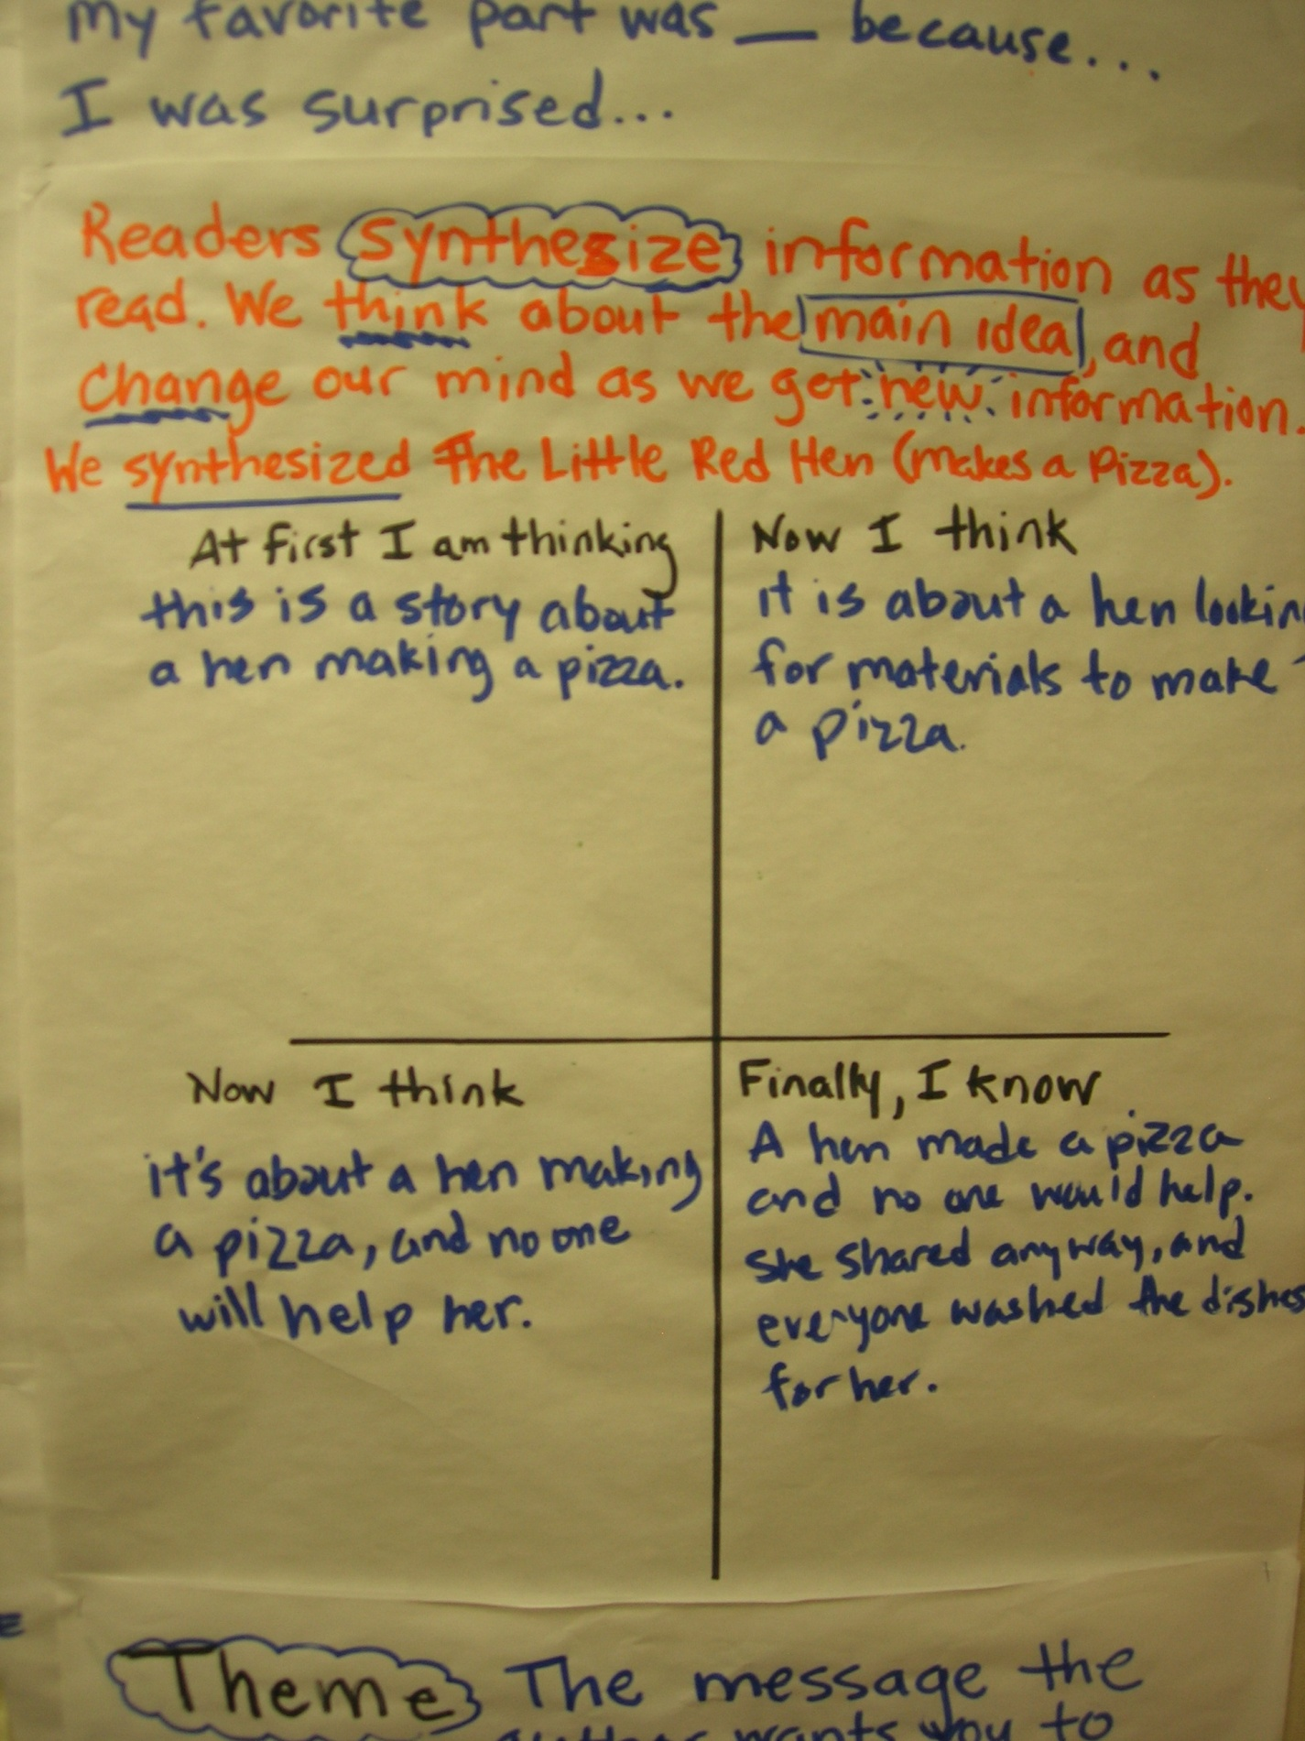

Slide 54
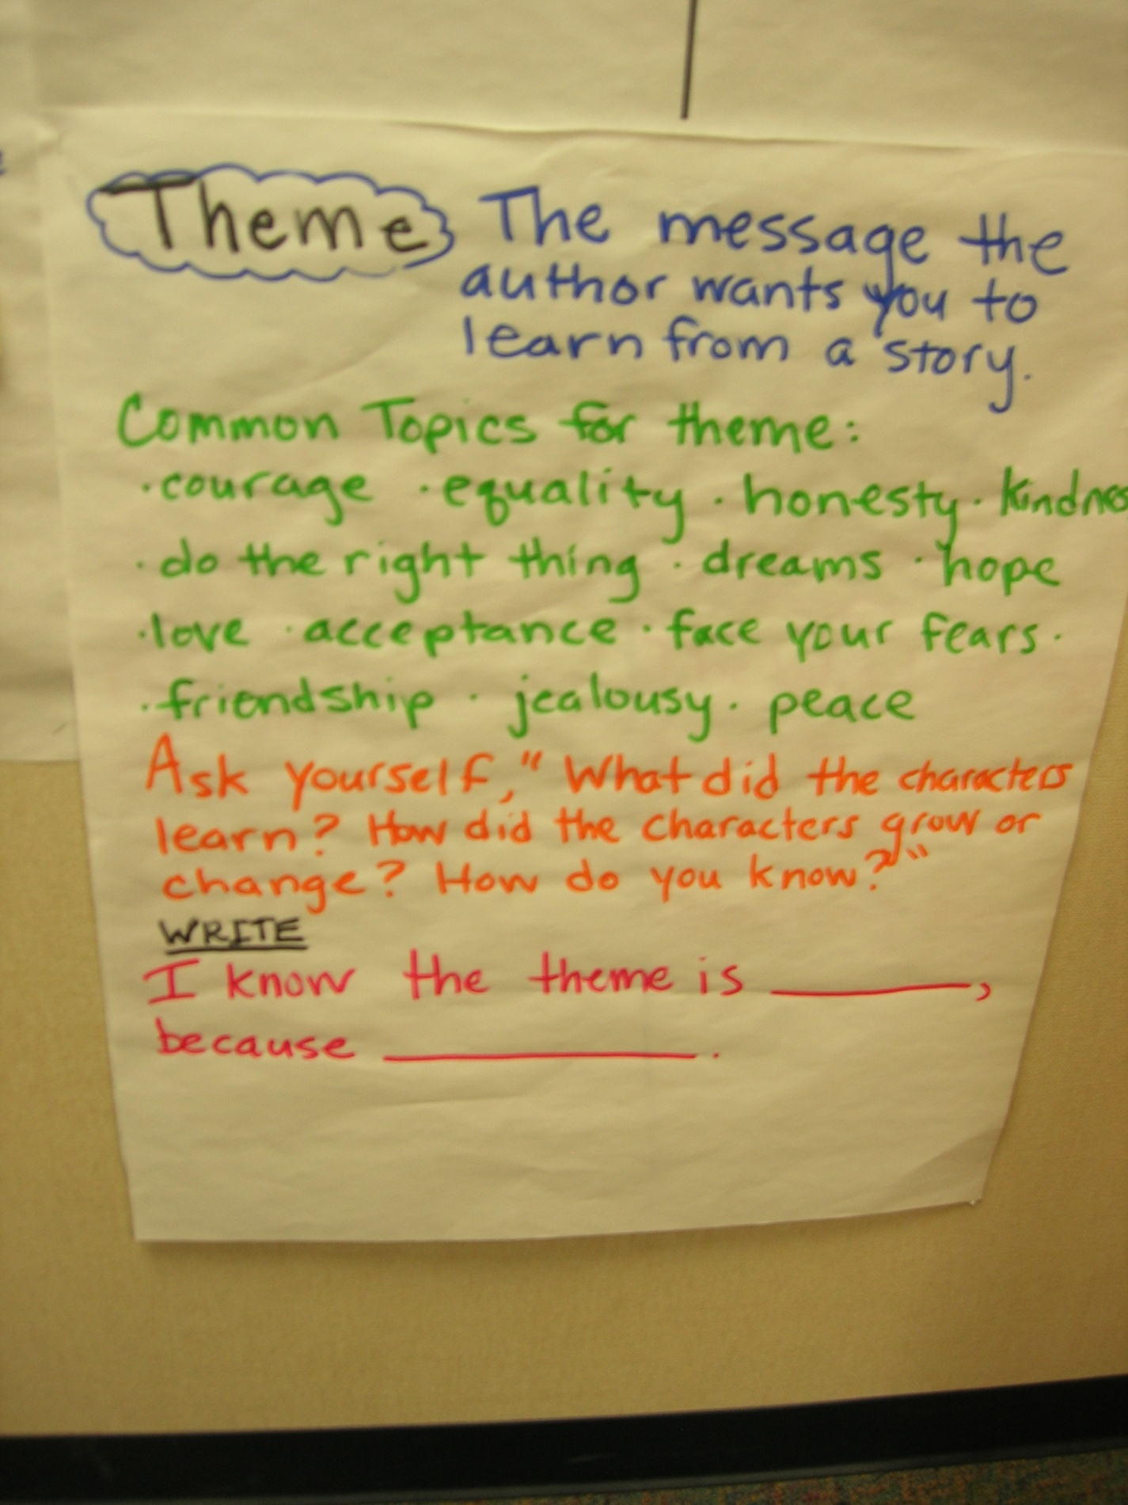

Slide 55
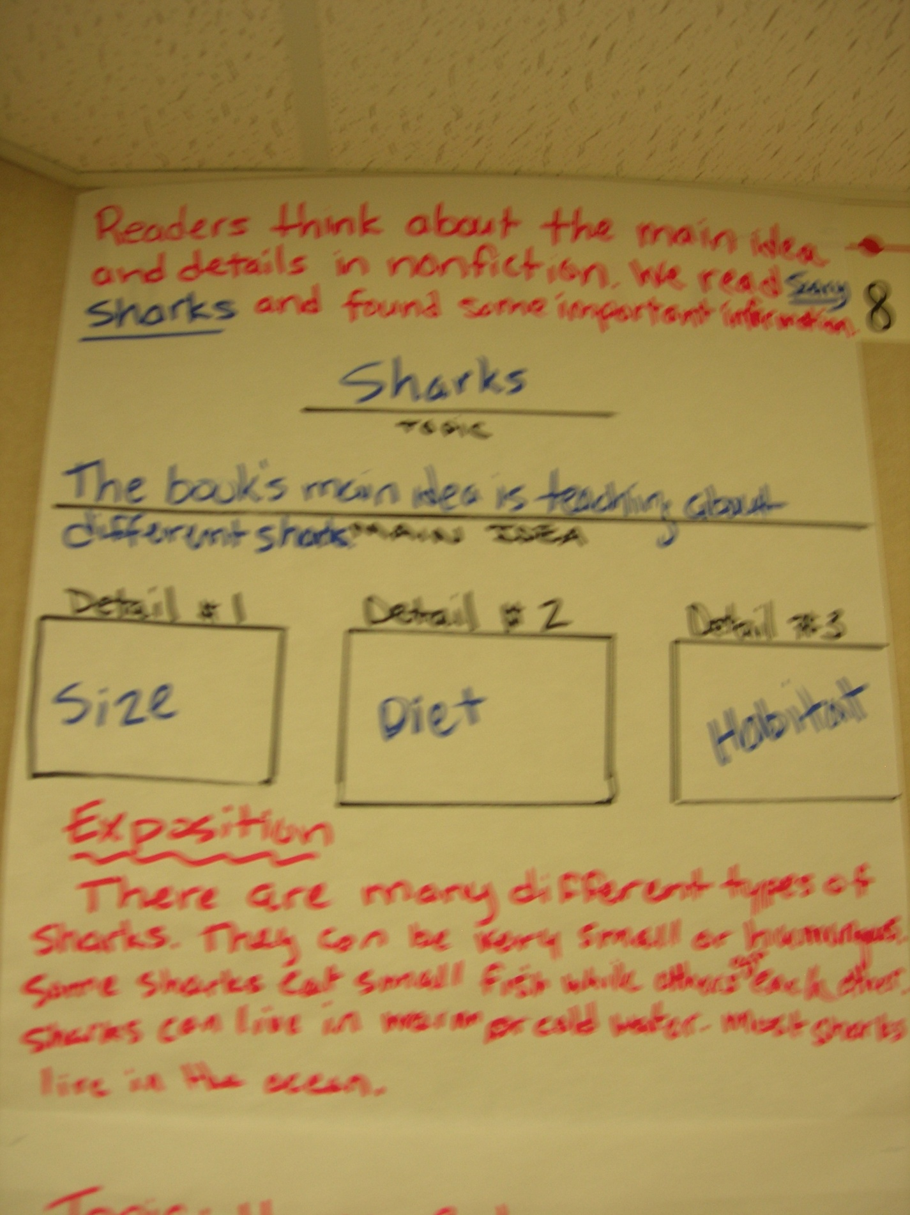

Slide 56
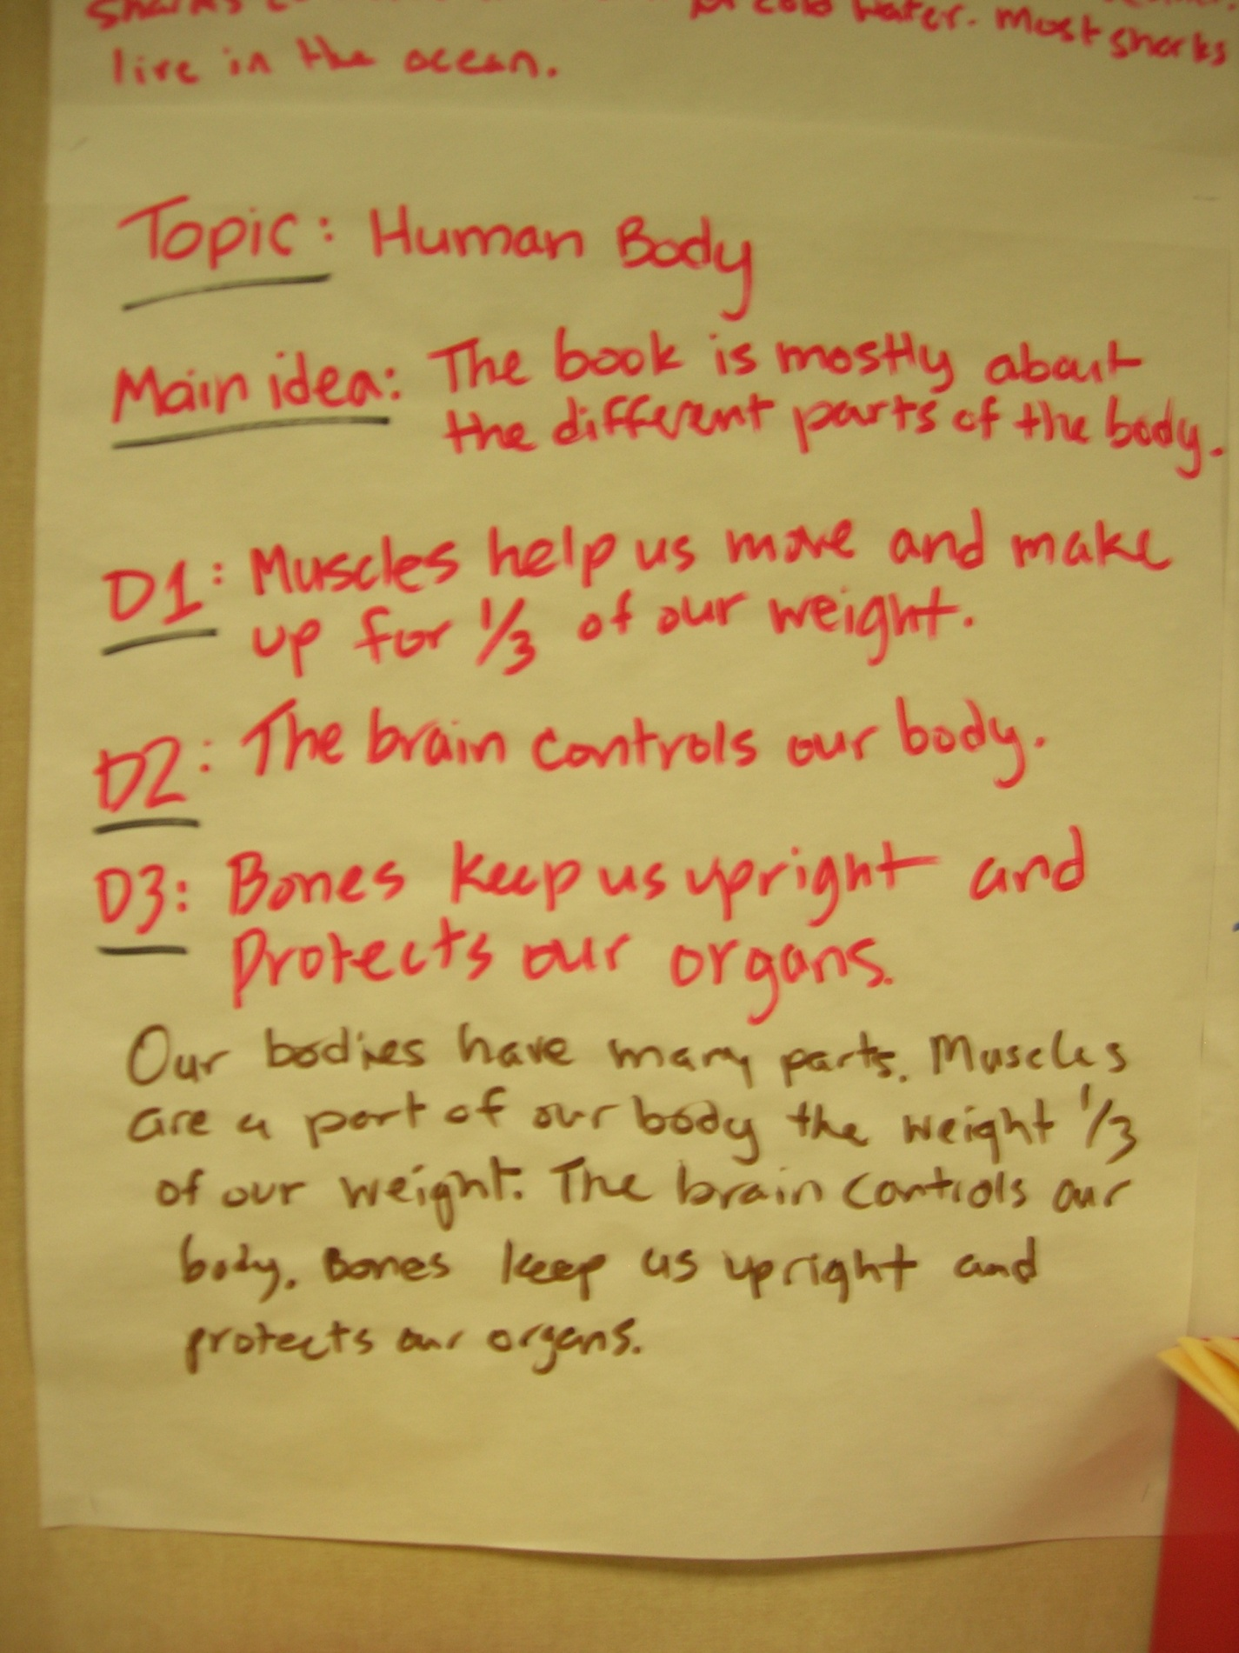

Slide 57
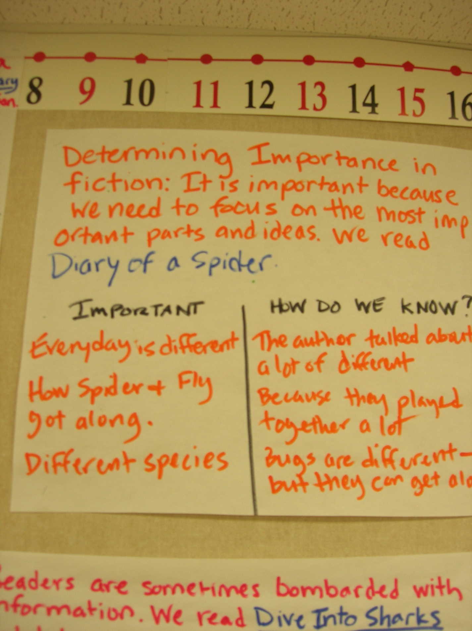

Slide 58


Slide 59


Slide 60

Book Trailers
Kids read books together, wrote, and produced book trailers using explain everything.

Slide 61
Diary of a Second Grader
https://www.youtube.com/watch?v=Qm2LW0rl7XI
Another Diary
https://www.youtube.com/watch?v=Zq0CHqjGgbM
Biography
https://youtu.be/LZBhSGETfTY
Math…
https://www.youtube.com/watch?v=LNKWC4biOpw
Life Cycles…
https://www.youtube.com/watch?v=juyHu0nZhWQ
Webcast
https://www.youtube.com/watch?v=vyJ5VxrKJAE
RT Scripts
https://www.youtube.com/watch?v=WtuNb5NNS_w
Conferring with an Avatar
https://www.youtube.com/watch?v=Y9gHpIH9RTA

Slide 62


Slide 63

TIER I

Slide 64


Listen child…
…and you shall read.

Slide 65

Video
Monday: Select scripts and read for meaning
Tuesday: Choose parts and focus on automaticity
Wednesday: Focus on Prosody
Thursday: Practice Performance
Friday: Performance

Slide 66

The Performance
Video (Example)

Slide 67

There Was An Old Woman – 4 Parts
Narrator 1: There was an old woman
Who lived in a shoe;
Narrator 2: With so many children,
What else could she do?
Narrator 3: Their home had no windows,
No doors, and no locks—
Narrator 4: The kids were all happy
But smelled like old socks.

Slide 68

I Gotta Go!
Readers Theater Performance

Slide 69

www.thebestclass.org (rtscripts)
www.timrasinski.com (resources)
Google “Readers Theater Scripts”
Teacher Created
Student Created
  Mentor
  Parody
  Scratch

Slide 70




Slide 71

Young, C., Stokes, F, & Rasinski, T. (In press). Readers Theater plus comprehension and word study. To appear in the Reading Teacher

Slide 72



Jack was Nimble – 3 Parts
Narrator 1: Jack was nimble,
Narrator 2: Jack was quick.
Narrator 3: Jack jumped over the candlestick.
Narrator 1: Jack kept jumping much too close.
Narrator 2: Now his pants
Narrator 3: smell like burnt toast.

Slide 73

POETRY ACADEMY Wilfong (2008)
Students choose a poem
Rehearse the poem daily
Recite to a volunteer
POETRY SLAMS
(Young & Rasinski, 2017)
Day 1: Choose a poem and read for overall meaning
Day 2: Word Identification
Day 3: Prosody
Day 4: Practice for a Partner
Day 5: Dim the lights, dress in black, and enjoy the poetry slam – don’t forget to “snap clap”

Slide 74
Volunteer? Anyone? Anyone?

Slide 75
The aliens have landed!
It's distressing, but they're here.
They piloted their flying saucer
through our atmosphere.
They landed like a meteor
engulfed in smoke and flame.
Then out they climbed immersed in slime
and burbled as they came.

Slide 76
Their hands are greasy tentacles.
Their heads are weird machines.
Their bodies look like cauliflower
and smell like dead sardines.
Their blood is liquid helium.
Their eyes are made of granite.
Their breath exudes the stench of foods
from some unearthly planet.

Slide 77
And if you want to see these
sickly, unattractive creatures,
you'll find them working in your school;
they all got jobs as teachers.

Slide 78



Primary Advanced
You can sing about anything!
Take our Test
Snowball Fight

Slide 79
TIER II

Slide 80


CHORAL READING

Slide 81
CHORAL READING
Let’s Try!
Cinnamon, Aluminum, Linoleum
Cinnamon, Aluminum, Linoleum
Cinnamon, Aluminum, Linoleum

Slide 82

ECHO READING

Slide 83
ECHO READING
Let’s Try!
Let’s eat, Grandma.
Let’s eat Grandma!

Slide 84

PAIRED READING
VIDEO

Slide 85


Slide 86

TIER III

Slide 87


Repeated Reading
(Samuels, 1979)
REPEATED READINGS

Slide 88


Slide 89



Slide 90



but I need another volunteer.
Trust me…
he’s not sorry.

Slide 91



Slide 92
Read Like Me

Slide 93


Slide 94
be that teacher… who guides students to the edges of possibility;
who uses challenge as motivation;
who learns alongside their students;
who provides meaningful and authentic learning experiences;
who clearly loves to teach;
that teacher who students remember forever.

Slide 95






Thank you
chase@thebestclass.org
Facebook/thebestclass.org

